Slide 1
Digital archives collection assessment
Presentation to Library Council, January 12, 2017
Creighton Barrett

Slide 2
Project overview
May 2016 – December 2016
Team: Domenic Rosati and Creighton Barrett
Goals:
  Locate and physically separate digital media carriers in the Archives Permanent Collection
  Produce an inventory of separated digital media carriers
Objectives:
  Inform development of digital archives program, especially digital forensics
  Help establish processing priorities for backlog of digital media

Slide 3
Snapshot of results
Number of digital media carriers: 2,914
Most commonly identified digital media carrier: 3.5 inch floppy disk
Approximate digital storage requirements: 325 TB
Fonds with largest volume of digital archival material: imX Communications fonds, Centre for Art Tapes fonds, Joan Cummings fonds, Solar Audio Recording Studio Collection, Marine Affairs Program fonds, and Neptune Theatre fonds

Slide 6
Action plan
Establish processing priorities for digital archives backlog
Update accessioning procedures to incorporate new separation workflow and “register of digital media carriers”
Develop digital forensics workflows and procedure manual
Establish procedures and infrastructure to support the monetary appraisal of digital archival material
Establish technical specifications for archiving born-digital audio and video

Slide 7
Work on action plan items
imX Communications collection assessment (part of Alex Jokinen’s Young Canada Works digital archives internship)
Accessioning, appraisal and processing of Bill Freedman fonds, including computers, hard drives, 300+ floppy disks, etc. (part of Alex Jokinen’s Young Canada Works digital archives internship)
Procurement of FTK digital forensics software and training
Research and development of “reformatting guidelines for digital videocassettes”

Slide 8
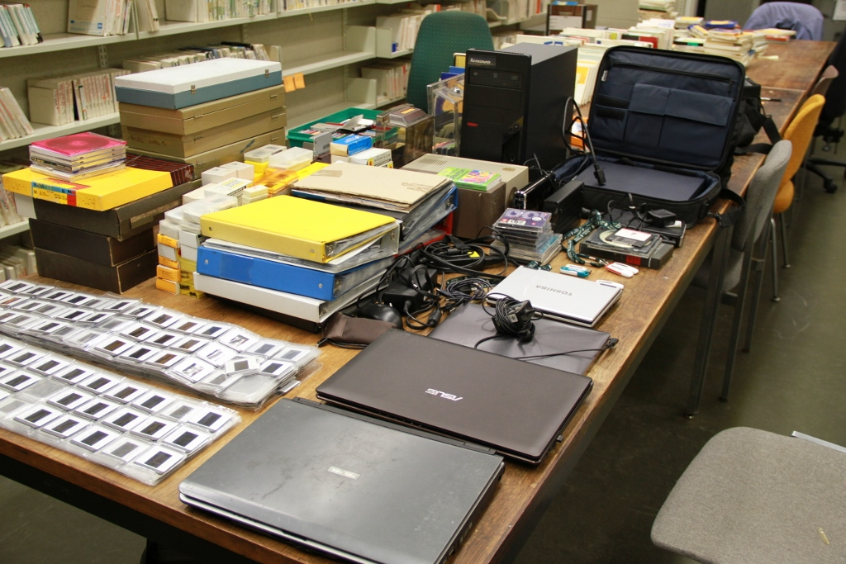
Bill Freedman digital archives

Slide 9
[DRAFT] digital video encoding formats, data rates, and estimated storage requirements
Format | Encoding | Scanning method | Width x height | Frame rate | Sampling frequency | Chroma sampling | Compression | Bit rate | Video data rate | Estimated storage per minute | Estimated storage per hour | Standard | Notes
DV | NTSC | Interlaced | 720 x 480 | 29.97, 25, 24 | 60 Hz | 4:1:1 | 5:1 | 8 bit | 25 Mbps | 217 MB | 13 GB | IEC 61834
 | PAL | Interlaced | 720 x 576 | 29.97, 25, 24 | 50 Hz | 4:2:0 | 5:1 | 8 bit | 25 Mbps | 217 MB | 13 GB | IEC 61834
DVCAM | NTSC | Interlaced | 720 x 480 | 29.97, 25, 24 | 60 Hz | 4:1:1 | 5:1 | 8 bit | 25 Mbps | 217 MB | 13 GB | SMPTE 314 | Sony DV format
 | PAL | Interlaced | 720 x 576 | 29.97, 25, 24 | 50 Hz | 4:2:0 | 5:1 | 8 bit | 25 Mbps | 217 MB | 13 GB | SMPTE 314 | Sony DV format
DVCPRO | NTSC | Interlaced | 720 x 480 | 29.97, 25, 24 | 60 Hz | 4:1:1 | 5:1 | 8 bit | 25 Mbps | 217 MB | 13 GB | SMPTE 314 | Panasonic DV format
 | PAL | Interlaced | 720 x 576 | 29.97, 25, 24 | 50 Hz | 4:1:1 | 5:1 | 8 bit | 25 Mbps | 217 MB | 13 GB | SMPTE 314 | Panasonic DV format
DVCPR0 50 | NTSC | Interlaced | 720 x 480 | 29.97, 25, 24 | 60 Hz | 4:2:2 | 3:3:1 | 8 bit | 50 Mbps | 423 MB | 25 GB | SMPTE 314 | Panasonic DV format
 | PAL | Interlaced | 720 x 576 | 29.97, 25, 24 | 50 Hz | 4:2:2 | 3:3:1 | 8 bit | 50 Mbps |  |  | SMPTE 314 | Panasonic DV format
DVCPRO HD | NTSC | Progressive | 960 x 720 | 59.94 | 60 Hz | 4:2:2 | 8:6:1 | 8 bit | 100 Mbps |  |  | SMPTE 370:2006 | Panasonic DV format
 | PAL | Progressive | 960 x 720 | 50 | 50 Hz | 4:2:2 | 8:6:1 | 8 bit | 100 Mbps |  |  | SMPTE 370:2006 | Panasonic DV format
 | NTSC | Interlaced | 1280 x 1080 | 29.97 | 60 Hz | 4:2:2 | 8:6:1 | 10 bit | 100 Mbps |  | 41.3 GB | SMPTE 370:2006 | Panasonic DV format
 | PAL | Interlaced | 1440 x 1080 | 25 | 50 Hz | 4:2:2 | 8:6:1 | 10 bit | 100 Mbps |  |  | SMPTE 370:2006 | Panasonic DV format
HDCAM | NTSC | Interlaced | 1440 x 1080 | 29.97, 24 | 60 Hz | 4:2:2 | 3:1:1 |  |  |  |  | SMPTE 367M:2001 | HD version of Digital Betacam
 | PAL | Interlaced | 1440 x 1080 | 25, 24 | 50 Hz | 4:2:2 | 3:1:1 |  |  |  |  | SMPTE 367M:2001 | HD version of Digital Betacam
HDCAM SR | NTSC | Interlaced | 1440 x 1080 |  | 60 Hz | 4:2:2 | 3:1:1 | 10 bit |  |  |  | SMPTE 409M:2005 | HD version of Digital Betacam
 | PAL | Interlaced | 1440 x 1080 |  | 50 Hz | 4:2:2 | 3:1:1 | 10 bit |  |  |  | SMPTE 409M:2005 | HD version of Digital Betacam
HDV | NTSC | Progressive | 1280 x 720 | 60, 50, 30, 25, 24 |  | 4:2:0 | 6:1 to 14:1 | 8 bit | 18.3 Mbps
 | PAL | Progressive | 1280 x 720 | 60, 50, 30, 25, 24 |  | 4:2:0 | 6:1 to 14:1 | 8 bit | 18.3 Mbps
 |  | Interlaced | 1440 x 1080 | 30, 25 |  | 4:2:0 | 6:1 to 14:1 | 8 bit | 25 Mbps
 |  | Interlaced | 1440 x 1080 | 30, 25 |  | 4:2:0 | 6:1 to 14:1 | 8 bit | 25 Mbps
 |  | Progressive | 1440 x 1080 | 30, 25, 24 |  | 4:2:0 | 6:1 to 14:1 | 8 bit | 25 Mbps
 |  | Progressive | 1440 x 1080 | 30, 25, 24 |  | 4:2:0 | 6:1 to 14:1 | 8 bit | 25 Mbps
Digital8 | NTSC | Interlaced | 720 x 480 | 30, 25, 24 | 60 Hz | 4:1:1 | 5:1 | 8 bit | 25 Mbps | 217 MB | 13 GB | IEC 61834 | Combination of Sony Hi8 and DV
 | PAL | Interlaced | 720 x 576 | 30, 25, 24 | 50 Hz | 4:2:0 | 5:1 | 8 bit | 25 Mbps | 217 MB | 13 GB | IEC 61834 | Combination of Sony Hi8 and DV
XDCAM HD
XDCAM EX, HQ mode
XDCAM EX, SP mode

