Slide 1
Tools for identifying duplicate files and known software files
Creighton Barrett
Digital Archivist, Dalhousie University Archives
BitCurator User Forum, Northwestern University
April 27-28, 2017

Slide 2
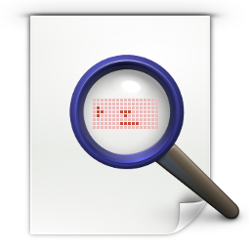


Tools
Notes:
FSlint utility (included in BitCurator environment)
Forensic Toolkit (FTK) “Flag Duplicates” processing option
FTK Known File Filter (KFF)
National Software Reference Library datasets (e.g., Reference Data Set)

Slide 3
FSlint (finds file system “lint”)
Duplicates
Installed packages
Bad names
Name clashes
Temp files
Bad symlinks
Bad IDs
Empty directories
Non stripped binaries
Redundant whitespace

Slide 4
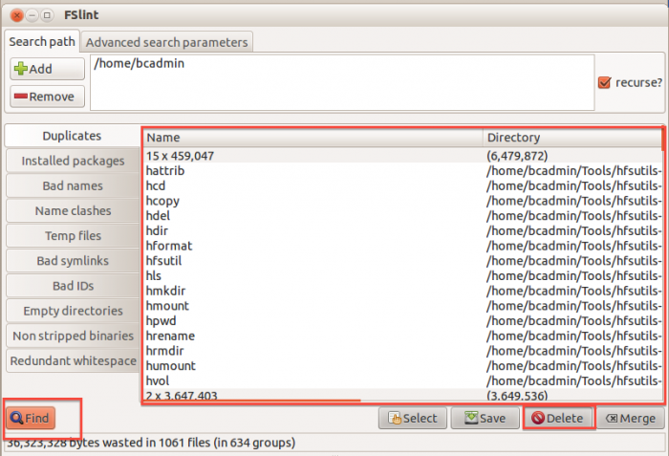
FSlint – Duplicates
Image source (BitCurator wiki): https://wiki.bitcurator.net/index.php?title=Identify_and_delete_duplicate_files
Notes:
Multiple scans to maximize efficiency and minimize false positives
Filters out files of different sizes
Checks to ensure files are not hard-linked
Checks first 4k bytes and filters out files with unique MD5
Checks entire file and filters out files with unique MD5
Checks remaining files and filters out files with unique SHA-1 (to avoid MD5 collisions)

Slide 5
FTK – Flag Duplicates
Simpler process than FSlint, still a powerful feature
  Checks entire file and generates MD5
  Assigns primary status to first instance of each MD5
  Assigns secondary status to subsequent instances of each MD5

Slide 6
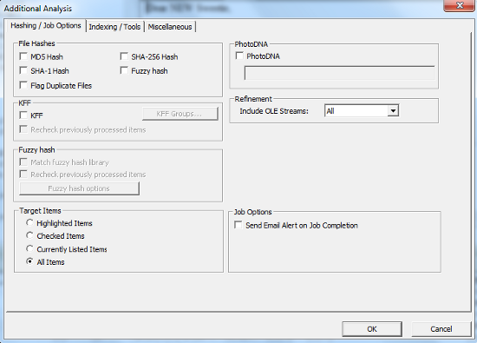
FTK – Flag Duplicates
6

Slide 7
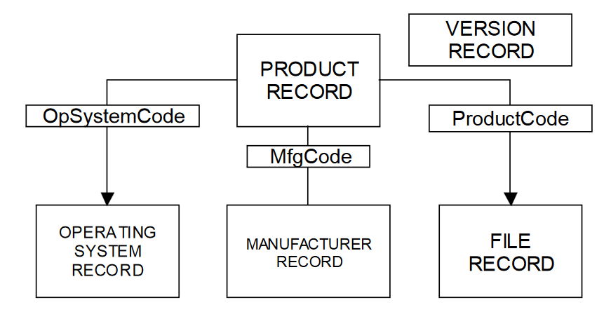
NSRL Reference Data Set (RDS)
Image source (NSRL): https://www.nsrl.nist.gov/Documents/Data-Formats-of-the-NSRL-Reference-Data-Set-16.pdf

Slide 8
NSRL Reference Data Set (RDS)
Hashsets and metadata used in file identification
Data can be used in third-party digital forensics tools
RDS is updated four times each year
As of v2.55, RDS is partitioned into four divisions:
  Modern – applications created in or after 2000
  Legacy – applications created in or before 1999
  Android – Mobile apps for the Android OS
  iOS – Mobile apps for iOS

Slide 9
FTK – Known File Filter (KFF)
KFF data – hash values of known files that are compared against files in an FTK case
KFF data can come from pre-configured libraries (e.g., NSRL RDS, DHS, ICE, etc.) or custom libraries
FTK ships with version of NSRL RDS bifurcated into “Ignore” and “Alert” libraries
KFF Server – used to process KFF data against evidence in an FTK case
KFF Import Utility – used to import and index KFF data

Slide 10
FTK – Known File Filter (KFF)
Notes:
Used to eliminate known software and OS files in a forensic case OR highlight presence of “alert” files
Used to “profile” someone before getting into case analysis (e.g., can help detect the usage of forensics programs such as drive cleaners)
Custom libraries can be used to find known files (especially in IP theft cases)
Custom libraries could be used to flag duplicates across multiple acquisitions from same donor

Slide 11
Other tools to work with NSRL RDS
nsrlsvr - https://github.com/rjhansen/nsrlsvr/
  Keeps track of 40+ million hash values in an in-memory dataset to facilitate fast user queries
  Supports custom libraries (“local corpus”)
nsrlllokup - https://rjhansen.github.io/nsrllookup/
  Command-line application
  Works with tools like hashdeep: http://md5deep.sourceforge.net/
National Software Reference Library - MD5/SHA1/File Name search - http://nsrl.hashsets.com

Slide 12
Bill Freedman fonds filtered in FTK
Filter | Description | # of files | Size
Unfiltered | All files in case | 26,651,084 | 3,568 GB
Primary status | Duplicate File indicator IS “Primary” | 731,417 | 83.48 GB
Secondary status | Duplicate File indicator IS “Secondary” | 16,569,218 | 271.5 GB
KFF Ignore | Match all files where KFF status IS “Ignore” | 2,548,119 | 44.29 GB
No KFF Ignore | Match all files where KFF status IS NOT “Ignore” + KFF status IS “Not checked” | 24,102,965 | 3524 GB
Primary status + No KFF Ignore | Match all files where duplicate file indicator IS “Primary” + KFF status IS NOT “Ignore” | 626,351 | 71.95 GB
Actual files + Primary status + No KFF Ignore | Match all disk-bound files where duplicate file indicator IS “Primary” + KFF status IS NOT “Ignore” | 103,412 | 61.81 GB
Notes:
Bill Freedman fonds:
Acquired in 2016
Hybrid collection
18 boxes of textual records
5000+ original slides
Five laptops
One desktop
Two external hard drives…

Slide 13
Questions
Does it matter which duplicate file is selected for preservation? What if there are MD5 matches with different file names or extensions?
Can queries against NSRL RDS be incorporated into BitCurator workflows?
Could provenance-based libraries of “known file” hashes be incorporated into BitCurator workflows?
Can repositories share provenance-based hash libraries (expose our “local corpus” of MD5s…)?

