Slide 1
Dalhousie Libraries Digital Collections
Migration from Joomla! to CQ5

Slide 2
Outline
Overview of existing digital collections architecture
Highlight some of the challenges/issues
Potential solution = digital library

Slide 3
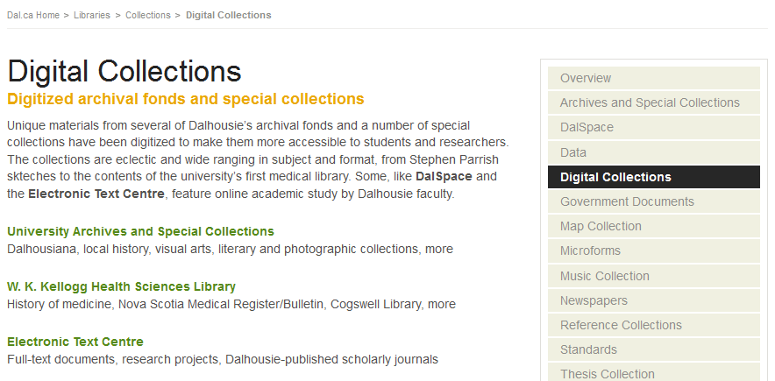
Digital Collections Homepage
Divided into three “categories”

Slide 4
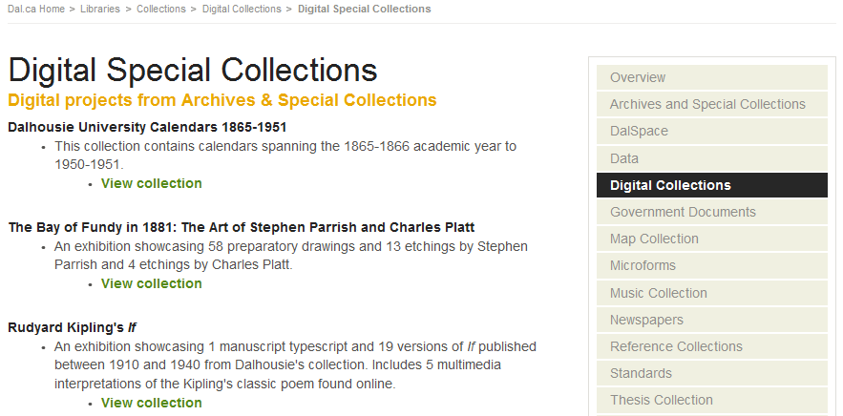
List of DUASC Digital Collections
Listed in random order
Titles aren’t hyperlinked

Slide 5
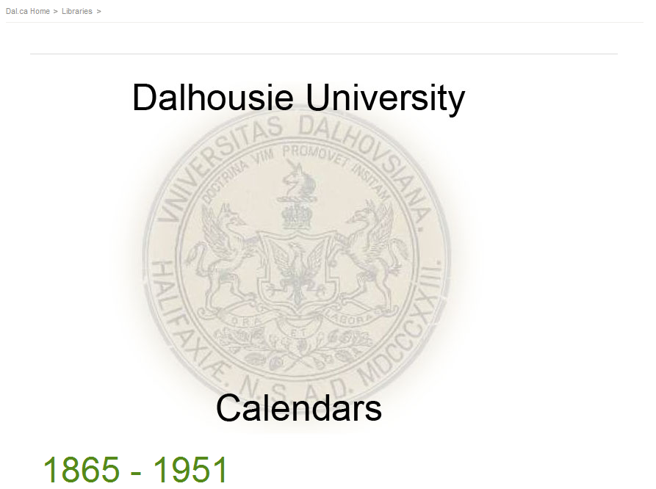
Example of DUASC Landing Page

Slide 6
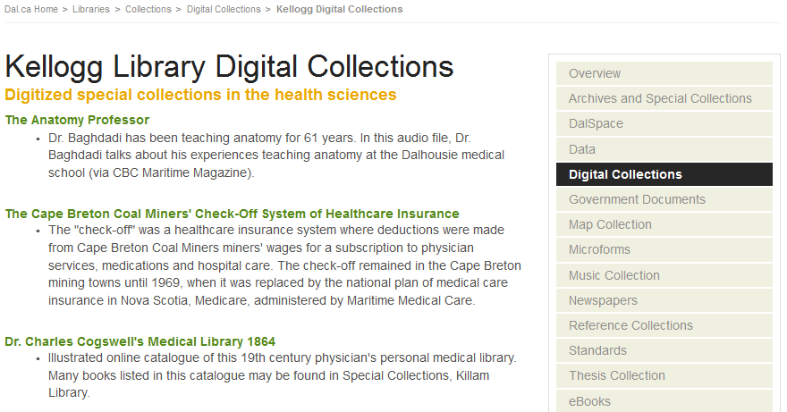
List of Kellogg Digital Collections
Hyperlinked titles

Slide 7
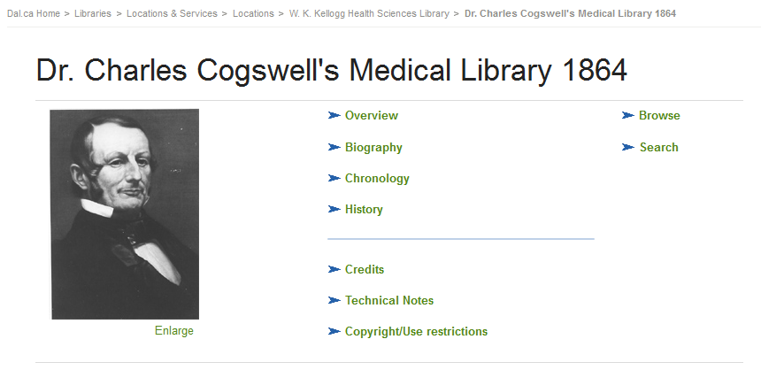
Example of Kellogg Landing Page
Inconsistent breadcrumbs

Slide 8
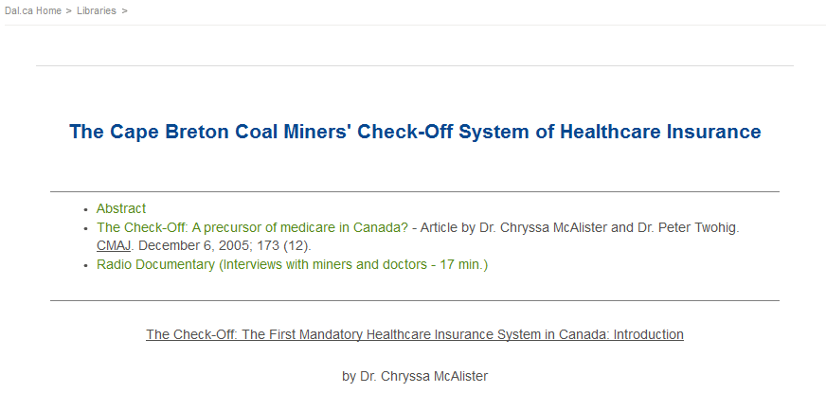
Example of Kellogg Landing Page

Slide 9
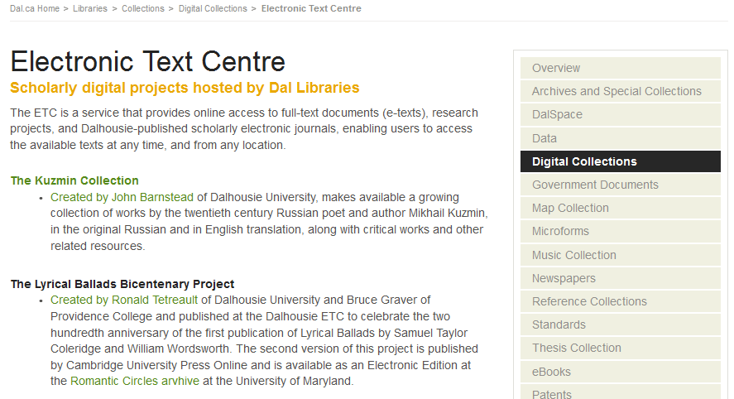
List of ETC Digital Collections

Slide 10
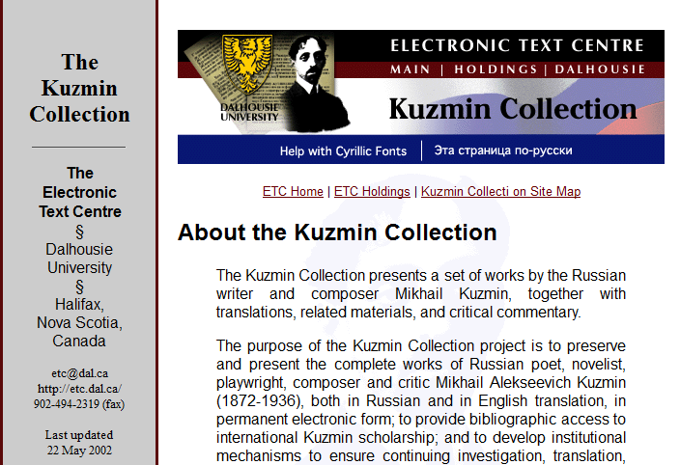
Example of ETC Landing Page

Slide 11
Challenges/Issues
Collections are not searchable
Collections are divided into locations
  This makes it difficult to browse
Collections are not clearly defined
  Some “collections” contain one object
  All digital objects are treated the same way (e.g., image files and pdf documents are not distinguished)
  Descriptions are sometimes inadequate

Slide 12
Challenges/Issues
We don’t distinguish between content type and/or subject
Digital objects are stored in many locations
It is difficult to “retire” a collection and still provide access to the scanned images
Breadcrumbs are inconsistent
  When you enter a collection the path back to the Digital Collections page is lost

Slide 13
Possible solution?
Instead of “Digital Collections” think “Digital Library”
A Digital Library would allow us to sub-divide collections based on their content type (e.g., image galleries, printed collections, printed items, sound recordings, etc.) rather than their location
It would give us a clear idea of how to organize existing and new digital projects
It would allow us to develop library-wide procedures for storing digital objects in DalSpace and building webpages in CQ5

Slide 14
Possible solution?
A Digital Library could be broken into categories
  Sound Recordings (audio files)
  Videos (do we have any?)
  Exhibits (will we need this?)
  Galleries (distinct groups of images)
  Images (individual images – e.g., posters)
  Printed Collections (distinct groups of documents)
  Printed Items (individual documents)

Slide 15
Possible solution?
A digital library would allow us to improve search and browse capabilities
It would allow us to standardize important aspects of our digital projects
  Storage of digital objects
  Architecture of web pages
  Indexing and abstracting?

Slide 16
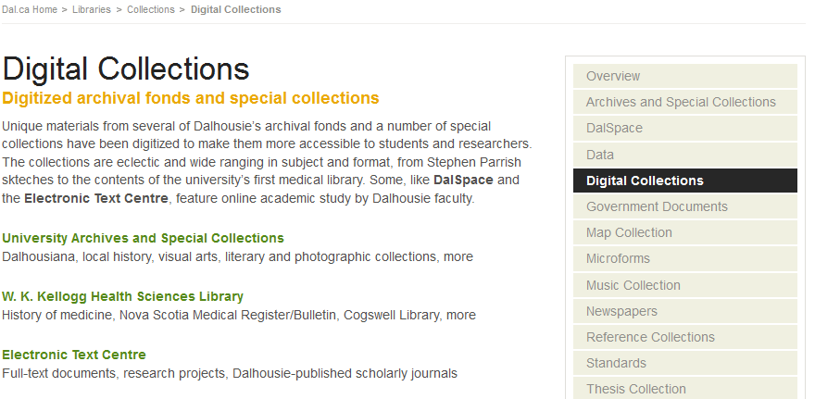
Instead of…

Slide 17
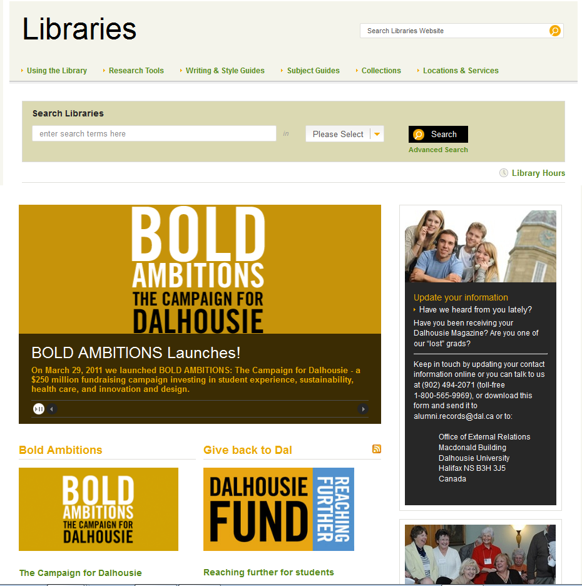
…there could be
Search the Dalhousie Digital Library
OR….

Slide 18
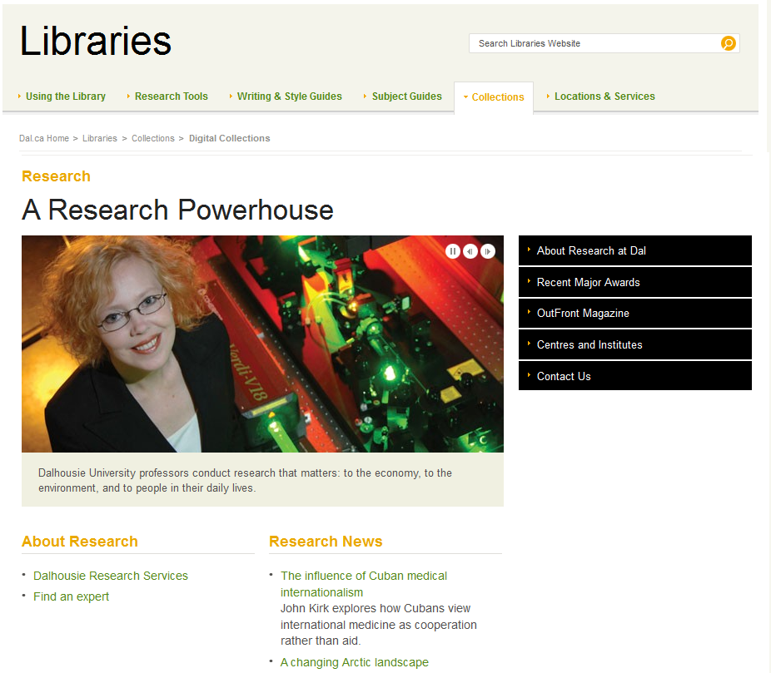
Digital Library

Slide 19
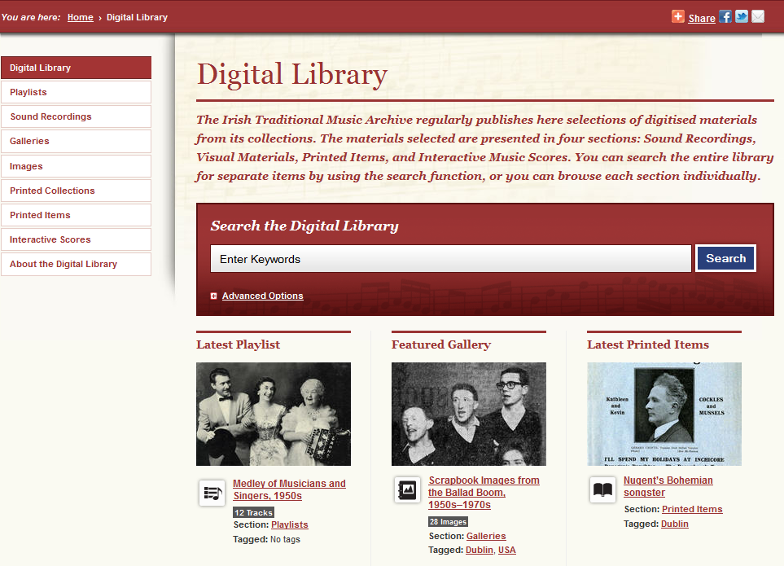
Irish Traditional Music Archive

