Slide 1

May 20, 2015
Presented by Creighton Barrett
Digital Archivist, Dalhousie University Libraries
HUMANITIES & ARCHIVES
Research Bootcamp

Slide 2
GOAL
Provide information on using archival material for humanities research
LEARNING OBJECTIVES
Differentiate types of archival institutions
Understand how to use and cite archival material
Examine challenges and opportunities of archival research in the humanities
Develop search strategies
Introduce the Dal Archives’ catalogue
Share tips for archival researchers

Slide 3
AGENDA
Introductions
Types of archives
Using and citing primary sources
Challenges and opportunities
Dalhousie University Archives’ collections and services
Dalhousie University Archives catalogue
Research question exercise
Tips for researchers
Q & A

Slide 4
RESEARCH INTERESTS?

Slide 5
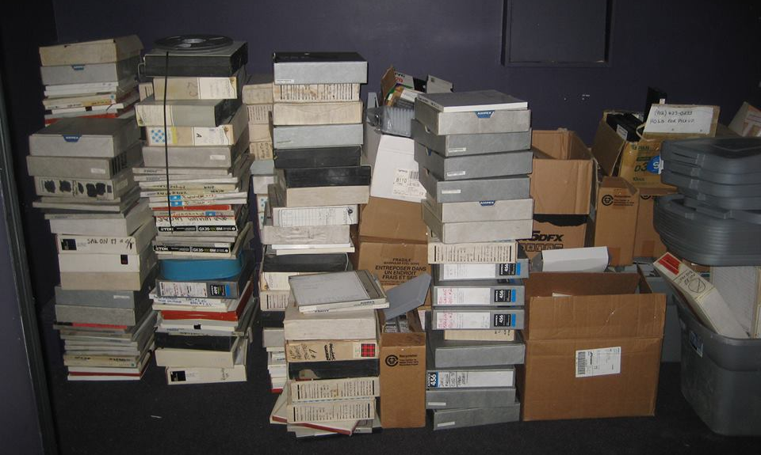
http://findingaids.library.dal.ca/solar-audio-collection

Slide 6
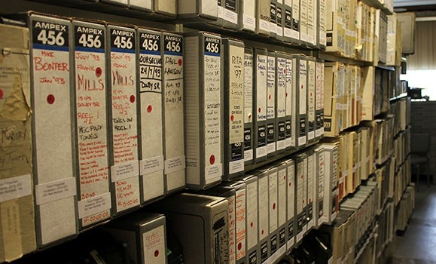
SOLAR AUDIO RECORDING STUDIO
http://findingaids.library.dal.ca/solar-audio-collection

Slide 7
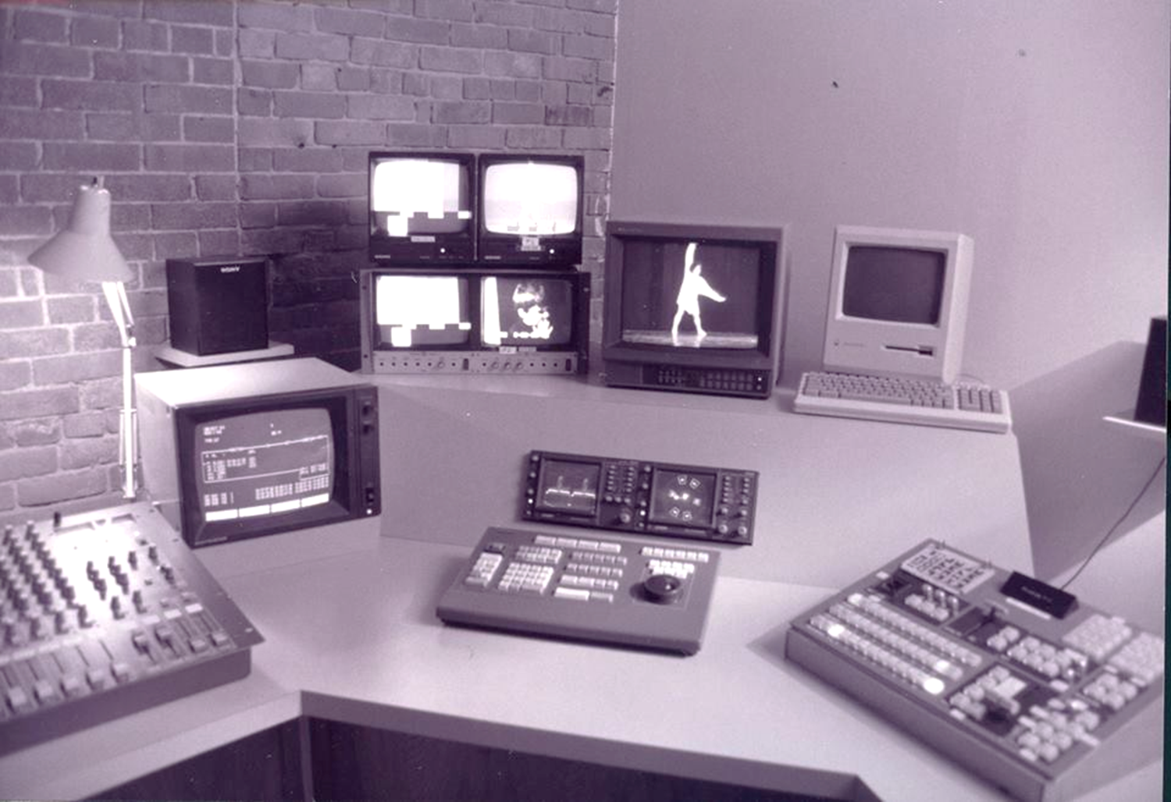
http://findingaids.library.dal.ca/centre-for-art-tapes

Slide 8
TYPES OF ARCHIVES

Slide 9
(Schmidt, Using Archives: A Guide to Effective Research)
UNIVERSITY AND COLLEGE ARCHIVES
Collect and preserve institutional memory
Some have records management programs
Materials in all formats
Some have research collections (often called “manuscripts” or “special collections”)
Typically focus research collections on specific subject areas
Examples: Dalhousie University Archives, Clara Thomas Archives and Special Collections, York University

Slide 10
(Schmidt, Using Archives: A Guide to Effective Research)
GOVERNMENT ARCHIVES
Municipal, provincial/state, federal records
Public mandate
Many have research collections (often called “manuscripts” or “special collections”) relevant to their geographic location and scope
Examples: Library and Archives Canada, Nova Scotia Archives, Halifax Municipal Archives
Notes:
Digital Analog image credit - SparkFun: https://learn.sparkfun.com/tutorials/logicblocks--digital-logic-introduction

Slide 11
(Schmidt, Using Archives: A Guide to Effective Research)
RELIGIOUS ARCHIVES
Traditions and institutions of major faiths, denominations, or individual places of worship
Varying degrees of public access
Location of records depends on approach to archives management (consolidated or federated)
Examples: Maritime Conference Archives, Presbyterian Church in Canada Archives, Shambhala Archives
Notes:
Digital Analog image credit - SparkFun: https://learn.sparkfun.com/tutorials/logicblocks--digital-logic-introduction

Slide 12
(Schmidt, Using Archives: A Guide to Effective Research)
COMMUNITY ARCHIVES AND HISTORICAL SOCIETIES
Preserves history of a region, historical period, theme or subject
Often managed by community volunteers or “lone arrangers”
Examples: Canadian Lesbian and Gay Archives, Mahone Bay Settlers Museum, Duxbury Rural and Historic Society

Slide 13
(Schmidt, Using Archives: A Guide to Effective Research)
MUSEUM ARCHIVES
Museums and archives share similar goals but collect different types of material and use different standards and best practices
Some museums include libraries and/or archives in addition to their collections of artifacts and/or artwork
Some archives have museum objects in their archival collections
Many museum archives in Nova Scotia
Examples: Canadian Museum of History, Cole Harbour Heritage Farm Museum

Slide 14
(Schmidt, Using Archives: A Guide to Effective Research)
CORPORATE ARCHIVES
Usually a department of a company that collects and preserves institutional memory
Serve the needs of the company
Varying degrees of public access
Examples: ScotiaBank Archives, Siemens Corporate Archives

Slide 15
HOW TO FIND ARCHIVAL INSTITUTIONS
Directory of Archives (Canadian Council of Archives)
Members’ Map (Council of Nova Scotia Archives)
Directory of Corporate Archives in the United States and Canada (Society of American Archivists)
Directory of Archival Organization (Society of American Archivists)
Internet searches

Slide 16
USING PRIMARY SOURCES

Slide 17
(Dan Elves, University of Manitoba, Archives Research Tutorial)
INTEGRATING PRIMARY SOURCES INTO ASSIGNMENTS
Evidence to back up a statement that supports your thesis
Compare and contrast information over time and space
Enhance your project with historical photographs
Research methodology involving critical and/or comprehensive examination of archival sources

Slide 18
INTEGRATING PRIMARY SOURCES INTO ASSIGNMENTS
Document analysis
Annotated bibliographies
Understand creative/artistic process (draft manuscripts, production records, research material, etc.)
Cite evidence of the evolution of an idea or way of thinking
Sources for text/data mining
  Text
  Metadata (archival descriptions)

Slide 19
Research topic/assignment | Primary sources
Influence of landlocked states on exclusive economic zones in “Law of the Sea” | UNCLoS III “series” in Elisabeth Mann Borgese fonds
Annotated bibliography of sources on conceptual art | Eyelevel Gallery fonds, Centre for Art Tapes fonds, and…
Significance of landscape in Atlantic Canadian literature | Thomas Head Raddall fonds, Donna Morrissey fonds, and…
Environmental activism in Nova Scotia | Ecology Action Centre fonds, M.O.V.E. fonds
Meta analysis of marine research on space shuttles | Uncatalogued videocassettes in Ron O’Dor fonds, and…
History of trigonometry | James Dinwiddie fonds, and…

Slide 20
(Dalhousie University Archives: Citing Archival Materials)
CITING PRIMARY SOURCES
You can’t just download your citations…
Use a style guide
  Chicago Manual of Style
  MLA Handbook
  APA Publication Manual
Chicago: Place the cited item first [in a note]
  There is no general agreement on the sequence of the remaining elements in the citation
Check your department for guidance
Check the journal, publishing company, etc.

Slide 21
(Dalhousie University Archives: Citing Archival Materials)
CITING PRIMARY SOURCES
Be consistent throughout your work once you adopt a sequence
Note: Correspondence from Henry Davies Hicks to the Annapolis County electorate, October 24, 1956, MS-2-511, Box 15, Folder 9, Henry Davies Hicks fonds, Dalhousie University Archives, Halifax, Nova Scotia, Canada.
Bibliography: Henry Davies Hicks fonds, MS-2-511. Dalhousie University Archives, Halifax, Nova Scotia, Canada.

Slide 22
(Schmiesing and Hollis, 2002)
TEACHING WITH PRIMARY SOURCES
“As a result of their reluctance to acknowledge the interrelationship between the text and its packaging, faculty and librarians have overlooked the pedagogical advantages of using rare materials and book history to further students’ understanding of subjects within a variety of disciplines.”

Slide 23
(Pugh & Rockenbach, 2011; Learn NC, Teaching with primary sources)
TEACHING WITH PRIMARY SOURCES
Studies have shown that students are ready to engage with primary sources early in their university career
Focus on course goals, learning objectives, and weekly schedule
Use as examples for lectures and seminars
Inquiry-based learning (start with questions, not “facts”)
Active learning techniques
Primary source analysis worksheets

Slide 24
(Lee Ann Potter, Integrating OurDocuments.gov into the Classroom)
TEACHING WITH PRIMARY SOURCES
Document analysis activities (research skills development)
Brainstorming activities (start a new unit with a primary source)
Cross-curricular activities (collaborate with colleagues)
Current events (“what is past is prologue”)
Geography activities (context is everything)
“Not-so-famous person report” (David Walbert)

Slide 25
CHALLENGES / OPPORTUNITIES

Slide 26
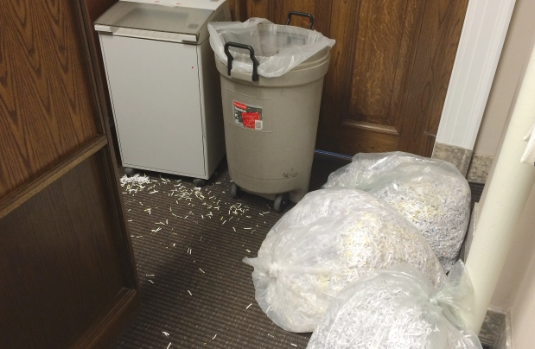
(Gerein, Edmonton Journal, May 8, 2015)
ALBERTA OPPOSITION CONCERNED ABOUT DOCUMENT SHREDDING

Slide 27
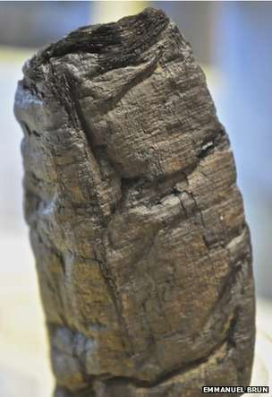
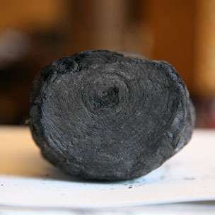
(Webb, BBC News, January 20, 2015)
X-RAY TECHNIQUE READS BURNT
VESUVIUS SCROLL

Slide 28
LANGUAGE AND SCRIPTS
Humanities research may require proficiency in multiple languages and/or scripts
Archival collections often have multilingual material
Cultural evolution of languages and communication
Paleography: Study of ancient and historical handwriting
Digitization and transcription of handwritten material is challenging and expensive but extremely rewarding

Slide 29
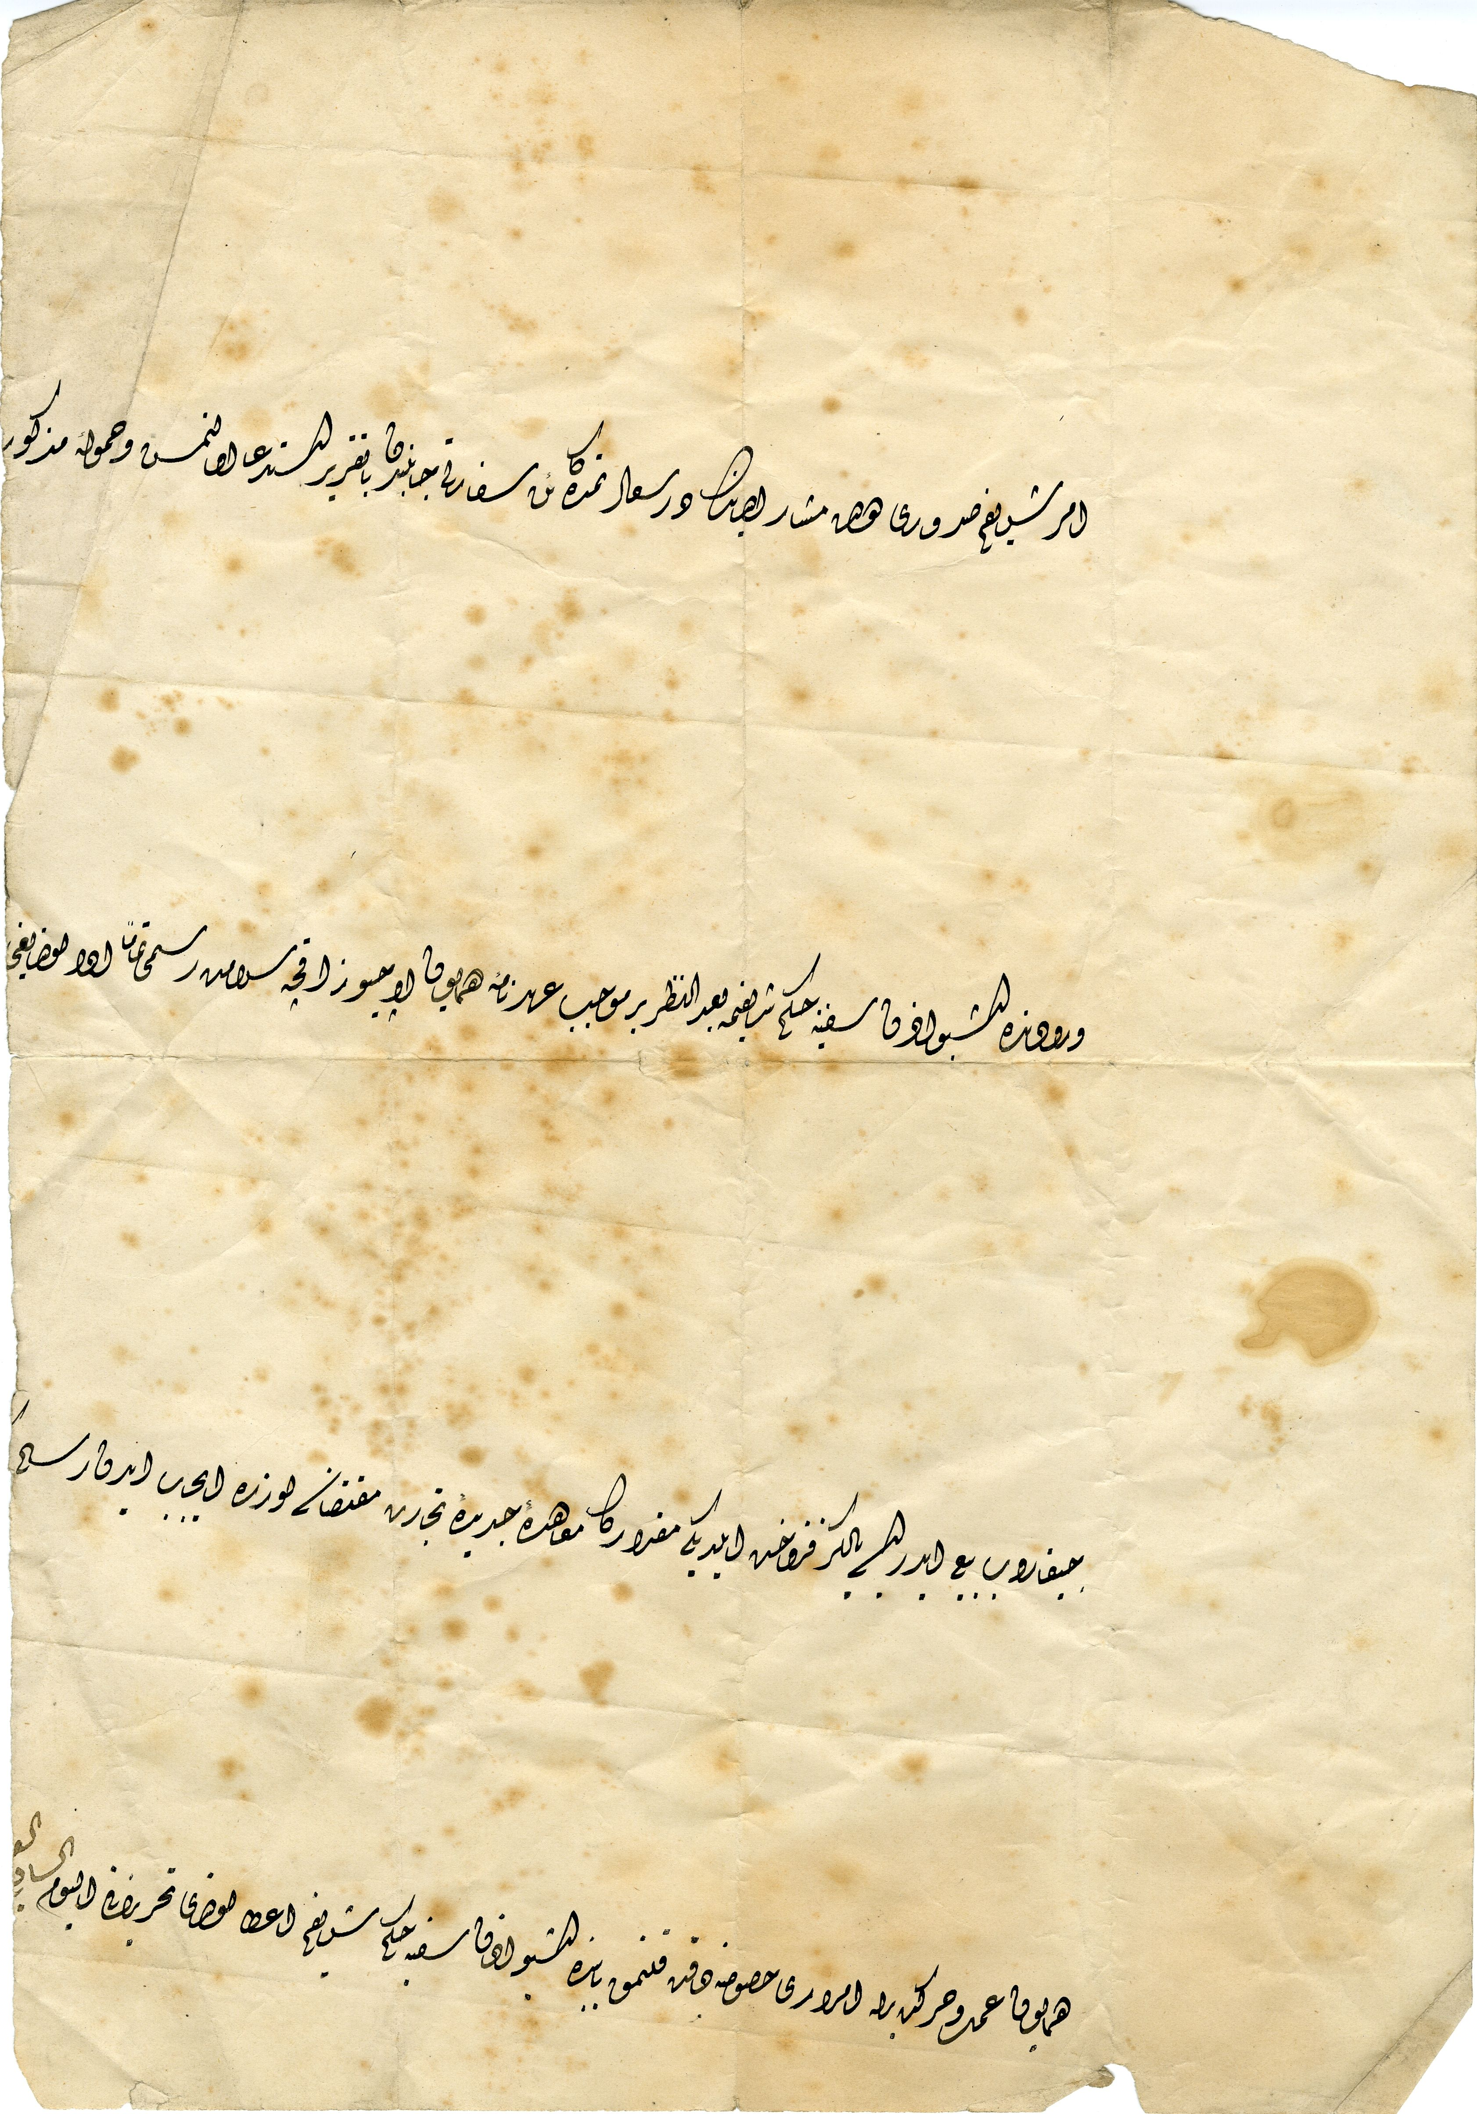
ORDER OF PASSAGE ISSUED TO THE ELIZA OULTON BY THE OTTOMAN EMPIRE, O’Brien Family fonds (MS-4-242, Box 2, Folder 3, Item 1)
Notes:
https://blogs.dal.ca/libraries/2011/10/uncovered-in-the-archives-19th-century-ottoman-manuscript/
“The issuance of my noble order has been requested with an official note by the aforementioned state’s embassy located in my Realm of Felicity [Istanbul].
…upon its arrival, after consideration (of?) my noble edict of permission for ship’s [passage] three hundred akches (aspers) having been paid in full as security duty in compliance with the imperial treaty.
…if [he] brings out…and purchases it, then the necessary duty required by the new trade pact only for the amount purchased…
With respect to attention being given to the matter of permission of passage acting in accordance with the imperial [...], my noble edict of permission for [ship's] passage has been granted. Written on the day…”

Slide 30
MATERIAL TYPE AND FORMAT
Many documentary formats in archives
  Text (papyrus, parchment, pulp, etc…)
  Sound recordings (vinyl, cassette, etc.)
  Moving images (film, video, etc…)
  Still images (tintype, print, negative, etc.)
  Technical drawings
  Research data
Archives may require advance notice for certain materials
Surrogates or alternative sources may be provided

Slide 31
ACCESS RESTRICTIONS
Donors can impose access or use restrictions
Archivists can impose access or use restrictions
FOIPOP requests
Ethics agreements
Access may be prohibited due to lack of equipment or preservation concerns
Uncatalogued “backlog” is professionally unacceptable but exists virtually everywhere

Slide 32
“ONE OF A KIND” OPPORTUNITIES
Archival materials can distinguish your work
Primary sources enhance your usage of secondary sources
Use archives to present new answers and perspectives
Archives can facilitate cross-disciplinary research
You may have a serendipitous “discovery”
You may find a possible career path in archives, museums, or libraries

Slide 33
DIGITAL HUMANITIES
Unprecedented access to archival materials
Technology enables new research methodologies
Data visualisation
Data/text mining
Digital mapping
Statistical analysis
Major advances in archival description standards and best practices

Slide 34
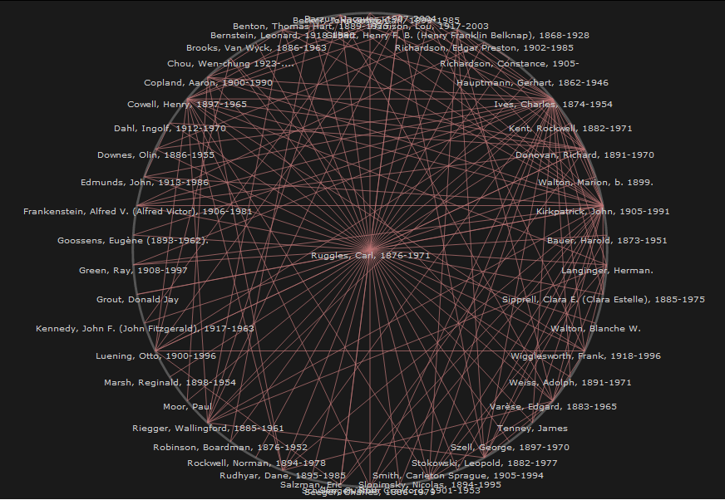
Notes:
SNAC Project visualisation of Carl Ruggles.

Slide 35
DALHOUSIE ARCHIVES

Slide 36
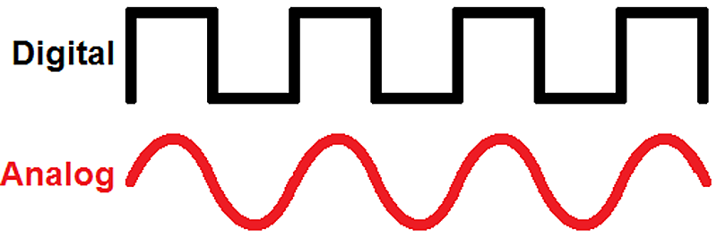
DAL ARCHIVAL COLLECTIONS
Almost 7 kilometres of physical records
  Textual records
  Sound recordings
  Film and videos
  Photographs
  Technical drawings and plans
Over 15 TB of digital records
  Digitization projects
  Born digital records
Strengths in 19th and 20th century Maritime Canadian sources

Slide 37
DAL ARCHIVAL COLLECTIONS
University records
Faculty papers
Theatre and culture / Literature
Business archives
Medical archives
Labour archives / Citizen action groups
Environment, oceans, and sustainability
Maritime history archives
Women’s archives

Slide 38
GUIDE TO MAJOR RESEARCH COLLECTIONS
Organizes collections into broad thematic areas
Each page contains:
    Summary of collection area
    List of key subjects
    List of featured collections
    Citations for published research that references collections of interest

Slide 39
DAL ARCHIVES SERVICES
Archives and Special Collections Reference Desk
    Research assistance
    Place materials on reserve
    Photocopy and scanning requests
Guide to major research collections
Archives catalogue and online collections
Guide to archival research
Class instruction
Support for archives assignments

Slide 40
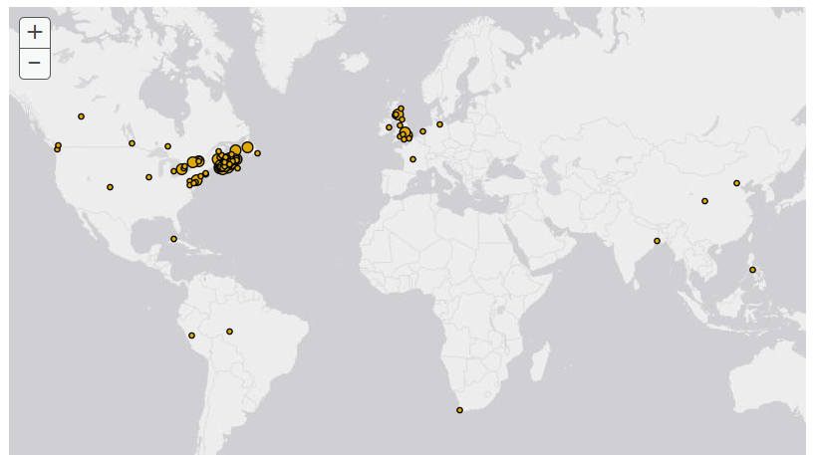
ARCHIVES CATALOGUE

Slide 41
ARCHIVES CATALOGUE
Fully searchable database of “finding aids” to Dal Archives collections
155,000+ archival descriptions
Digital archives embedded into catalogue records on an ongoing basis
Map of collections
Quality of data varies
Feedback is strongly encouraged!

Slide 42
ARCHIVES CATALOGUE
Browse by
  Title
  Name (of creator)
  Subjects
  Geographic location
  Digital object
Basic and advanced search
Search facets

Slide 43
ARCHIVES CATALOGUE HELP
Archives and Special Collections Reference Desk (902-494-3615)
Archives email: archives@dal.ca
Dal Archives “Guide to Archival Research”
  Detailed instructions on searching and browsing the catalogue
Council of Nova Scotia Archives (CNSA) MemoryNS YouTube video tutorials
“Access to Memory” documentation

Slide 44
SEARCH STRATEGIES

Slide 45
(Dalhousie University Libraries Research Bootcamp Fundamentals 1 & 2)
FUNDAMENTALS
Searching for archives is not like searching for journal articles
Search for archives is just like searching for journal articles!
  Focus your research question
  Break your question into concepts
  Identify subject headings/keywords for each concept
  Manage your search results/citations
Check other catalogues/websites
Write an email, pick up the phone, drop by…

Slide 46
BROAD
CONCEPTS IN YOUR
RESEARCH QUESTION
Example: How did landlocked states influence the Exclusive Economic Zones of the UN “Law of the Sea”?
 | CONCEPT 1 | CONCEPT 2 | CONCEPT 3
Keyword
Keyword
Keyword
Keyword
Keyword
Keyword

Slide 47
NARROW
CONCEPTS IN YOUR
RESEARCH QUESTION
Example: Who wrote the quotation on Eyelevel Gallery’s webpage about R. Holland Murray’s 1983 exhibition?
 | CONCEPT 1 | CONCEPT 2 | CONCEPT 3
Keyword
Keyword
Keyword
Keyword
Keyword
Keyword

Slide 48
SEARCH EXERCISE

Slide 49
CATALOGUE SEARCH EXERCISE
Write down your research question
Break your research question into concepts (back to the fundamentals!)
Brainstorm keywords for each concept
Start with simple search
Use AND/OR in basic search box
Use quotations to search for phrases
Build searches using advanced search page
Tip: Refer to the Research Bootcamp Foundations, Part 1 slides and exercise sheet

Slide 50
TIPS FOR RESEARCHERS

Slide 51
(Library and Archives Canada, 2008)
GENERAL TIPS
Start with clear information about the type and scope of archival materials needed to support your project
Spend time becoming comfortable with document analysis, paleography, languages and scripts, research methods, and other skills that will help you conduct archival research and use archival sources
Consult with archivists during every phase of your project

Slide 52
(Library and Archives Canada, 2008)
NOTE TAKING TIPS
Notes should include:
  Name of institution
  Manuscript collection/record group
  Series and/or file title
  Date(s) of material
  Reference codes
  Exact title or description of the item
  Annotation of the information that interests you
Make sure factual data and quotations that you intend to use are recorded in full

Slide 53
(Library and Archives Canada, 2008)
NOTE TAKING TIPS
Record complete citations for all materials referenced, even the material you do not intend to use
Consider writing summary notes for each collection you consulted
  Chronological scope and arrangement
  Whether all or only part was checked
  Items which you plan to use
  Those which are irrelevant

Slide 54
TIPS FOR RESEARCH TRIPS
Plan every detail in advance
Research the collections in advance
Engage the institution in advance
Prioritize your research activities
Adjust your priorities accordingly
Request reproductions for key material
Ask many questions while you are visiting
Talk to your professors, advisors, mentors, etc.
Imagine yourself wishing you had access again
Observe habits of other researchers
Notes, notes, notes, notes…

Slide 55
RESEARCH GUIDES
Using Archives: A Practical Guide for Researchers (Library and Archives Canada)
Using Archives: A Guide to Effective Research (Society of American Archivists)
Determining Public Domain Status (Dalhousie Libraries’ Copyright Office)
Library Skills for the History Student (Trent University Online History Workbook)
Archives Research Tutorial (University of Manitoba Libraries)

Slide 56
REFERENCES

Slide 57
REFERENCES
Dalhousie University Libraries. “Guide to Archival Research.” Last updated May 19, 2015. http://dal.ca.libguides.com/archivalresearch.
Dan Elves. “Archives Research Tutorial.” Accessed May 20, 2015. http://www.umanitoba.ca/libraries/units/archives/tutorial/tutorial_introduction.html.

Slide 58
REFERENCES
Keith Gerein. “Alberta opposition concerned about document shredding.” Edmonton Journal, May 8, 2015, http://www.edmontonjournal.com/Alberta+opposition+concerned+about+document+shredding/11041087/story.html.
Library and Archives Canada. “Using Archives: A Practical Guide for Researchers.” Last modified January 14, 2008, https://www.collectionscanada.gc.ca/04/0416_e.html.

Slide 59
REFERENCES
Lee Ann Potter. “Integrating OurDocuments.gov into the Classroom.” OurDocuments.gov. Accessed May 20, 2015. http://www.ourdocuments.gov/content.php?flash=true&page=integration.
Mary Pugh and Barbara Rockenbach, “Archives, undergraduates, and inquiry-based learning: Case studies from Yale University Library,” American Archivist 74, no. 1 (2011): 297-311. http://americanarchivist.org/doi/abs/10.17723/aarc.74.1.mml4871x2365j265.

Slide 60
REFERENCES
Ann Schmiesing and Deborah Hollis. “The Role of Special Collections Departments in Humanities Undergraduate and Graduate Teaching: A Case Study.” Portal: Libraries and the Academy 2, no. 3 (July 2002): 465-480. https://muse.jhu.edu/.
Laura Schmidt. “Using Archives: A Guide to Effective Research,” accessed on May 18, 2015, http://www2.archivists.org/usingarchives.

Slide 61
REFERENCES
University of North Carolina School of Education. “Teaching with Primary Sources.” Accessed May 20, 2015. http://www.learnnc.org/lp/pages/5316.
Jonathan Webb. “X-ray technique reads burnt Vesuvius scroll.” BBC News, January 20, 2015, http://www.bbc.com/news/science-environment-30888767.

