Slide 1
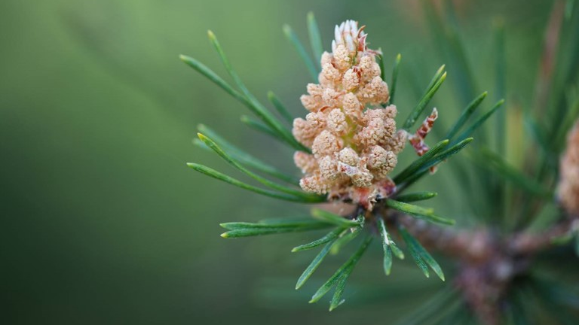
Study spaces: designing for wellbeing in an ‘echo’ pandemic
Linda Bedwell
Coordinator of Assessment
Dal Libraries
September/October 2022

Slide 2
Pandemic Effects on Current Students
Chronicle of Higher Education (Brown, 2021)
Pandemic only exacerbated already high levels of anxiety and depression among post-secondary students
Student counselors are observing an increase in anxiety related to current circumstances (rather than future/past)
Evidence of Post-traumatic Stress Disorder (PTSD)
U.S. Healthy Minds Study
Post-secondary student surveys since 2007
There has been an upward trend in student anxiety and depression well before and continuing into the pandemic

Slide 3
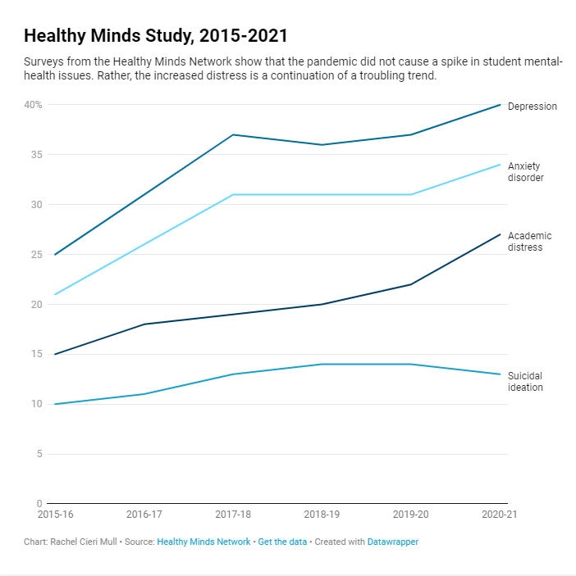

Slide 4
Pandemic Effects on Current Students
Impacts of Great Recession on 18-25 year-olds (Schoon & Mortimer, 2017)
Ages 18-25 are the “impressionable years” – a critical “make or break” time when significant external events can have lifelong impacts on lifelong beliefs and values and end up shaping societal values and economics
The recession slowed the “development of positive self-views” and was linked to increases in depression and “lowered levels of subjective health”
Levels of self-esteem among adolescents continued to drop after the recession

Slide 5
Great Recession
&
SARS
Great Recession
Researchers noted an increase in abuse-related internet searches such as “my mom beat me” or “my dad hit me” (Bryant et al., 2020).
SARS
Children who experienced quarantine were four times as likely to experience post-traumatic stress than those who did not (Sprang & Silman, 2013).

Slide 6
Pandemic Effects on Adolescents
(10-19 year-olds according to WHO)
“Second chance” became a “second hazard” (Leuzinger-Bohleber & Montigny, 2021)
The pandemic has caused a significant risk to adolescent development
Adolescence is a “second chance” to process early childhood trauma, for identity creation, and for brain changes – all of which require socializing with others
Masking, social distancing and shutdowns have limited these crucial interactions, making this “second chance” a “second hazard”, particularly for traumatized, poor, immigrant, and/or racialized adolescents

Slide 7
Pandemic Effects on Adolescents
Society for Research on Adolescents’ (SRA) Covid Response Team
International, interdisciplinary research initiative to investigate the pandemic effects on adolescent development
Their research mirrors the impacts of wars and the Great Depression and Great Recession, including disruptions in emotional regulation and development, and academic aspirations
Effects are especially harsh for the marginalized and less fortunate, including immigrants
Acknowledge a duo pandemic: Covid-19 and the social unrest/justice movement (Covid-19 Response Team, n.d.)

Slide 8
Pandemic Effects on Adolescents
The pandemic has been damaging to youth who “already carried the anxiety and trauma of surging racial tensions, political uncertainties, and climate crises delivered without interruption to their pockets via cell phones.” (Hussong et al., 2021)

Slide 9
Pandemic Effects on Adolescents
Society for Research on Adolescents’ (SRA) Covid Response Team
Institutions and communities must step up to help youth recover from pandemic disruptors such as quarantine and restrictions, social isolation, increases in domestic abuse, household financial impacts, housing insecurity, prolonged family illnesses and deaths in the family (Hussong et al., 2021).

Slide 10
Pandemic Effects on Adolescents
Parenting
Parenting has been challenged during the pandemic, leading to “harsh parenting” and fragile families (abuse, worsened neglect), and the economic fallout has added even more pressure, all causing “lifetime and intergenerational consequences” (Perks et al., 2020).
Caregivers can be absorbed in their own trauma and may not be bridging the communication gap to help adolescents (Leuzinger-Bohleber & Montigny, 2021).
One study looked at numbers of child abuse and neglect investigations in four U.S. jurisdictions before and during the pandemic and estimated that 200,000 cases went unreported (Nguyen, 2021).

Slide 11
Pandemic Effects on Adolescents
COPSY (Ravens-Sieberer, 2020)
Longitudinal study of the pandemic’s mental health effects on children and adolescents in Germany.
Comparisons between data from COPSY and pre-pandemic data from BELLA.
Anxiety and risk for other mental health problems (except depression) rose.
More family discord, more school-related problems.
39% of children said their friendships dwindled.

Slide 12
Pandemic Effects on Adolescents
Trauma
(Substance Abuse and Mental Health Services Administration, 2014)
A traumatizing event has three elements:
“it was unexpected
the person was unprepared
there was nothing the person could do to prevent it from happening”

Slide 13
Pandemic Effects on Adolescents
Trauma
Among SAMHSA’s common types of trauma, we find matches to the Covid-19 pandemic:
Repetitive (e.g., shutdowns, school closures, news reports)
Complex (e.g., various effects including isolation, domestic disturbances)
Complex development trauma (occurring during childhood and adolescence)
Vicarious (e.g., reports of the sick and dying)
Collective (e.g., community and global impacts)

Slide 14
Pandemic Effects on Adolescents
Trauma
Repetitive exposure to childhood trauma causes complex development trauma, results of which are:
“lack of continuous sense of self
poor emotion regulation and impulse control
uncertainty about the reliability and predictability of others” (Recognizing and responding to the effects of trauma, 2015)

Slide 15
Even prior to the pandemic, childhood trauma was more prevalent than most realize
2019 General Social Survey (Statistics Canada)
  62% of Canadians had experienced “harsh parenting” (i.e., neglect and emotional abuse)
  22% experienced physical abuse
  21% witnessed violence in the home
  6% were sexually abused
  93% who experienced childhood physical or sexual abuse said it went unreported
  (Childhood maltreatment and the link with victimization in adulthood, 2021)

Slide 16
Pandemic Effects on Adolescents
Adverse Childhood Events (ACEs)
Some researchers are investigating pandemic-related ACEs (abuse, neglect, and household dysfunction) that have lifelong impacts on physical and mental health (see What are ACEs?, n.d.).

Slide 17
Pandemic Effects on Adolescents
CDC-Kaiser ACE Study
Major U.S. study conducted in the late 90s.
Examined the life experiences of over 17,000 people.
Revealed that ACEs were more common than previously realized, and were linked to various addictions, chronic diseases and mental illnesses later in life (Center for Disease Control and Prevention, 2022; Recognizing and responding to the effects of trauma, 2015).

Slide 18
Pandemic Effects on Adolescents
Adverse Childhood Events (ACEs) – Pre-pandemic data
Prior to the pandemic, 45% of U.S. children had at least one ACE, with these rates increasing to 61% for Black non-Hispanic children and 51% for Hispanic children (Sacks & Murphey, 2018).
Various studies in Canada provided results ranging from 56% to 76% of participants having at least one ACE (Grant, 2021)

Slide 19
Pandemic Effects on Adolescents
Adverse Childhood Events (ACEs) – August 2020 survey in Germany
Child abuse and neglect increased by one-third.
Families with younger children were especially at risk, as were families led by parents who have their own ACEs (Calvano et al., 2021).
(Parent-reported data so under-reporting is possible)
Increase in ACEs linked to stress of job losses and finances (particularly psychological abuse and domestic violence).

Slide 20
Pandemic Effects on Adolescents
Weitzman Institute at Community Health Center (U.S.)
“...low socio-economic status as well as social isolation, both of which are on the rise in the current pandemic, are major risk factors for ACEs”
Calling for increased supports “within and beyond health care” to avoid lifetime consequences of an increase in ACEs due to the pandemic (Bryant et al., 2020)

Slide 21
Responsibility of Post-Secondary Education
Students will be more inclined toward empathic contacts and relationships with their university (Sens & Moll, 2021).
Universities must accept their responsibility for student mental health and whole-heartedly support student needs (Connaway et al., 2022).
Must ensure students feel comfortable in our spaces (Whitmer, 2021).

Slide 22
Responsibility of Post-Secondary Education
According to Maslow’s Hierarchy of Needs (1943), in order to succeed in their academic work, students must first feel physically and psychologically safe.
It’s the ethos of the university that will dictate how libraries will provide study space (Baker & Ellis, 2021).
Universities may have noticed the rise in mental disease but what about our impact on it? Study space design is one way to accept our role in supporting mental health.
Notes:
Maslow

Slide 23
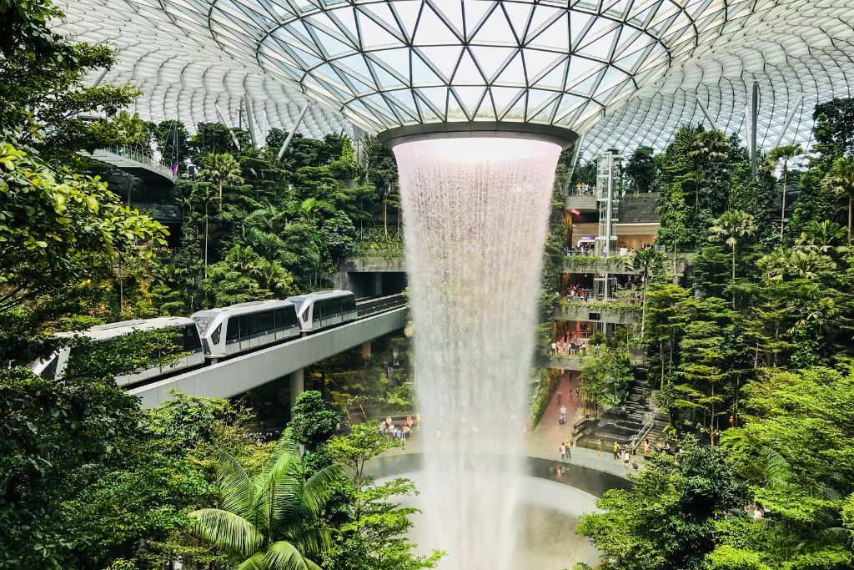
Space design

Slide 24
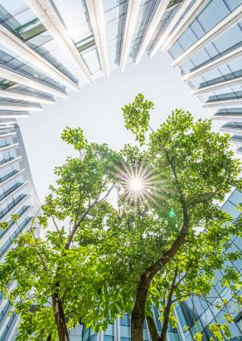
Space Design
“We shape our buildings; thereafter they shape us.”
- Winston Churchill, 1943
Source: https://www.discovery.com/science/biophilic-design-is-a-natural-recipe-for-better-buildings-and-he

Slide 25
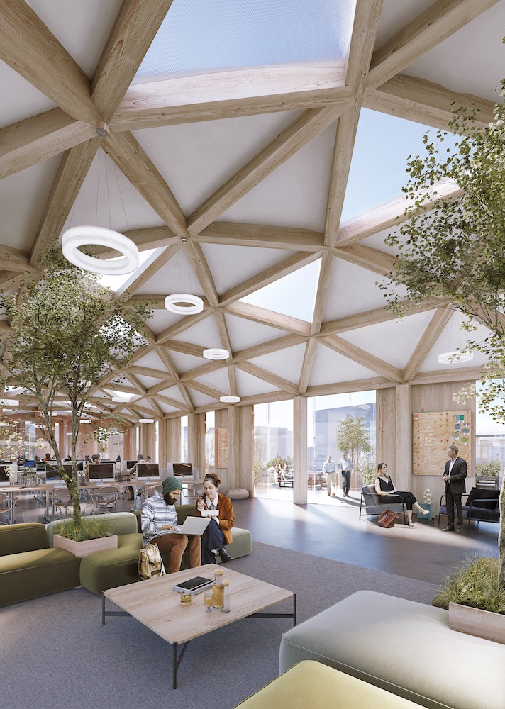
Types of Space Design Investigated
Trauma-informed Care & Design
Biophilic
Salutogenic
Restorative Environment
Disease Prevention
Wellness-based
Anti-anxiety
Source: https://www.workdesign.com/2021/02/stimulating-biophilia-through-corporate-interior-design/

Slide 26
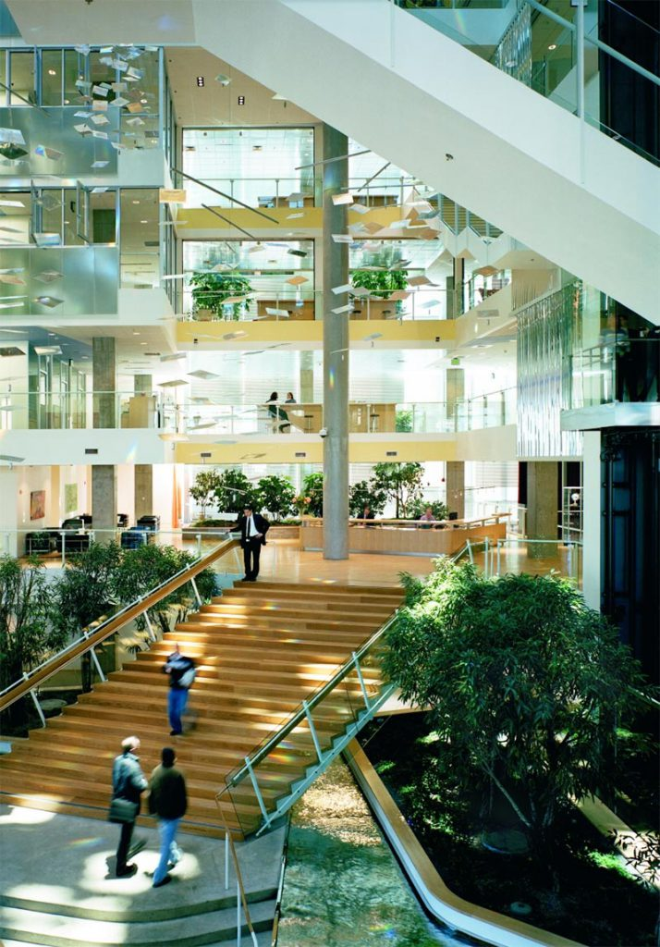
Common Themes
Elements of nature
Opportunities for social connections
Places for self-care
The lack of the above in our current study spaces should give cause for concern, especially given the effects of the pandemic on mental health.

Slide 27
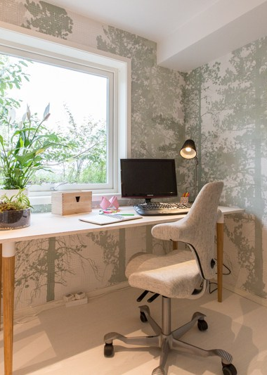
Space Design
Inside Out, a UK group of learning space designers, are calling for special design considerations in buildings of high anxiety – particularly university buildings.
They suggest that university rankings could someday include “wellbeing metrics” (Anti-anxiety architecture, n.d.).
Source: https://www.designingbuildings.co.uk/wiki/Biophilic_design_research

Slide 28
Four Rs of Trauma-Informed Care (TIC)
This approach “REALIZES the widespread impact of trauma and understands potential paths for recovery; RECOGNIZES the signs and symptoms of trauma in clients, families, staff and others involved with the system; and RESPONDS by fully integrating knowledge about trauma into policies and procedures, and practices, and seeks to actively RESIST retraumatization” (Trauma-informed approaches, 2015).

Slide 29
Six Principles of TIC
Safety - clients feel physically and psychologically safe
Trustworthiness and Transparency - processes and decisions are transparent in order to develop and maintain a sense of trust with clients and staff
Peer Support – working with peers for recovery and healing
Collaboration and Mutuality – facilitating relationships between clients, staff and administration as well as the sharing of power and decision-making
Empowerment, Voice and Choice – clients are empowered to use their voice, participate in decision-making and given the right of choice
Cultural, Historical and Gender Issues – responsive to historical and gender-based trauma as well as cultural, racial and ethnic needs
(Substance Abuse and Mental Health Services Administration, 2014)

Slide 30
Applying TIC principles to our study spaces
By collaborating with our diverse users, we can ensure the spaces are designed so they feel safe and welcome within their surroundings, that there are places for self-care, and that the spaces support peer-collaboration, and reflect openness and transparency.

Slide 31
Trauma-Informed Design (TID)
The Committee on Temporary Shelter (COTS) in Vermont used the TIC principles to develop TID principles for a homeless shelter environment.
Research conducted on several permanent supportive housing projects found four approaches of TID:
  ‘Provide multiple common areas to maximize resident choice and safety
  Separate spaces with walls but connect them with interior windows to provide safety
  Build a central third stair to encourage social engagement
  Design places for future resident empowerment and voice” (Bollo & Donofrio, 2021).

Slide 32
Trauma-Informed Design (TID)
e4h (Environments for Health), an American architecture firm specializing in healthcare and health science environments, has developed some elements for TID, highlighting the basics of TIC – “empathy and understanding” (Empathy in Architecture, 2020).
Bassetti Architects developed an open-source TID workbook for learning environments, particularly secondary schools. Some examples include: clear visibility (acknowledging hypervigilance and the need to feel safe); a variety of ‘shelters’ (places of refuge, fidget toys); places to nap or prepare food; choice of furniture, lighting, and noise levels; opportunities for interaction with others; and biophilic design elements (McConachie, Bergsagel, & Bharatkumar, 2022).

Slide 33
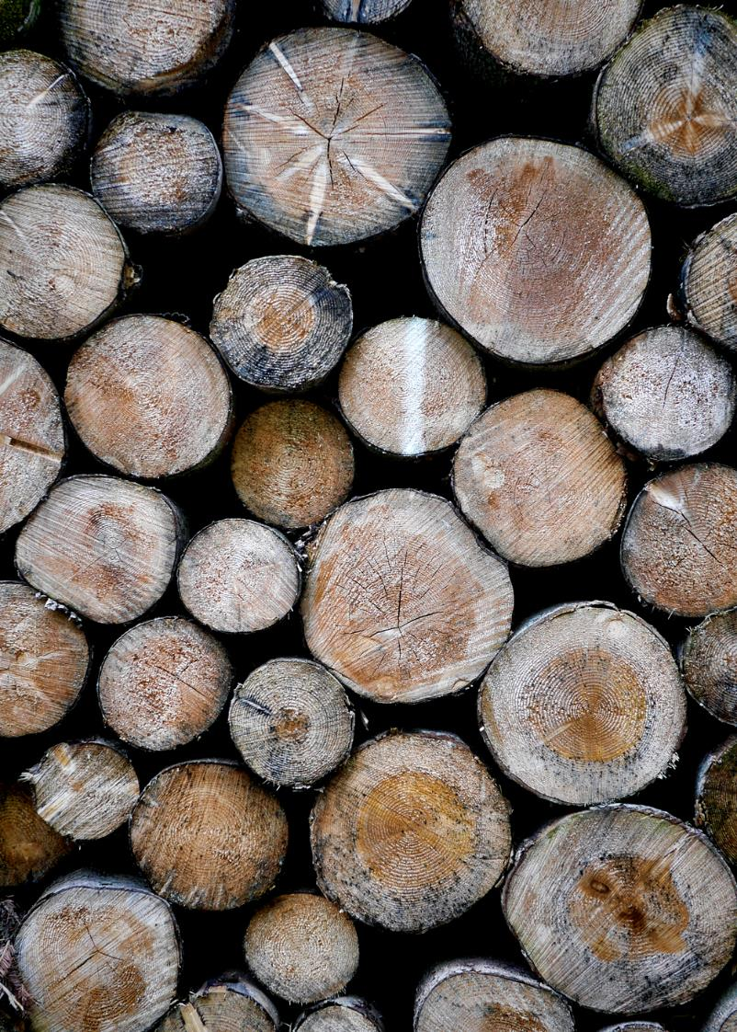
Biophilic Design
Biophilic design brings natural elements into our built spaces or finding ways within the spaces to mimic properties of nature - prospect, refuge, mystery, legibility and fractal patterns (Kahn, 2011).

Slide 34
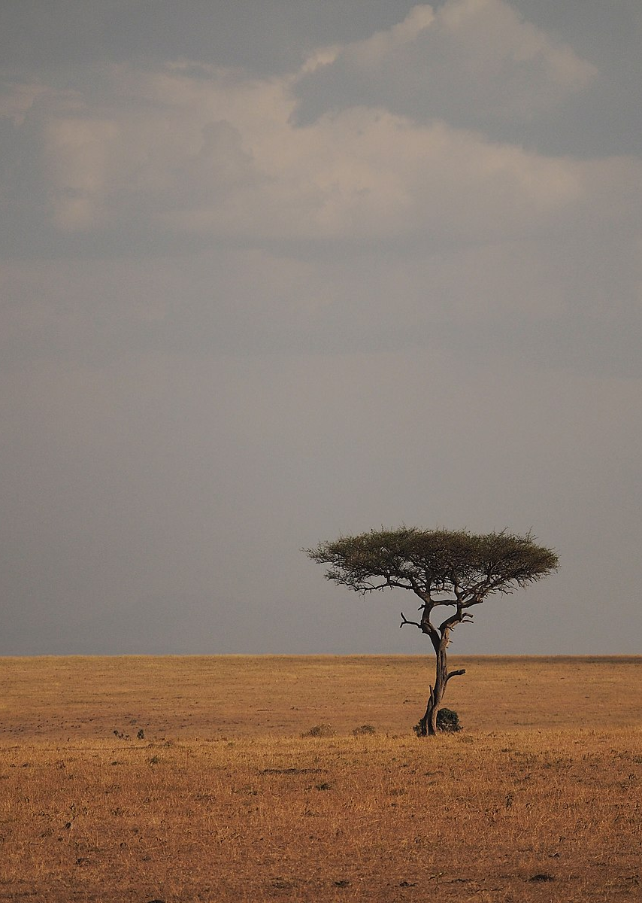
Biophilia
Hypothesized by Wilson in 1984 and rests on the premise that humans evolved on the African savannah. Knowledge of and reactions to elements in that environment led to individual and group survival and therefore to an innate attraction to certain natural features.

Slide 35

Benefits of Biophilic Design
stress reduction
attention restoration
improves emotions
lowers blood pressure
lowers cortisol (stress hormone)
(Vermes, 2021; Ryan et al., 2014)
Notes:
Quick sum

Slide 36
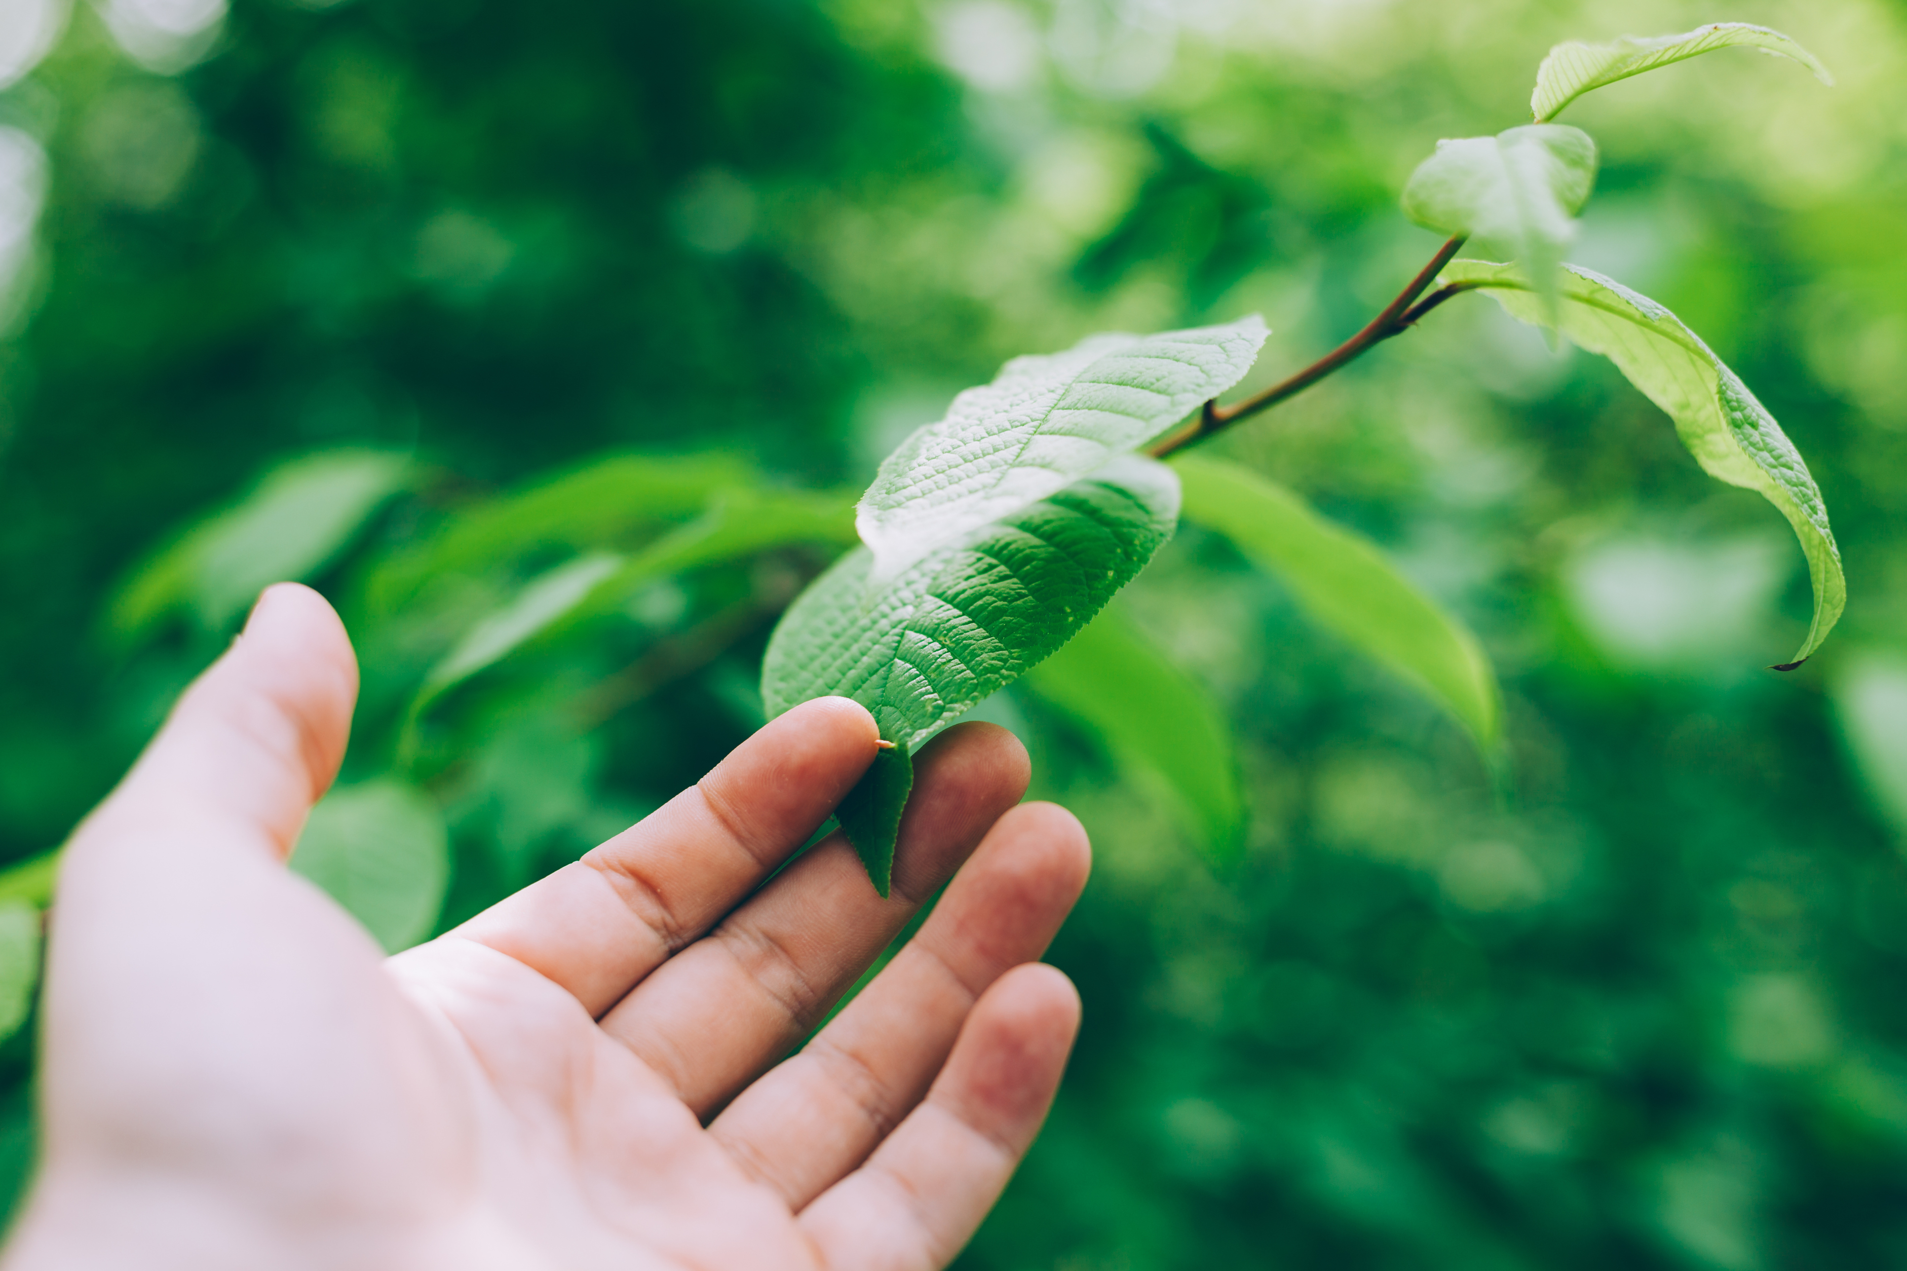
Attention Restoration Theory (ART)
Biophilia helps us recover from directed attention fatigue
Evolutionally speaking, our directed attention would have been limited or we would not have survived the dangers in our surroundings.
"Directed attention plays an important role in human information processing; it's fatigue, in turn, has far-reaching consequences.”
Attention Restoration Theory provides an analysis of the kinds of experiences that lead to recovery from such fatigue" (Kaplan, 1995)

Slide 37
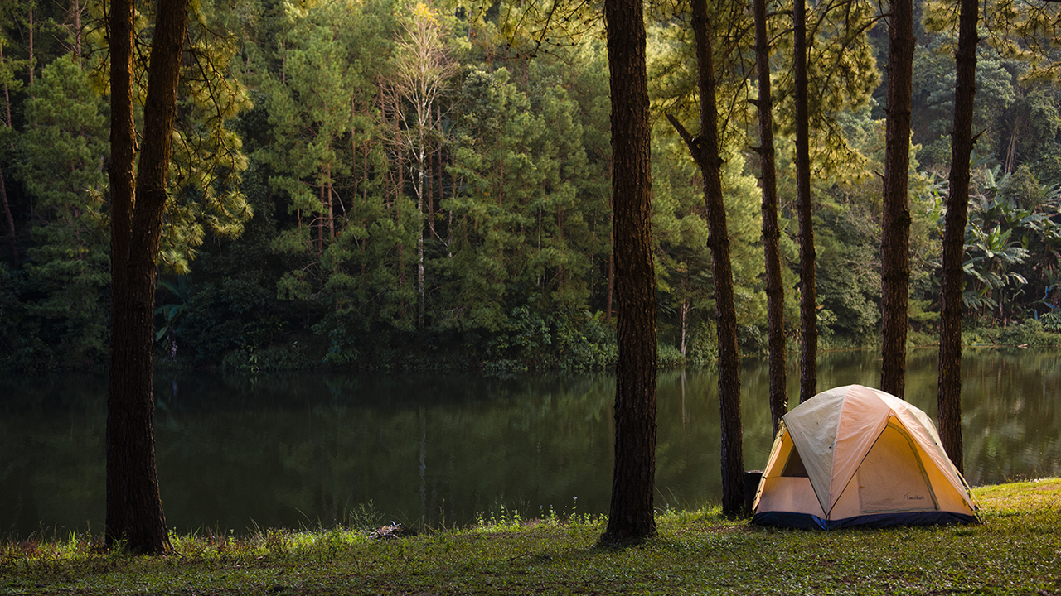
Kaplan’s model of restorative experience (1995)
Being away
a new environment, an old environment experienced differently, or even just a redirection of one’s gaze
Fascination
either an experience or an environment, (e.g., seeing a rare animal or being in a cave)
Extent
the environment is “rich enough and coherent enough so that it constitutes a whole other world”
Compatibility
an environment where one can conduct their actions and behaviours naturally and comfortably

Slide 38

Biophilic Design
Nature in the Space
bringing natural elements or conditions directly into the built space
Natural Analogues
objects, artwork, or materials that resemble nature
Nature of the Space
designs that provide for our intrinsic human preferences for exploration, mystery, prospect and refuge (Pinter-Wollman et al., 2018)

Slide 39

14 Patterns of Biophilic Design
Terrapin Bright Green (design consultants) published a report in which they identify 14 patterns within the three categories of biophilic design “from empirical evidence and interdisciplinary analysis of more than 500 peer-reviewed articles and books” (Ryan et al., 2014). The positive mental, emotional and cognitive effects of each are provided, supported by referenced research.

Slide 40
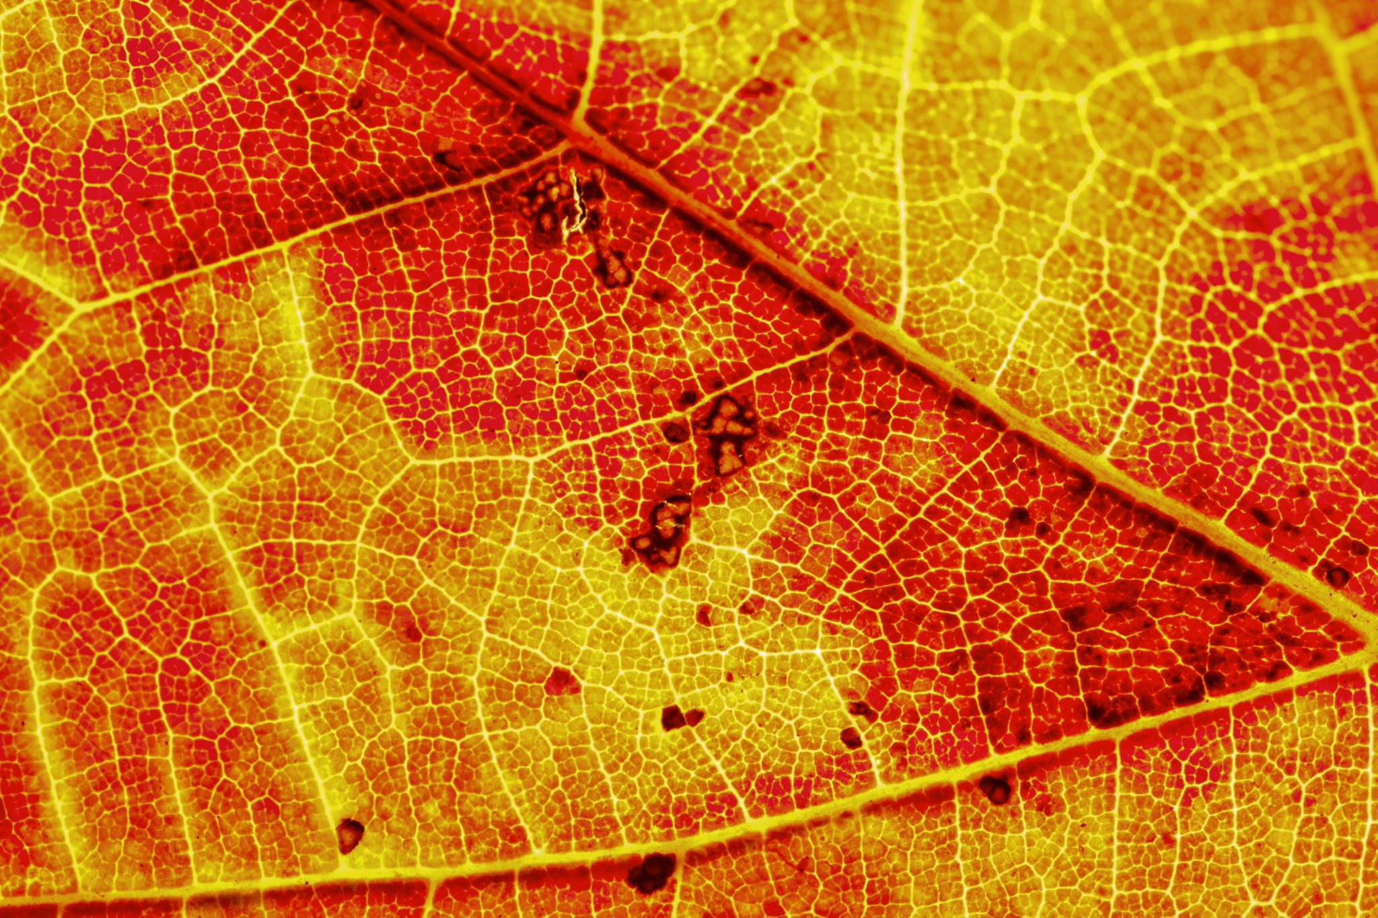
Highlights from TPG’s Research
Just as there is evidence for stress reduction by being in nature, there is similar evidence for viewing images of nature; however, instances of real nature in the built environment should be prioritized, however small.
Adding non-visual nature experiences to visual experiences creates an even stronger effect. (e.g., the babbling of water in a fountain installation)

Slide 41

Highlights from TPG’s Research
Providing variability in sensory stimulation, such as through natural ventilation or variation of light, can aid in concentration, while lack of variability can cause boredom.
The presence of water in green spaces improves mood and self-esteem.
Fractal designs with a scale of 3 reduce stress (most fractals in modern design are limited to a scale of 2) (Ryan et al., 2014).

Slide 42


Biophilia in Post-Secondary Education
The Canadian Standards Association’s “National Standard for Mental Health and Well-Being for Post Secondary Students” (2020) subclause 5.4.2.2 states that learning space considerations should include “providing spaces that highlight connections to the land and incorporating nature into interior spaces to enhance health and well-being”.
Simon Fraser University developed “Principles for Enhancing Well-being in Physical Spaces at SFU” (n.d.) which include “enhance access and connection to nature” with suggestions including patio gardens and outdoor workspaces.

Slide 43


Biophilia in Post-Secondary Education
The London School of Economics has a webpage listing all their social and green spaces, such as rooftop and terrace gardens, beehives, etc. (Social and Green Space, n.d.).

Slide 44

Studies with University Students
Benefits of micro-breaks viewing a green roof (Lee et al., 2015)
  150 university students were randomly assigned a green roof or a concrete roof to during 40-second breaks from their work
  Students were given baseline and post-break tasks to measure their sustained attention
  Those who viewed the green roof made significantly lower errors and more consistent responses
  Viewing a green roof boosts sub-cortical arousal and cortical attention control

Slide 45
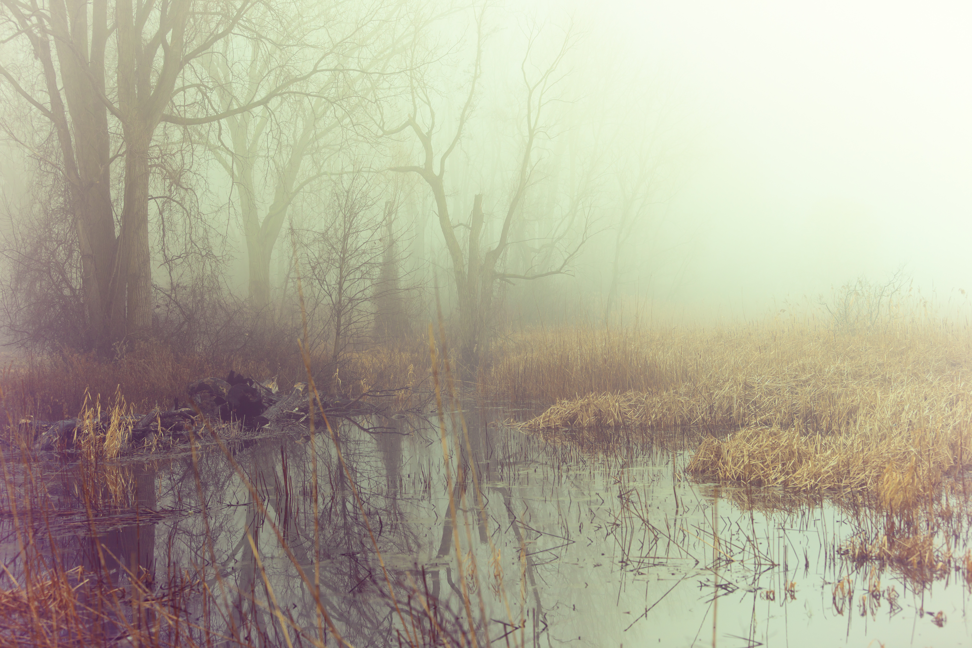
Studies with University Students
Survey on place attachment, landscape preferences, and emotional effects during the pandemic (Liu, et al., 2022)
  Results: natural elements like trees, open areas, and bodies of water are essential to emotional recovery during a pandemic.
  Experimental study to measure the psychological effects of digital forest bathing compared to actual forest bathing (Shinrin-yoku) (Takayama et al., 2022)
    Results upheld the restorative effects and showed psychological effects similar to those from real forest bathing.

Slide 46

“Green Response” to the Pandemic
Increase in backyard gardening
Increase in park use
PaRx program expanded
  Doctors prescribe free national park passes for the purposes of improving health
  Patients are prescribed 2 hours/week in outdoor settings, 20+ minutes at a time (The feel good factor, nd; PaRx, nd.; Vermes, 2021)

Slide 47
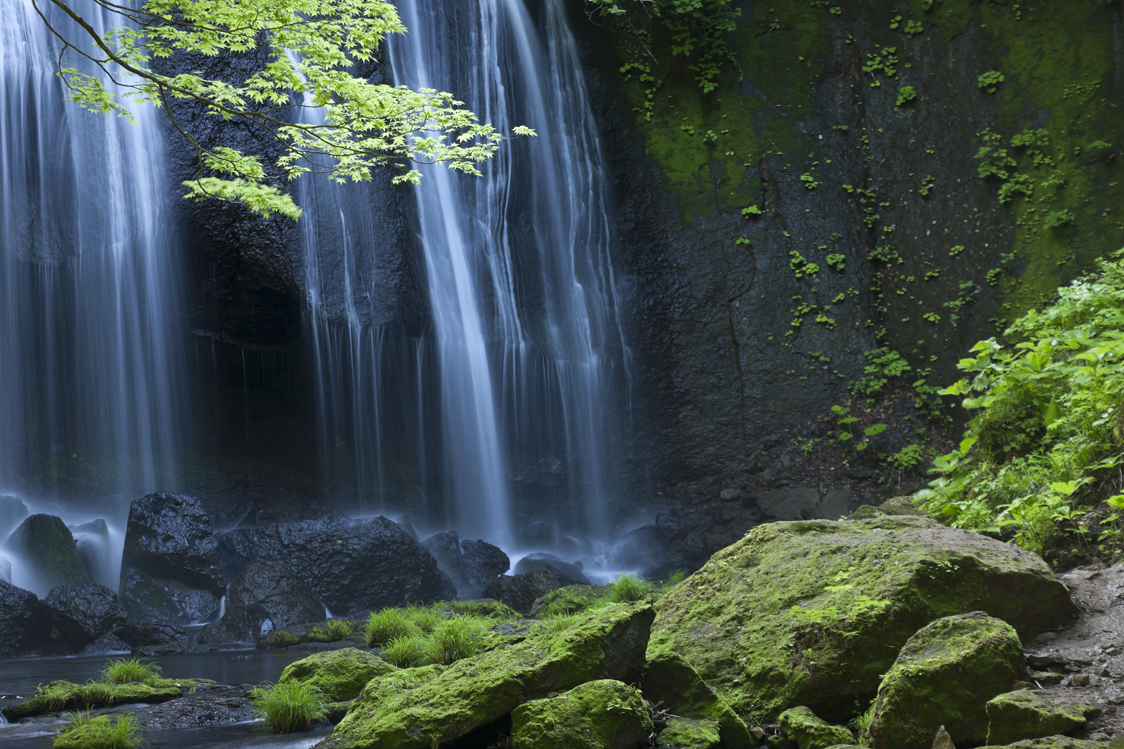
“Green Response” to the Pandemic
One study looked at restorative environments and post-traumatic growth (PTG) (Zobel et al., 2022)
  Compared the impact of the pandemic on our lives and daily behaviours to the DSM-5 definition of trauma, along with the outcomes of studies on the SARS outbreak, and proved the likelihood of Covid-19 pandemic-induced PTSD.
  Survey measured and correlated restorative qualities of the home environment and time in nature to PTG. Restorative qualities in these environments correlated to spiritual changes – a core outcome within PTG.

Slide 48
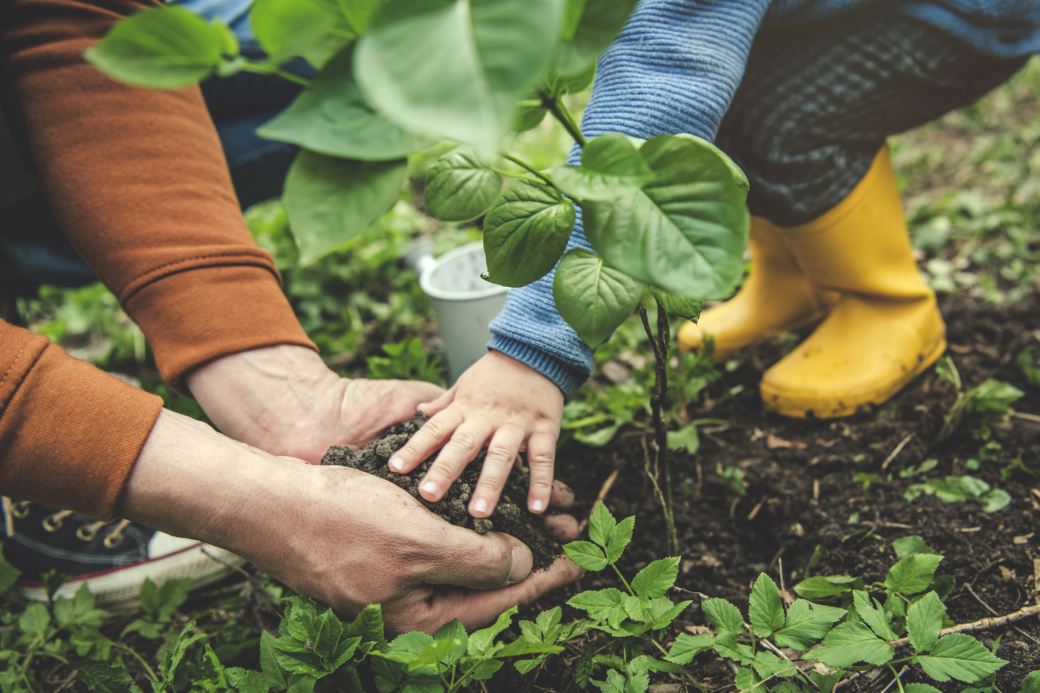
Green Responses – Tidball, 2012
  Large-scale disasters (a flu pandemic was included in the examples) remind humans of their attraction to living things, and of cultivating living things, for their ability to recover and to gather resilience.
    community gardening by veterans and widows in Bosnia
    caretaking of trees that survived in Hiroshima
    planting of flowers in WWI trenches
  Nature is used as therapy, gardening is considered horticultural therapy, and green spaces are used as restorative spaces for those dealing with trauma
  What is our “green response” when it comes to study spaces?

Slide 49
Recommendations

Slide 50
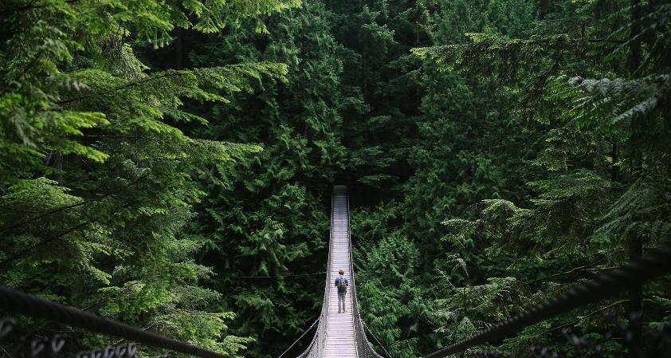

Recommendations
This is not an exhaustive list. It is intended to inspire further thoughtful considerations. Additional considerations should be given for increasing a sense of belonging, with considerations for equity, diversity, inclusion and accessibility. For convenience, I am basing the suggestions on the scenario of a Killam Library renovation.

Slide 51
Recommendations
Of the 14 biophilic design patterns, I believe the following 5 are the most important for study spaces, based on the strength of research on their effects on stress reduction, cognitive performance and mood. In order of priority, and with customized suggestions:
  Provide a visual connection with nature via an indoor garden, single potted plants or other installations such as aquariums, terrariums with amphibians, ant farms, etc. Research shows these strongly improve levels of stress, attention and happiness.
  b) Provide for prospect – Also highly impactful, a broad view allows one to survey their surrounding environment. This is already achieved with the views into the atrium; however, atrium overhangs (or balconies), a third stair (these also provide social opportunities), and any broad view to the building’s exterior would provide further effects of comfort and safety, and reduction of stress, boredom and fatigue. (Atrium overhangs would also provide for the patterns of refuge and risk.)

Slide 52
Recommendations
  c) Provide a non-visual connection with nature, particularly through the presence of a water fountain or any movement of water that creates a sound (this is two patterns in one). This would reduce stress, improve cognitive function, memory and concentration, and elevate mood.
  d) Provide places of refuge – e.g., placement of furniture in alcoves, partially enclosed cubicles, rolling white boards that can be used to create a sense of privacy/refuge where one can feel enclosed but with a view of the surroundings. Places of refuge allow users to feel safe and to concentrate better.
  e) Thermal and airflow variability can be provided through windows that open – a longstanding request from students. This improves productivity and concentration.

Slide 53
Recommendations
2) Considering the salutogenic resources:
  Comprehensibility should be examined via assessment studies – is the purpose of spaces clear, can students easily wayfind. For easy, independent wayfinding, a beacon-enabled app can be deployed to provide a self-guided tour experience, find more information on a particular space, locate available study spaces, find books in the collection, and more (see Lippincott, 2020).
  b) Manageability can be provided by giving voice to students via student library committees and conducting human-centred design studies to support natural behaviours in study spaces.

Slide 54
Recommendations
  c) Meaningfulness - the most intangible of the three resources - can be supported through staff-led or do-it-yourself mindfulness programs in makerspaces or the LINC classroom (see Coholic et al., 2020 and Recognizing and responding to the effects of trauma, 2015), green spaces that allow a user to spend time such as a meditation garden, home-like settings, and a roof garden or interior gardens. The meditation room should be more visible, findable, recognizable and inviting.

Slide 55
Recommendations
3) For disease prevention:
  foot traffic should be limited throughout the building by designing self-sustaining spaces – those that include washroom facilities and water fountains, so occupants don’t have to travel to other building locations.
  b) A to-the-desk food delivery service could also limit foot traffic.
  c) Special attention should be given to surface and furniture materials for easy cleaning and disinfection.
  d) Install automatic doors (touch-free).
  e) Increase use of hand sanitizers by placing them at eye level.

Slide 56
Recommendations
4) Green roofs, green walls, and other opportunities for students to redirect their gaze have proven attention restoration benefits.
5) The presence of plant motifs, wood and stone add further natural elements and natural analogues.
6) Natural light is repeated so much in the literature that it needs no further support. In addition to windows, light/windcatchers add to the “nature in the space” and also provide non-rhythmic sensory stimuli.
7) Offices with glass doors, open spaces with glass walls accommodate views into the rest of the building and help establish a sense of safety.

Slide 57
Recommendations
8) Displays of the human and geological history of the location of Dal campus (e.g., location of the original stream under the Killam, etc.) provide for a sense of awe.
9) Consider providing space and technology for digital forest bathing. See the Homeforest app for inspiration. (Forest Bathing Recreated at Home with Smart Devices, 2021)
10) Provide opportunities to actively engage with nature. Include onsite gardening or even bee-keeping activities, or gardening activities.

Slide 58
Recommendations
11) Enclosed outdoor areas that are extensions of the building itself with spaces to study.
12) Fabric designs and artwork that employ fractals with a scale of 3 and include nature motifs.
13) Provide trauma-informed service training for staff to both improve awareness and sensitivity to student trauma and be aware of one’s own history of trauma. This can also aid in faculty/staff – student relationship building (see Spinelli, 2021).

Slide 59
Recommendations
14) Allow for personal customization of study spaces:
Low Tech: Allow manual manipulation of lighting, lend usb desk fans and ceramic warming stones (also provides the biophilic pattern of thermal variability).
High Tech: Use Alterspace (open-source code) and tablets that allow space users to customize light and sound for their current needs. (See Alterspace, n.d.)

Slide 60
Recommendations
15) Create opportunities for social connection and opportunities of peer-to-peer support:
Low Tech: Small whiteboards at each table (individual or group) where users may indicate what assignment they are working on and if they invite social interaction (this could be by colour-coding, etc.)
High Tech: An app that uses beacon technology and learning analytics so users can identify study space locations where other users attend the same classes or are doing similar research (see Lippincott, 2020).

Slide 61
Recommendations
16) Allow student input in design and in regular responsibilities for the buildings/spaces. Devise student-run committees that report to a library representative or to Library Council (e.g., design committee, health & safety committee, standing committee for each library).
17) Provide flexible seating arrangements in all spaces and easily moveable furniture but begin by placing most seats facing out from sheltering walls and cornered to avoid direct eye contact but to also allow for conversations.
18) Provide a mix of formal and less-formal (home-like) spaces but with furniture appropriate for work (similar to “working from home” settings).

Slide 62
Recommendations
19) Provide task lights for independent choice and customization.
20) Replace the red, yellow and orange paint colours with soft hues of blue, green and purple.
21) Lend fidget toys or place them in boxes along with sanitizing spray for easy retrieval and return.
22) Provide napping rooms/alcoves.
23) Test every seat for views of exits/exit signs.

Slide 63
Recommendations
24) Accommodate response to stress & trauma as well as healing and recovery by creating alcoves or private spaces for stepping away and practicing self-care.
25) For additional social considerations, display a large map (digital/printed) in a prominent area that pins where all the students are from, and student art exhibits in the foyer and other sharing/showcasing of student creativity.

Slide 64
References
Alterspace. (n.d.). Library Innovation Lab. Retrieved May 9, 2022, from http://lil.law.harvard.edu/projects/alterspace
Anti-anxiety architecture: How do we build spaces that ease student anxiety? (2019.). Inside Out. Retrieved February 25, 2022, from https://io.education/inside-out/articles/anti-anxiety-architecture-how-do-we-build-spaces-that-ease-student-anxiety/
Baker, D., & Ellis, L. (2021). Libraries, Digital Information, and COVID: Practical Applications and Approaches to Challenge and Change. Elsevier Science & Technology. http://ebookcentral.proquest.com/lib/dal/detail.action?docID=6661528
Bollo, C., & Donofrio, A. (2021). Trauma-informed design for permanent supportive housing: four case studies from Seattle and Denver. Housing and Society (ahead-of-print), 1–22. https://doi.org/10.1080/08882746.2021.1989570
Brown, S. Did Covid Break Students’ Mental Health? (2021). The Chronicle of Higher Education. https://www.chronicle.com/article/did-covid-break-students-mental-health
Bryant, D. J., Oo, M., & Damian, A. J. (2020). The rise of adverse childhood experiences during the COVID-19 pandemic. Psychological Trauma: Theory, Research, Practice, and Policy, 12(S1), S193–S194. https://doi.org/10.1037/tra0000711
Calvano, C., Engelke, L., Di Bella, J., Kindermann, J., Renneberg, B., & Winter, S. M. (2021). Families in the COVID-19 pandemic: Parental stress, parent mental health and the occurrence of adverse childhood experiences - Results of a representative survey in Germany. European Child & Adolescent Psychiatry. https://doi.org/10.1007/s00787-021-01739-0

Slide 65
References (cont’d)
Centers for Disease Control and Prevention. (2022). About the CDC-Kaiser ACE Study. https://www.cdc.gov/violenceprevention/aces/about.html
Childhood maltreatment and the link with victimization in adulthood: Findings from the 2019 General Social Survey. (2021). Statistics Canada. https://www150.statcan.gc.ca/n1/pub/11-627-m/11-627-m2021064-eng.htm
Coholic, D., Schinke, R., Oghene, O., Dano, K., Jago, M., McAlister, H., & Grynspan, P. (2020). Arts-based interventions for youth with mental health challenges. Journal of Social Work, 20(3), 269–286. https://doi.org/10.1177/1468017319828864
Connaway, L.S., Faniel, I.M., Brannon, B., Doyle, B., & Lavoie, B. (2022). Guest Post—What’s Your Vision for a New Model Library? The Scholarly Kitchen. https://scholarlykitchen.sspnet.org/2022/01/05/guest-post-whats-your-vision-for-a-new-model-library/
COVID-19 Response Team. (n.d.). Society for Research on Adolescence. Retrieved February 23, 2022, from https://www.s-r-a.org/covid-19-response-team
Empathy in Architecture: Using Trauma-Informed Design to Promote Healing. (2020). E4H. https://e4harchitecture.com/empathy-in-architecture-using-trauma-informed-design-to-promote-healing/

Slide 66
References (cont’d)
Farrell, J. (2014). Trauma informed design: How the physical environment supports recovery from homelessness. https://cotsonline.org/wp-content/uploads/2018/04/Trauma-Informed-Design.BOD_.pdf
Grant, T. (2021). Creating and Supporting Trauma Informed Environments. (Slideshow for inhouse course, Dalhousie University, December 2021).
Hussong, A. M., Benner, A. D., Erdem, G., Lansford, J. E., Makila, L. M., & Petrie, R. C. (2021). Adolescence amid a pandemic: Short‐ and long‐term implications. Journal of Research on Adolescence, 31(3), 820–835. https://doi.org/10.1111/jora.12671
Kahn, P.H. Jr. (2011). Technological nature: Adaptation and the future of human life. The MIT Press. http://ezproxy.library.dal.ca/login?url=https://search.ebscohost.com/login.aspx?direct=true&db=e000xna&AN=359965&site=ehost-live
Kaplan, S. (1995). The restorative benefits of nature: Toward an integrative framework. Journal of Environmental Psychology, 15(3), 169–182. https://doi.org/10.1016/0272-4944(95)90001-2
Lee, K. E., Williams, K. J. H., Sargent, L. D., Williams, N. S. G., & Johnson, K. A. (2015). 40-second green roof views sustain attention: The role of micro-breaks in attention restoration. Journal of Environmental Psychology, 42, 182–189. https://doi.org/10.1016/j.jenvp.2015.04.003

Slide 67
References (cont’d)
Leuzinger-Bohleber, M., & Montigny, N. (2021). The pandemic as a developmental risk. International Journal of Applied Psychoanalytic Studies, 18(2), 121–132. https://doi.org/10.1002/aps.1706
Lippincott, S. (2020). Mapping the Current Landscape of Research Library Engagement with Emerging Technologies in Research and Learning: Building and Managing Learning and Collaboration Spaces. https://www.arl.org/wp-content/uploads/2020/11/2020.11.12-emerging-technologies-building-managing-learning-collaboration-spaces.pdf
Liu, S., Ji, Y., Li, J., Peng, Y., Li, Z., Lai, W., & Feng, T. (2022). Analysis of students’ positive emotion in green campus during COVID-19 pandemic in China [Preprint]. https://doi.org/10.21203/rs.3.rs-1330932/v1
Maslow, A. H. (1943). A theory of human motivation. Psychological Review, 50(4), 370–396. https://doi.org/10.1037/h0054346
McConachie, L., Bergsagel, V., & Bharatkumar, D. (2022). Trauma-Informed Design Workbook. (Version 3.1). Bassetti Architects. https://static1.squarespace.com/static/5e5d2de082e3c20bed5c2a9d/t/622261f4a9fc06382cc9629e/1646420509200/Trauma+Informed+Design+Workbook+V3.1.pdf
National standard for mental health and well-being for post-secondary students. (2020). Mental Health Commission of Canada. Retrieved March 14, 2022, from https://mentalhealthcommission.ca/studentstandard/

Slide 68
References (cont’d)
Nguyen, L. H. (2021). Calculating the impact of COVID-19 pandemic on child abuse and neglect in the U.S. Child Abuse & Neglect, 118, 105136. https://doi.org/10.1016/j.chiabu.2021.105136
PaRx: A prescription for nature. (n.d.). Retrieved April 28, 2022, from https://www.parkprescriptions.ca/
Perks, B., & Cluver, L. D. (2020). The parenting ‘vaccine.’ Nature Human Behaviour, 4(10), 985. http://dx.doi.org/10.1038/s41562-020-0932-8
Pinter-Wollman, N., Jelic, A., & Wells, N. M. (2018). The impact of the built environment on health behaviours and disease transmission in social systems. Philosophical Transactions: Biological Sciences, 373(1753), 1–18. http://doi.org/10.1098/rstb.2017.0245
Principles for enhancing well-being through physical spaces at SFU. (n.d.) SFU Health Promotion. Retrieved May 11, 2022, from https://www.sfu.ca/content/dam/sfu/healthycampuscommunity/Physical_Spaces/Principles%20and%20Guidelines%20for%20Enhancing%20Wellbeing%20through%20Physical%20Spaces.pdf
Ravens-Sieberer, U., Kaman, A., Otto, C., Adedeji, A., Devine, J., Erhart, M., Napp, A.-K., Becker, M., Blanck-Stellmacher, C., Löffler, R., & Schlack, K. (2020). Mental Health and Quality of Life in Children and Adolescents During the COVID-19 Pandemic-Results of the Copsy Study. Deutsches Ärzteblatt International., 117(48), 828–829. https://doi.org/10.3238/arztebl.2020.0828

Slide 69
References (cont’d)
Recognizing and responding to the effects of trauma: A discussion guide for health and social service providers. (2015) Nova Scotia Department of Health and Wellness. https://novascotia.ca/dhw/addictions/documents/TIP_Discussion_Guide_2.pdf
Ryan, C. O., Browning, W. D., Clancy, J. O., Andrews, S. L., & Kallianpurkar, N. B. (2014). Biophilic Design Patterns: Emerging Nature-Based Parameters for Health and Well-Being in the Built Environment. International Journal of Architectural Research: ArchNet-IJAR, 8(2), 62. https://doi.org/10.26687/archnet-ijar.v8i2.436
Sacks, V., & Murphey, D. (2018). The prevalence of adverse childhood experiences, nationally, by state, and by race/ethnicity. Child Trends. Retrieved May 11, 2022, from https://www.childtrends.org/publications/prevalence-adverse-childhood-experiences-nationally-state-race-ethnicity
Schoon, I., & Mortimer, J. (2017). Youth and the Great Recession: Are values, achievement orientation and outlook to the future affected? International Journal of Psychology, 52(1), 1–8. https://doi.org/10.1002/ijop.12400
Sens, T., & Moll, K. (2021). University library research results: What you don’t know might hurt you. University Business. https://universitybusiness.com/university-library-research-results-what-you-dont-know-might-hurt-you/
Social and green space. (n.d.). The London School of Economics and Political Science. Retrieved March 25, 2022, from https://info.lse.ac.uk/current-students/estates-division/facilities-guide/social-and-green-space

Slide 70
References (cont’d)
Spinelli, M., Lionetti, F., Setti, A., & Fasolo, M. (2021). Parenting stress during the COVID-19 outbreak: Socioeconomic and environmental risk factors and implications for children emotion regulation. Family Process, 60(2), 639–653. https://doi.org/10.1111/famp.12601
Sprang, G., & Silman, M. (2013). Posttraumatic stress disorder in parents and youth after health-related disasters. Disaster Medicine and Public Health Preparedness, 7(1), 105–110. https://doi.org/10.1017/dmp.2013.22
Substance Abuse and Mental Health Services Administration. (2014). SAMHSA’s Concept of Trauma and Guidance for a Trauma-Informed Approach. https://ncsacw.acf.hhs.gov/userfiles/files/SAMHSA_Trauma.pdf
Takayama, N., Morikawa, T., Koga, K., Miyazaki, Y., Harada, K., Fukumoto, K., & Tsujiki, Y. (2022). Exploring the physiological and psychological effects of digital Shinrin-Yoku and its characteristics as a restorative environment. International Journal of Environmental Research and Public Health, 19(3), 1202. https://doi.org/10.3390/ijerph19031202
Terrapin Bright Green. (2014). 14 Patterns of Biophilic Design. http://www.terrapinbrightgreen.com/reports/14-patterns-of-biophilic-design/
Tidball, K. G. (2012). Urgent biophilia: Human-nature interactions and biological attractions in disaster resilience. Ecology and Society, 17(2). https://www.jstor.org/stable/26269048

Slide 71
References (cont’d)
Trauma-informed approaches: An introduction and discussion guide for health and social service providers. (2015) Nova Scotia Department of Health and Wellness. https://novascotia.ca/dhw/addictions/documents/TIP_Discussion_Guide_1.pdf
Vermes, J. (2021). Prescribing nature: Research suggests the outdoors are good for your mental health. CBC Radio. https://www.cbc.ca/radio/thecurrent/the-current-for-sept-6-2021-1.6163980/prescribing-nature-research-suggests-the-outdoors-are-good-for-your-mental-health-1.6163985
Whitmer, S. (2021). Inclusive campus environments: An untapped resource for fostering learner success. Current Issues in Education, 22(1 (Sp Iss)). https://cie.asu.edu/ojs/index.php/cieatasu/article/view/1902
Wilson, E. O. (1984). Biophilia. Harvard University Press. http://ezproxy.library.dal.ca/login?url=https://search.ebscohost.com/login.aspx?direct=true&db=e000xna&AN=282598&site=ehost-live
World Health Organization. (n.d.). Adolescent health. Retrieved April 11, 2022, from https://www.who.int/health-topics/adolescent-health
Zobel, S. B., Rogier, G., Parolin, L., & Velotti, P. (2022). Enhancing post traumatic growth during the COVID-19 lockdown: The roles of nature relatedness and perceived restorativeness [Preprint]. https://doi.org/10.21203/rs.3.rs-1250637/v1

Slide 72

Thank you
Linda Bedwell
Coordinator of Assessment
Dal Libraries
October 2022

