Slide 1
Creative Commons: What, Where, Why, & How?
Roger Gillis
Except where otherwise indicated, this work is licensed under a Creative Commons Attribution-NonCommercial-ShareAlike 4.0 International License.
Notes:
Hi everyone, and welcome to “Introduction to Creative Commons Licenses” as part of the Dalhousie Libraries Scholarship Series – thank you for joining me today and allowing me to talk to you about Creative Commons Licenses

Slide 2

Introduction
Roger Gillis
  Copyright and Digital Humanities Librarian
  Dalhousie Libraries Copyright Office
  copyright.office@dal.ca
Photo by Sebaastian Ter Burg. Licensed under CC-BY
https://libraries.dal.ca/copyright
Notes:
About me:
So, as I mentioned my name is Roger Gillis and I'm a librarian here at the Dalhousie libraries and a as part of my role, I advise the campus community on copyright-related issues. I work out of the Copyright Office which is based in the Dalhousie Libraries,. The copyright office advises the campus community on a wide variety of topics related to copyright ranging from: using material in the classroom to fair dealing, using licensed materials from our databases, showing films in class and on campus, as well as questions about copyright. I’m also part of the Creative Commons Global Network and the Creative Commons Canada Chapter and have been a little involved with Creative Commons over the past few years, which is the global non-profit organization that oversees the Creative Commons licenses.
One of the topics that we are hearing about more and more in the Copyright office is open licenses, and in particular Creative Commons licenses, so, I thought this would be a good topic to talk about as part of this webinar series that we’re doing. Before we begin though, as we do with most of our presentations from the Copyright Office, I’d like to preface my talk by saying what I share as part of this presentation is not to be taken as legal advice.

Slide 3
Agenda
Copyright and Creative Commons
Copyright and user exceptions
The Elements of Creative Commons
Creative Commons Public Domain Tools
How Creative Commons licenses work
Finding Creative Commons licenses works
Considerations for using CC licenses
Notes:
So, in terms of what I cover today, this session is intended as an introduction to Creative Commons licensing, and to give you a sense of what it is exactly, what is involved in Creative Commons licenses, and what the considerations are when adopting Creative Commons licenses as an approach, as well as how you can go about finding and using works that are licensed under Creative Commons licenses. So, here is what I intend to cover today: (read agenda)

Slide 4
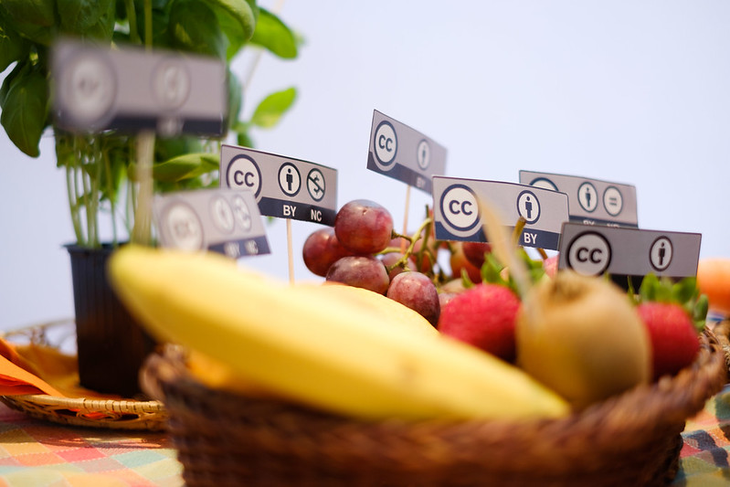
What is Creative Commons?
“A bowl of fruit” Photograph by Sebastiaan Ter Burg. Licensed CC-BY.
Notes:
So, starting off: what is Creative Commons exactly? You may have heard about it before, or have seen it on the footer of a webpage or in the cover page of a document where the copyright information for a work can often be found.

Slide 5

Notes:
Most of us are familiar with this symbol:
Copyright, which is used to indicate that something is protected by copyright. Copyright protection is actually automatic from when something is “fixed” so it’s written down or recorded in some way. And copyright gives the rights for copyright holders to exclusive rights to use, distribute, adapt, perform, or otherwise use creative works, which could be anything from books, photographs, written works, or software.

Slide 6
All rights reserved.
Notes:
Often times, accompanying the Copyright symbol, we see this phrase: “All rights reserved”, which entails that the copyright holder reserves the rights that fall under copyright, which includes the right to make copies and distribute the particular work, whether that be an article, an image, or some other type of work that’s protected by copyright.

Slide 7

Notes:
Enter Creative Commons: Often noted by this CC symbol – the two Cs rather than just the one, which takes us beyond what can be done by Copyright, but still works within the framework of Copyright.

Slide 8
All Some rights reserved.
Notes:
Creative Commons licenses offer an alterative to the all rights reserved model by being “Some rights reserved” rather than “All rights reserved” – I want to explain further about what that means.

Slide 9


Copyright exceptions/user rights
There are a number of exceptions and limitations under Copyright Law that allow users to use copyright-protected works without payment or permission (e.g. fair dealing)
Sometimes, these exceptions apply to any individual. In other situations these apply to individuals in certain institutional settings like research, education, journalism, and cultural heritage (e.g. Libraries, Archives, and Museums)
Notes:
One thing that’s worth noting, before we dive deeper into Creative Commons, is that there are a number of different exceptions under copyright law that allow us to use copyright protected works, or portions of works without getting the permission of copyright owners, or paying them. One of these key copyright exceptions is such as fair dealing, which is a big one that we rely on here in the educational sector, which allows users to say copy a book chapter or an article and distribute it to a class.
Some of these exceptions apply to certain settings like in a research, educational environment, in journalism, as well as exceptions for cultural heritage organizations that allow organizations like Libraries and Archives to use copyright protected works without payment or permission for certain purposes, such as document delivery, preservation, and other functions key to the operation of these organizations.

Slide 10
Exceptions are great, but
wouldn’t it be great if we just
had permission to use
copyright-protected works?
Notes:
So, having exceptions that we can use like fair dealing are great, because we can use copyright-protected works in certain settings, such as sharing an article through Brightspace, or having a handout in a class. But sometimes, these scenarios don’t apply, and we can’t use all types of works, and it is necessary to seek the permission of the copyright owner to use a work.

Slide 11
With Creative Commons – you do.
Notes:
With resources that have a Creative Commons license attached to them – you do have permission out of the gate to use a particular resource.

Slide 12
But subject to some conditions
Notes:
However, it’s important to note that Creative Commons licensed material have different conditions, based on the license chosen. And I’m going to get into a bit more of what that entails in just a moment.

Slide 13


Licenses
Licenses are essentially permissions to use copyright-protected work(s), subject to different conditions
Sometimes these take the form of are restrictive, complex, legal agreements such as Terms of Use or End User License Agreements (EULA).
Other times, these are licenses that allow the free use of works, such as Creative Commons Licenses.
Notes:
I think it’s important to say something a bit more broadly about licenses in general. Essentially, a license, in the copyright world is permission – permission to do something with work or works, and subject to certain conditions.
Often, online, and with certain software products, we must be accustomed to seeing a long stream of text, such as a Terms of use, or End User License agreement – spelling out, in complex terms what users are and are not permitted to do with the works that they are access.
For Creative Commons licenses, that long complex and legal agreement exists – and I’ll get into that in a little bit when I talk about the legal deed in licenses, but Creative Commons licenses express, in more easy-to-understand terms, how works can be used, and what types of usage that the copyright owner or creator is authorizing for the particular work.

Slide 14




Elements of Creative Commons Licenses
Notes:
Creative Commons has four handy symbols that you need to know in order to identify what kind of license a work has. Each symbol indicates the a different condition for re-use. And, I want to walk you through each one individually.

Slide 15
CC-BY (Attribution)
Requires that you credit or attribute the original creator/copyright owner
A part of all of the 6 Creative Commons licenses
A way to show gratitude and give credit to the creator
Notes:
First, the little person or “BY” “By” indicates attribution. That is, if you want to use this work, you need to credit the original author or creator. What this symbol is saying “You can use this in any way you want – you could rework it, include it as part of another work – whatever -- but you have to say it’s ‘by’ me!” All CC licenses have the “By” condition. And, that’s a big emphasis in Creative Commons is placed on gratitude and giving credit or thanks to the creator of a given work.

Slide 16
Non-Commercial (NC)
Works can only be used for a non-commercial purpose
Based on the use and not the user
Notes:
This is NC or Non-commercial indicated by a crossed out dollar sign. This symbol indicates that the work can only be used for a non-commercial purpose. That means that permission has to be sought for the work to be used for a commercial purpose, such as being sold as a part of a product.
It’s important to keep in mind that this restriction is about the use, not the user. For example, a big for-profit corporation can use a Creative Commons Licensed work with the non-commercial condition in training materials for their employees, but not to sell it as part their products. Generally speaking, something that has a Creative Commons license with the NC condition cannot be sold – or included as a part of something that is sold, unless the permission of the copyright owner is obtained.

Slide 17
No-Derivatives
Cannot create an adaptation or derivative work (without permission)
Small changes (e.g. format shifting, or minor changes) – that do not alter the nature of the work, are acceptable.
Notes:
This equals symbol means “no derivatives.” It’s saying “if you share your version, your version must equal mine.” A user can also take a work licensed with the No-Derivatives condition and use it as a piece of a collection of works, as long as the licensed work itself is unaltered. It’s worth noting that, CC licenses grant permission to use the licensed material in any media or format regardless of the format in which it has been made available . Small changes such as minor cropping, or format shifting – things that don’t alter the nature of the original work, would be acceptable.

Slide 18
Share-Alike
Any derivative work or adaptation needs to be ”Shared-alike”
In the creation of a new work that incorporates a Share-Alike work, a similar license or more liberal license (e.g. CC-BY) needs to be used.
Notes:
The last possible condition is the ShareAlike condition. This is the condition that says, “If you want to share something you built using my work with others, you have to share it with the same license or a compatible license.” This shows that the user wants the work to stay openly licensed in some way. Essentially, the copyright owner is expressing a desire that the work remain openly licensed and shared in the manner in which it was shared – with an open license.
If you remix, transform, adapt or build upon the material in some fashion, you must distribute your contributions under the same license as the original.
Going along with this, and this would apply to other licenses as well, is that you can’t apply additional legal restrictions that go beyond the license that would restrict users from doing anything that the license would allow for – such as prohibiting copying and pasting, or another type of technological measure.

Slide 19
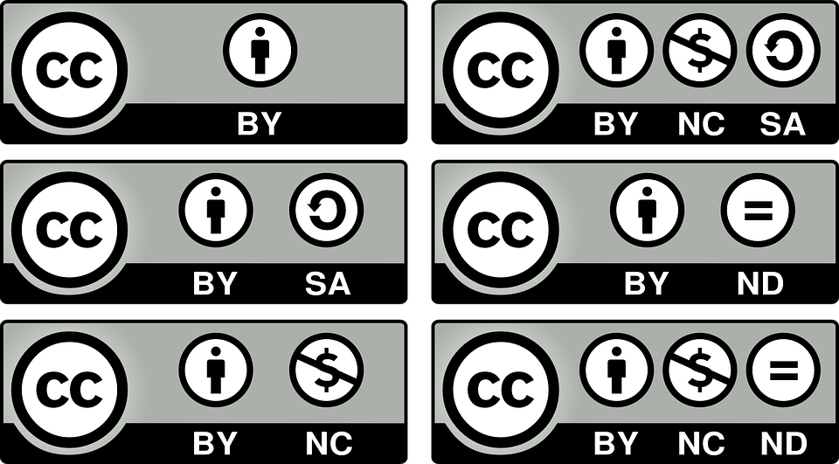
The Creative Commons Licenses
Notes:
All of these particular elements can then be combined to create the six different Creative Commons licenses. So, as you can see they all have the creative commons symbol in the left corner, followed by a series of other symbols, each representing the conditions we just talked about.

Slide 20
CC-BY License
Just one condition:
Attribution
Notes:
This is a CC-By License, it has just one condition: Attribution. Again – giving credit to the creator and/or owner of the resource being used.

Slide 21
CC-BY Attribution ShareAlike License
Two conditions:
  Attribution
  Share-Alike
Notes:
This is CC-BY-Share-Alike. It has two conditions: Attribution - You must Credit me - and ShareAlike - If you share, you must use the same or a compatible license. So, you can start to see how the different elements can be combined for the license.

Slide 22
CC-BY Non-Commercial
Two conditions:
Attribution
Non-commercial use
Notes:
Next, there is s CC-BY-NC, which again has the attribution condition, as well as the non-commercial condition - use this, but only for non-commercial purposes

Slide 23
CC-BY-ND
2 conditions:
Attribution
No-Derivative works
Notes:
And this is our last license with only two conditions: CC-BY-ND. This license still requires attribution, but it says that if you share, your version must equal the original.

Slide 24
Licenses with 3 conditions
CC-BY-NC-SA:
Attribution
Non-Commercial
Share-Alike
CC-BY-NC-ND:
Attribution
Non-Commercial
No-Derivatives
Notes:
There are two licenses that have three conditions: CC-BY-NC-SA and CC-BY- NC-ND. They both have the attribution condition “You must credit me” and the noncommercial condition “You can use this, but only for noncommercial purposes.” CC-BY-NC-SA also has the share-alike condition, “you must share any adaptations of this work with the same or a compatible license” whereas the bottom license, CC-BY-NC-ND has the no derivatives condition “your that you create work must equal mine.”
You’ll note here that there are no licenses with all four conditions because ShareAlike and No Derivatives are incompatible. No derivatives means no one can share adaptations of the work, whereas the sharealike condition only applies when a user is sharing an adaptation of a work - so they do not Gel together.

Slide 25
Recap
Four symbols (four possible conditions)
Six Creative Commons Licenses
Notes:
So, to recap: there are the 4 symbols that indicate each of the conditions of the license, and in total there are the six CC licenses that these symbols are used in.

Slide 26

The Public Domain
CC licenses only apply to works that are in copyright
Public domain = works that are out-of-copyright
  Copyright is waived
  Copyright has expired
Determining Public Domain status can be tricky
    Varies from country-to-country
    Rule in Canada is author’s life + 50 years
Canadian Public Domain Flowchart (University of Alberta)
Notes:
Creative Commons licenses apply to works that are in copyright – they should not apply to works that are in the Public Domain. For works that are not in copyright, there are other tools that Creative Commons offers.
The Public Domain refers to works in which copyright no longer exists. Works that are in the Public Domain can be used freely by anyone without any condition – not even attribution is required (although it’s always good to cite your sources). Works are in the Public Domain, typically for two main reasons: because the copyright has expired, or the work was deliberately placed in the public domain by the creator or copyright owner.
Determining works to be in the Public Domain can be tricky, and there are different rules under different countries’ copyright laws. In Canada, generally speaking the rule is that works enter the public domain 50 years after the death of the creator – there are some exceptions for certain types of works. The Public Domain Flowchart from the University of Alberta is a great resource for helping in determining public domain status in the Canadian context.

Slide 27

Public Domain Mark
Typically used for older works, believed to be in the Public Domain.
Mostly used by Cultural Heritage institutions (e.g. Archives, Museums, Libraries)
Not a license. An indicator that a work is believed to be in the Public Domain.
Public domain mark FAQ
Notes:
Using the Public Domain Mark, is a way of letting users use with old works, such as cultural heritage works - that are free of copyright restrictions around the world, or works that have been affirmatively placed in the worldwide public domain prior to the expiration of copyright by the rights’ holder. It should not be used to mark works that are in the public domain in some jurisdictions while known to be restricted by copyright know that a work is likely to be in the public domain.
It’s important to note that the Public Domain Mark is not a license – unlike the other Creative Commons licenses – rather it is an indicator that an item is believed to be in the public domain in all jurisdictions.
I don’t want to dwell too much on the Public Domain Mark, because it’s arguably one of the most complex tools of the Creative Commons tools out there, but, if you’re interested in more in-depth information on the Public Domain Mark, here is a a link to the FAQ for the Public Domain Mark.

Slide 28

CC Zero
Used to indicate when a work is deliberately dedicated to the Public Domain
Creators using CC0 waive any rights under copyright
Unlike CC licenses users are not required to adhere to any conditions or provide attribution (although it is considered good practice to do so)
CC0 FAQ
Notes:
The Creative Commons Zero waiver, indicated by the zero icon (and often accompanied by an indication that it is in the public domain) is a tool that can be used by copyright holders in which they are the holder of copyright or database rights and choose waive all your interests, if any, to a work worldwide. This may be the case, for example, if you are reproducing an underlying work that is in the public domain and want to communicate that you claim no copyright in your digital copy where copyright law may grant protection, or in a lot of cases it is used by creators to specifically place certain works in the Public Domain.
Again, this is different than a Creative Commons license – it is a waiver – that empowers yet another choice altogether – the choice to opt out of copyright and protection, and the exclusive rights automatically granted to creators through copyright – this is on the far end of the spectrum the “no rights reserved” as opposed to the “Some rights reserved” of the main Creative Commons licenses.
So, with something that is assigned a CC0 waiver – anything goes. The user doesn’t have to attribute or adhere to any conditions when using works that have the CC0 waiver – although users are still free to provide attribution – it’s just not required.
And, similar to the Public Domain Mark, there is an in-depth FAQ on CC0 on the Creative Commons wiki: https://creativecommons.org/share-your-work/public-domain/cc0/

Slide 29
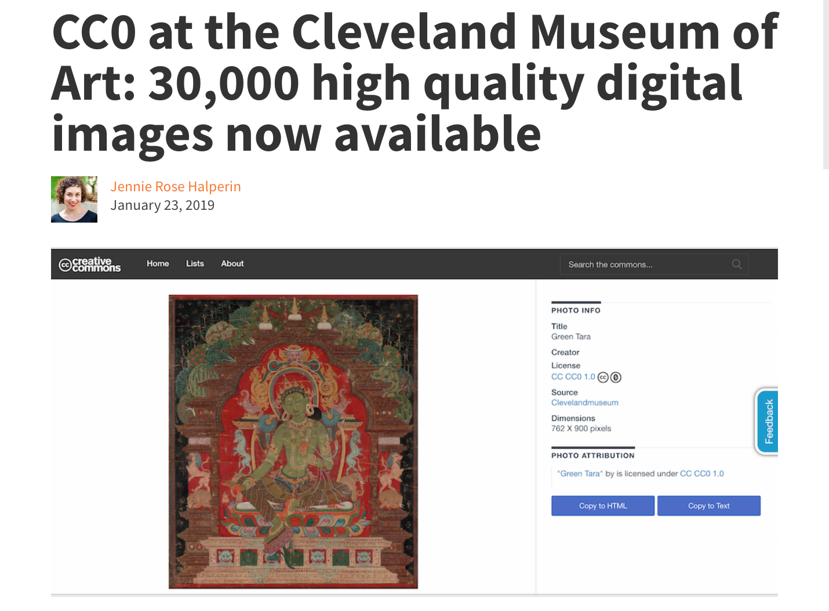
Cleveland Museum of Art: CC0 waiver
Source: Screenshot of https://creativecommons.org/2019/01/23/cleveland-museum/.CC-BY
Notes:
Here’s an example of a cultural heritage organization – the Cleveland Museum of Art who recently used CC0 with it’s art collections that it is digitized and placed online. This was a way of the museum placing the collection in the Public Domain worldwide and open it up freely for anybody to use.

Slide 30
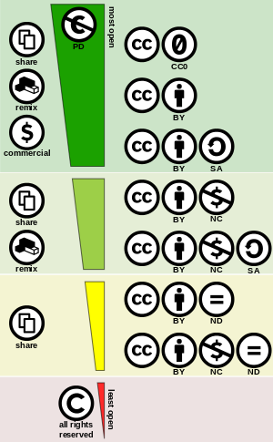
Creative Commons Spectrum.Creative Commons. Licensed under CC-BY 4.0
Notes:
So, this chart gives you an idea of the spectrum of the different licenses going from the least restrictive – Public Domain tools – the In between – the CC licenses, right up to the All rights reserved model, which is the default that exists within Copyright.

Slide 31
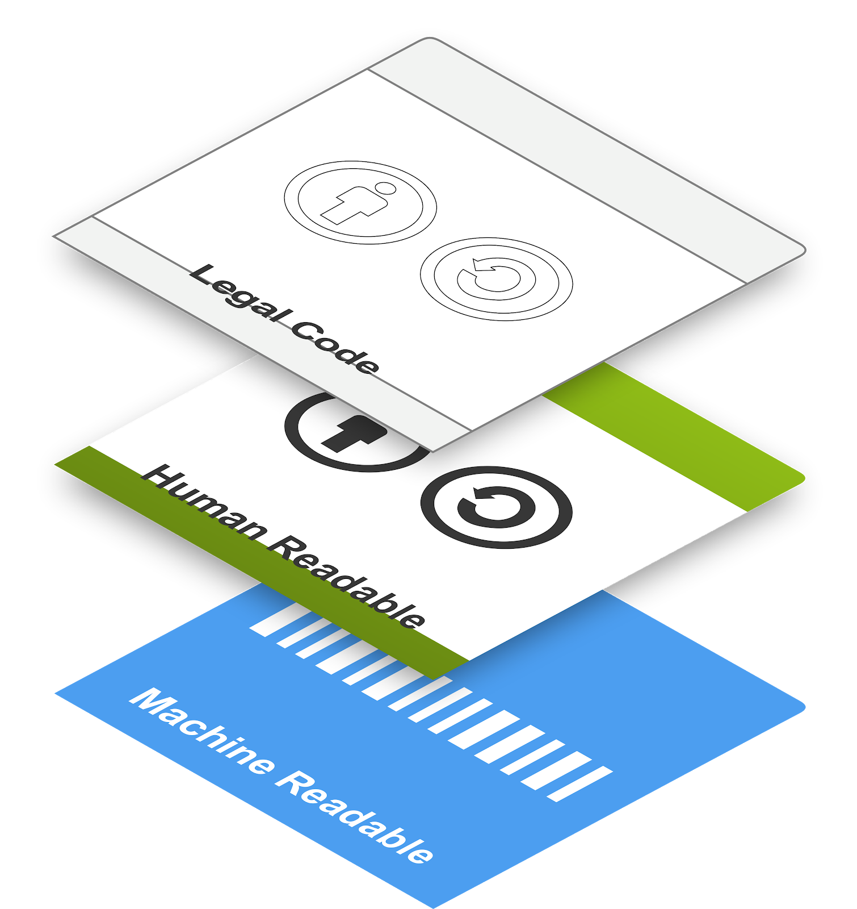
Layers of Creative Commons
Notes:
To give you a sense of how CC licenses work, and what advantages they offer, I wanted to introduce you to the 3 different layers of CC licenses.
Creative Commons licenses, consist of three layers: the legal code, a human readable deed, and machine readable layer. The legal code, which contains the full legal terms and conditions, that can be read in full online (and in multiple languages). The commons deed, which includes the license terms as a plain language summary (again, in multiple languages). And, then lastly, the machine readable layer, which allows for the license metadata to be identified and processed by search engines and relevant web technologies, such as search engines, in order that they can identify the rights information associated with the digital object through search engines and other indexing tools.

Slide 32
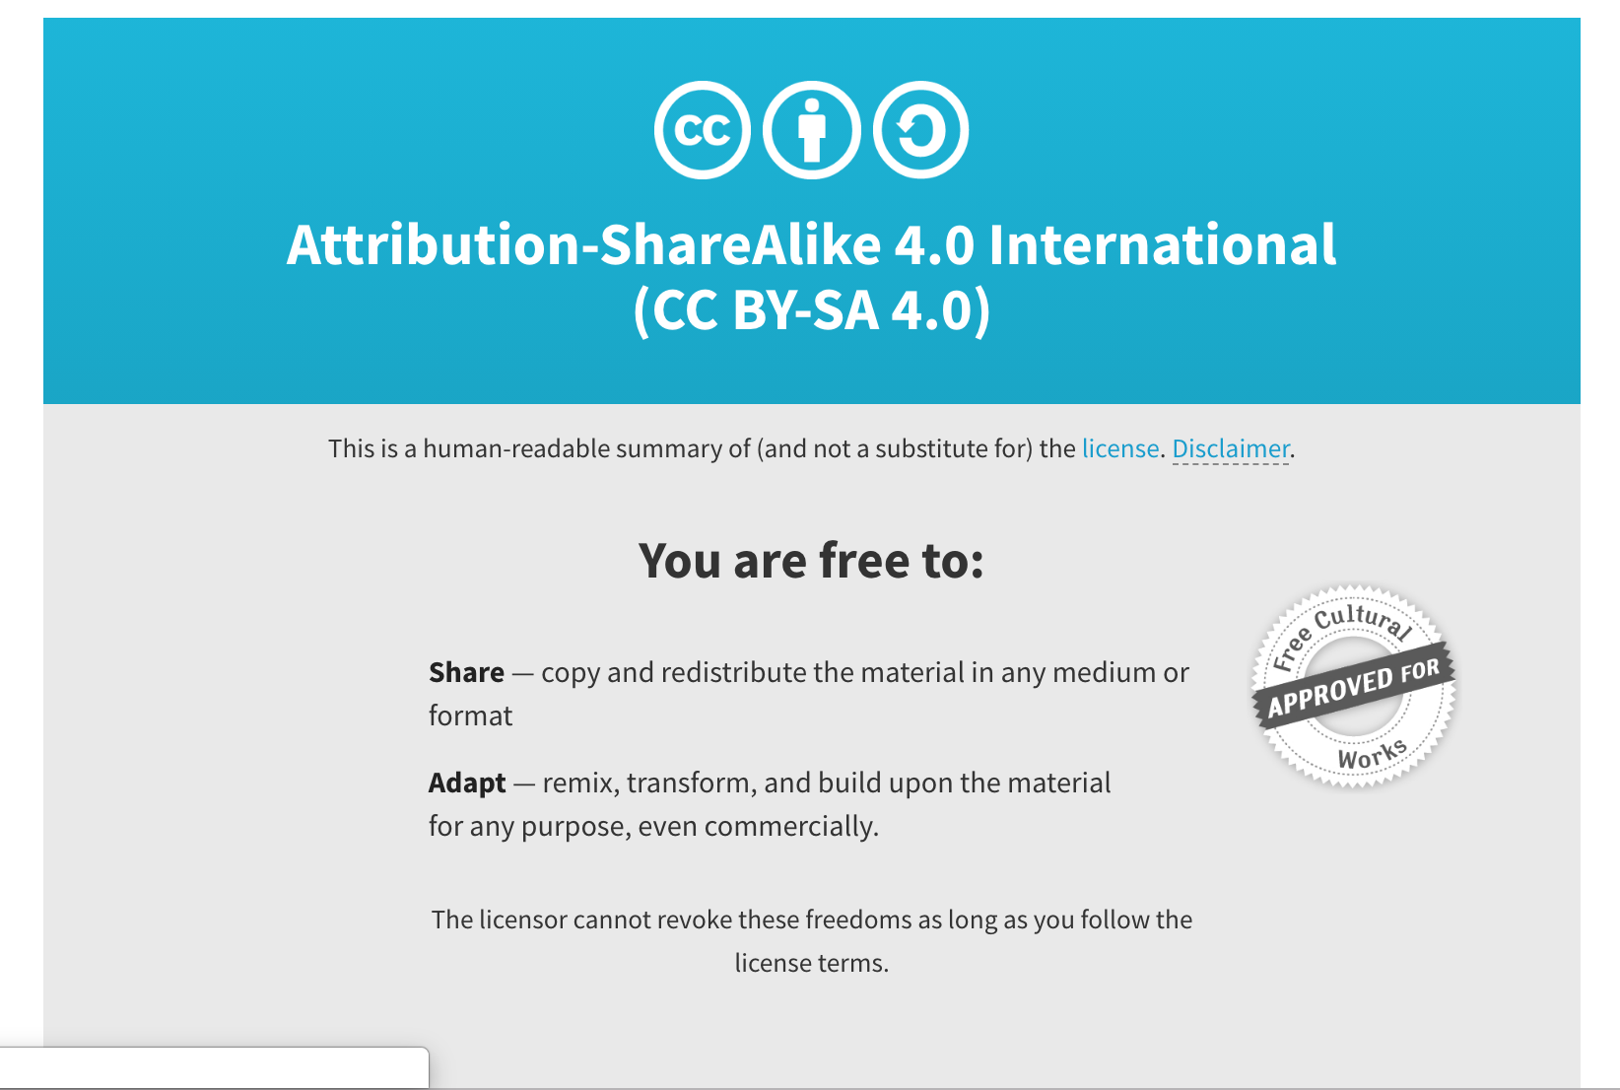
Human-readable (Commons Deed)
https://creativecommons.org/licenses/by-sa/4.0/
Notes:
The first layer is the human-readable layer. This is a plain language summary of each of all of the terms of the license. These are not legally enforceable, but they make it easy for folks to get a sound summary of the terms of the license.
https://creativecommons.org/licenses/by-sa/4.0/

Slide 33
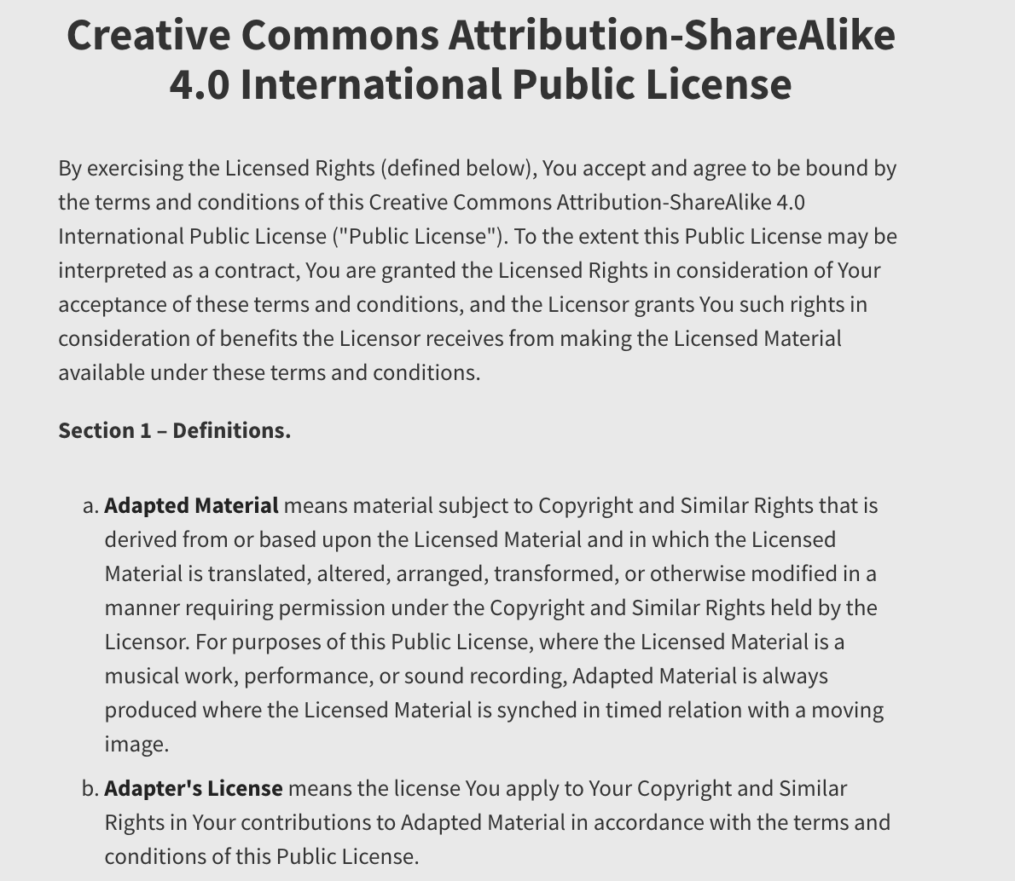
Legal deed
Source: https://creativecommons.org/licenses/by-sa/4.0/legalcode
Notes:
The second layer is linked to in the human-readable deed, and contains a detailed legal-ese explanation of the license. This is where the legally-enforceable terms and conditions are. This legal code is sound and designed to work within copyright law internationally. This is where the detailed version of the license exists that has been vetted by lawyers. For example this is a , and this is what makes it trustworthy.
https://creativecommons.org/licenses/by-sa/4.0/legalcode
\

Slide 34
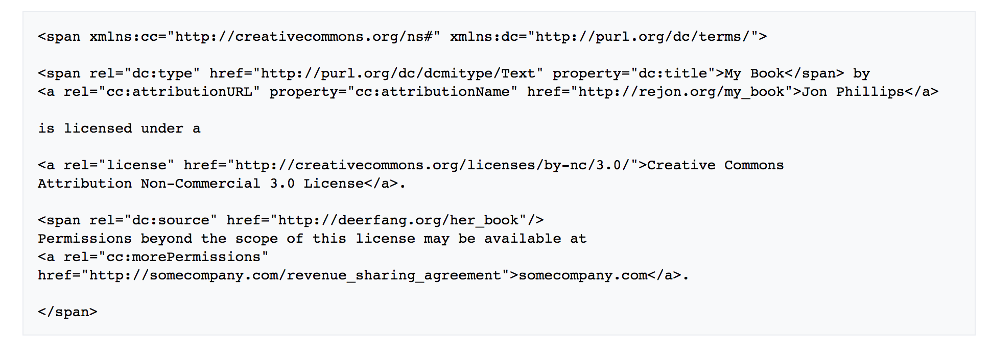
Machine-Readable
Screenshot: Creative Commons Rights Expression Language. Source: https://wiki.creativecommons.org/wiki/CC_REL
Notes:
Source: https://wiki.creativecommons.org/wiki/CC_REL
I don’t want to get too much into technical details, but I wanted to point out that Creative Commons licenses can be embedded into webpage and software code in order that it can be interpreted by Search engines and web pages to allow for these platforms to recognize materials that have open licensed resources.
Through this layer, in order to make it easy for websites and web services to know when a work is available under a Creative Commons license, Creative Commons provides a “machine readable” version of the license—a summary of the key freedoms granted and obligations imposed written into a format that applications, search engines, and other kinds of technology can understand. This includes a standardized way to describe licenses that software can understand called CC Rights Expression Language When this metadata is attached to CC licensed works, someone searching for a CC licensed work using a search engine (e.g., Google advanced search) can more easily discover CC licensed works. This is a key advantage of using CC licenses over say just putting terms of use and conditions on a website – using CC licenses lets search engines and other discovery tools know that a work is available under a Creative Commons licensed, which can improve the discoverability of the work or works being licensed.

Slide 35
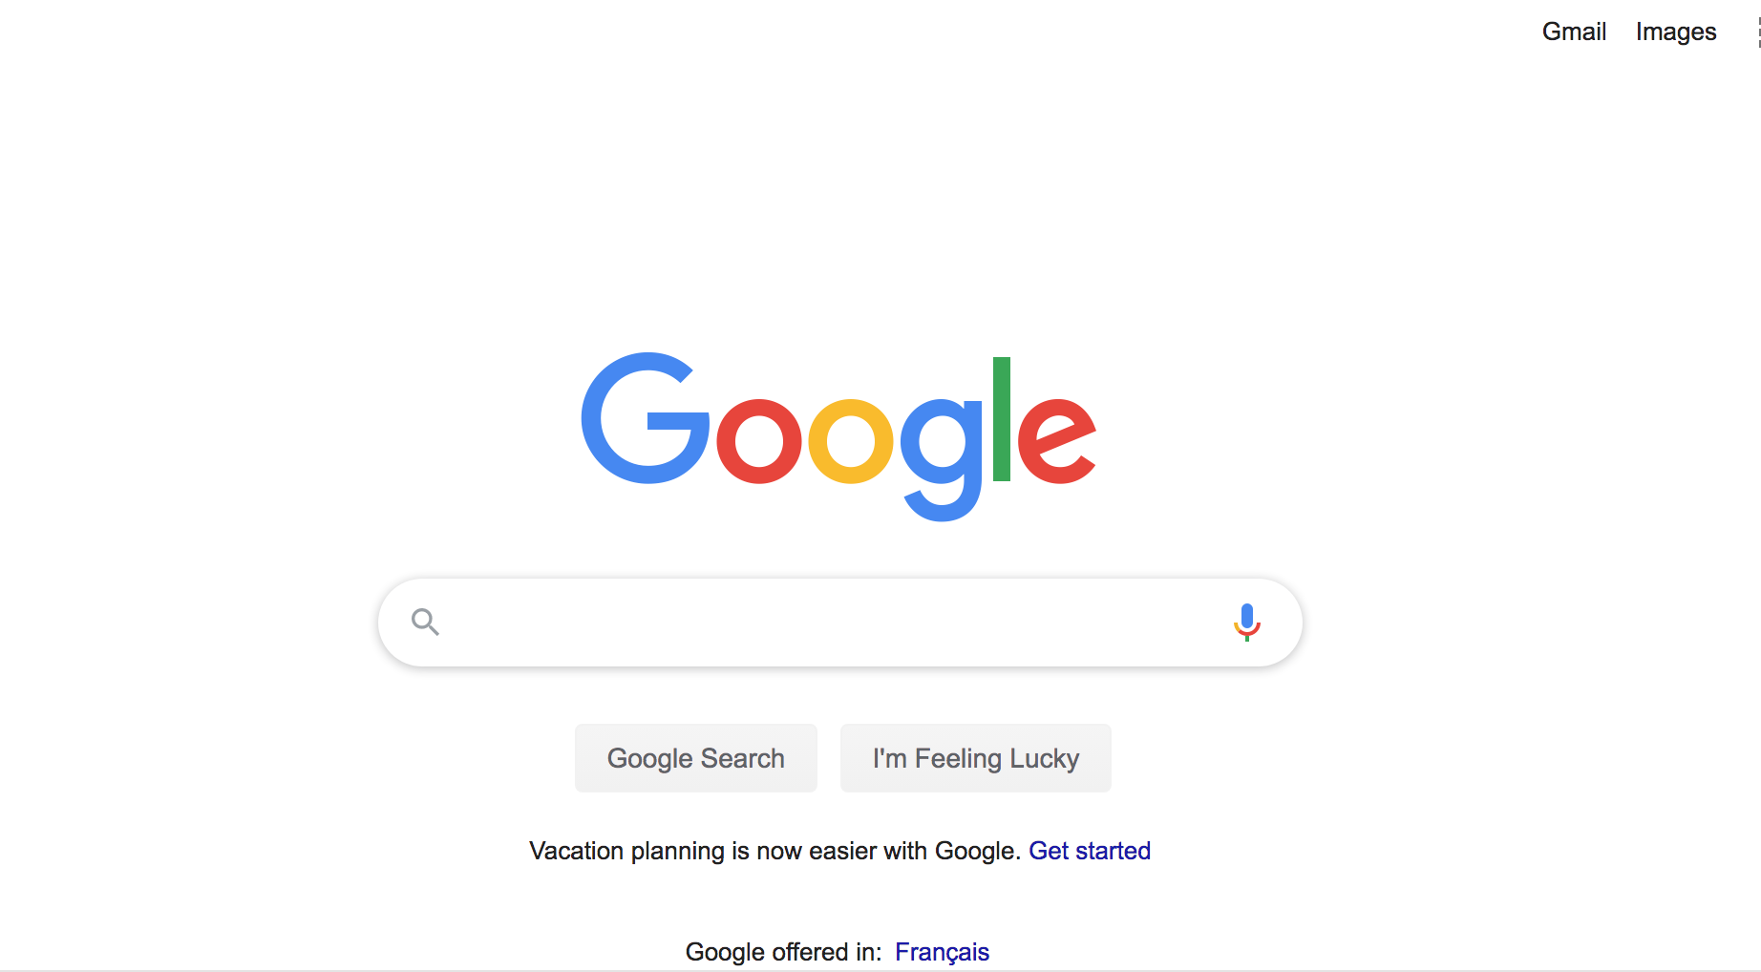
Demo: Google Images
Notes:
I’m going to try to give a quick demo
Go to Google Search – Advanced search – Filter.
Search engines and various platforms are set-up to filter content according to usage rights, which, most often are Creative Commons licenses. Having a CC-licensed makes material more discoverable.

Slide 36
Why Creative Commons ?
Enables sharing - others can build and share your work with clear terms and conditions for doing so
Gives clear and easy-to-understand standard licenses
Can help with discoverability / dissemination of your work
Wanna work together? (Creative Commons)
Notes:
Next, I want to talk a little bit about *why* creators should consider Creative Commons licenses and why they are important.
It’s no secret that digital technology has made it easier than ever to copy and reuse work others have created, and it has made it easier than ever to create and share your own work.
But simply because something is up and available online, that doesn’t mean it’s free for the taking – works are still protected by copyright.
And since nearly every use of a work online involves making a copy, copyright law plays a role in a lot of what we do online.
Technology makes it possible for online content to be consumed by millions of people at once, and it can be copied, shared, and remixed with speed and ease. But copyright law, since it imposes an all-rights reserved model out of the box places limits on our ability to take advantage of these possibilities. Creative Commons was founded to help us realize the full potential of the internet, and the ability to share.
With Creative Commons, the CC licenses allow works to be shared and provide clear terms for expressing the conditions under which works can be shared and used. It also gives those using your work the assurance that they’ve been granted permission to use it.
As, I (hopefully) demonstrated, having standard licenses that can be easily understood and are widely used, can go a long way in aiding in the discoverability and dissemination of your work.
This video from Creative Commons explains some of the advantages:
https://vimeo.com/13590841
.

Slide 37
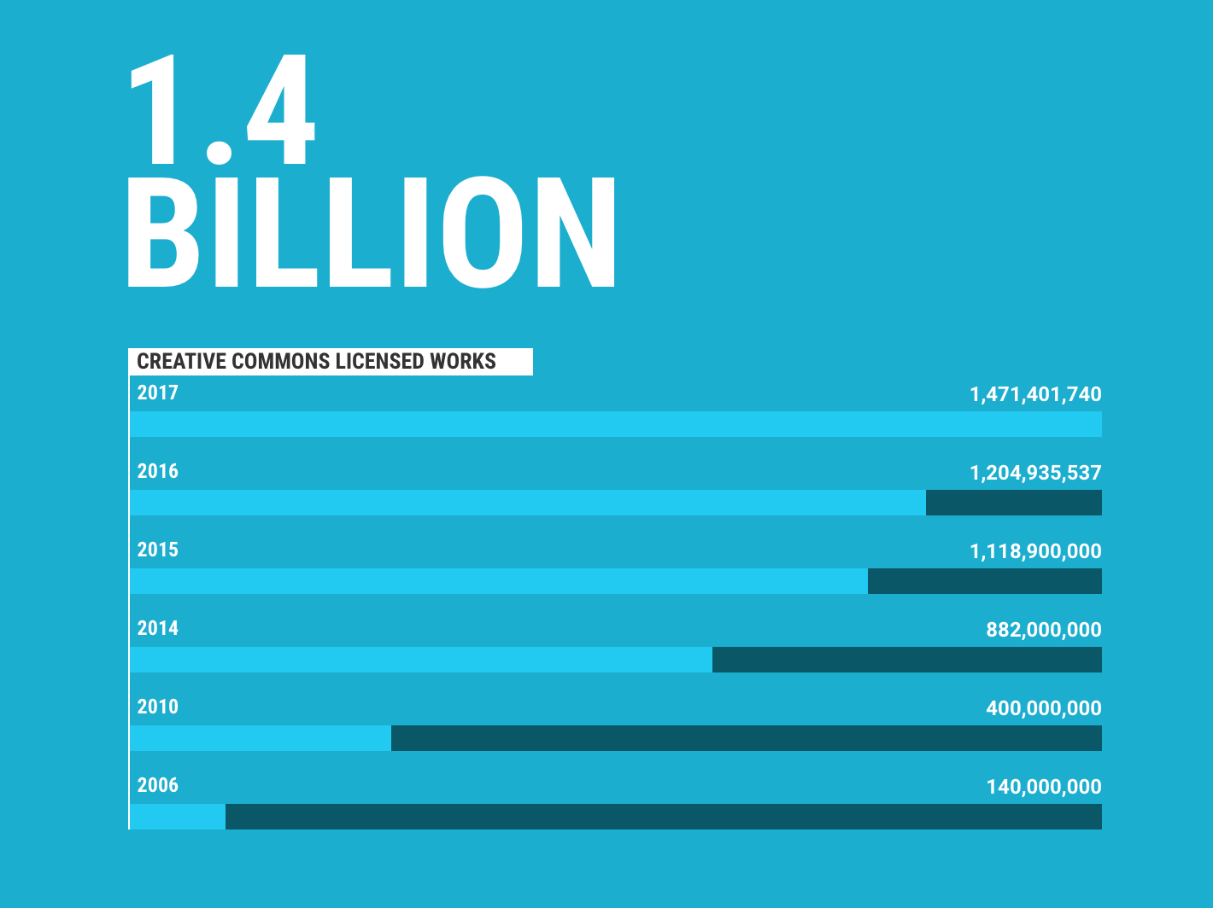
Creative Commons Licensed works
Adapted from
State of the Commons report. Creative Commons. Licensed under CC-BY 4.0
Notes:
The latest figure that I have is from 2017, that number has only likely increased significantly over the past few years (I think I’ve read that it’s at 1.6 billion now), but it’s estimated that there are over 1.4 billion works shared using Creative Commons licensed works online – it’s the largest open license in use today.

Slide 38
What types of work are CC-licensed?
Open Educational Resources
Journal article and other scholarly material
Cultural Heritage material
Multimedia: Images, sound, and video
Government information
List of CC-licensed works
Notes:
There are a wide variety of material that use Creative Commons licenses – Open Educational Resources – Textbooks, assignments, and other educational resources that have open licenses.
Creative Commons licenses are used widely for Open Access publishing in the academic sector.
Increasingly, we see more and more cultural heritage material that is digitized by cultural heritage organizations – like Galleries, Libraries, Archives, and Museums, such as the Cleveland Museum of Art, the Rijksmuseum, The MET in New York, and many more.
There are also a wide variety of sites that offer CC-licensed material: Youtube, Flickr, Vimeo – and many more.
https://en.wikipedia.org/wiki/List_of_major_Creative_Commons_licensed_works

Slide 39
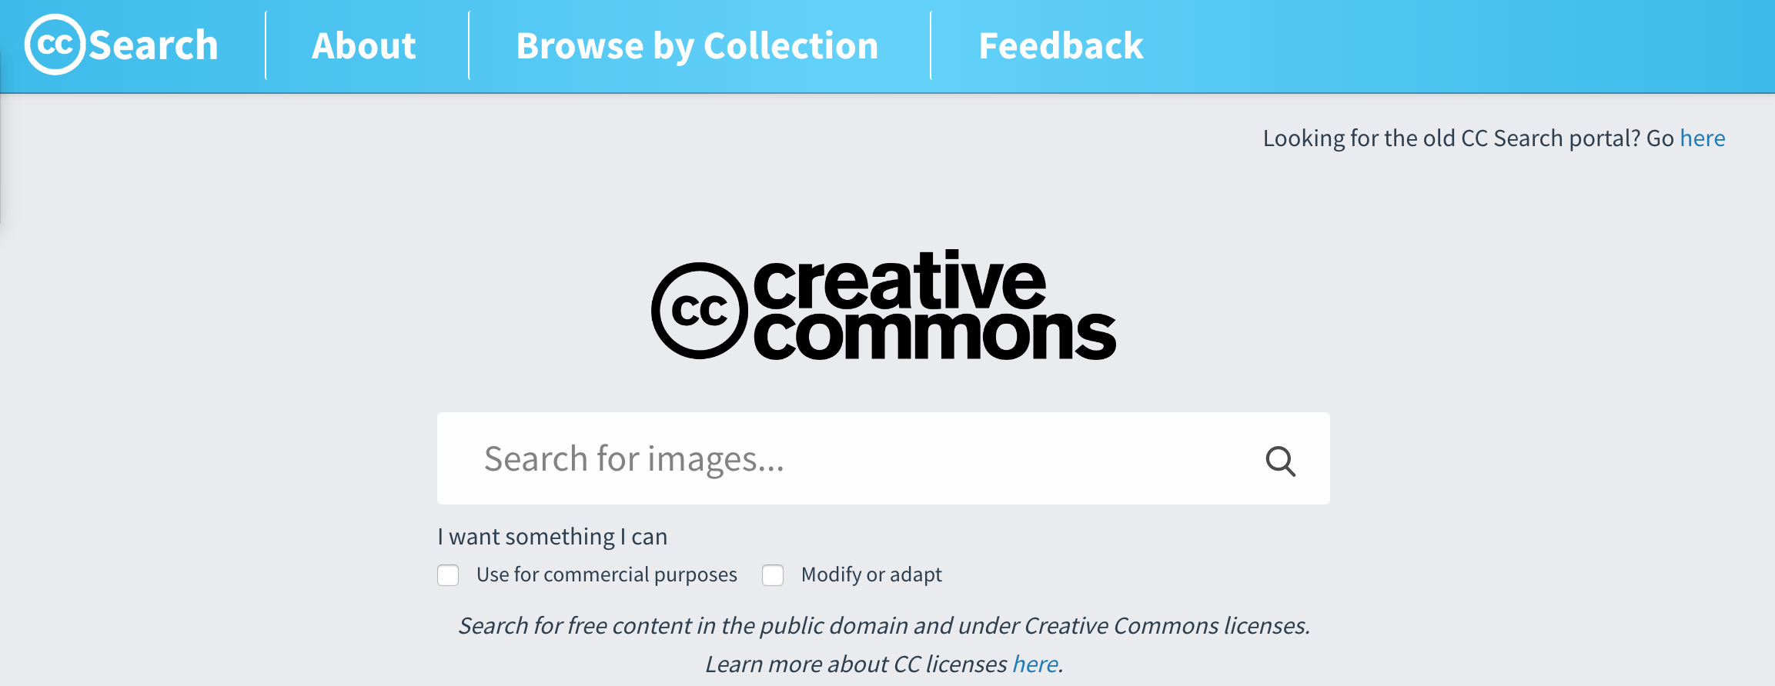
ccsearch.creativecommons.org
Notes:
Demo Search at search.creativecommons.org

Slide 40
Attributing CC-licensed work
Title
Author (or Creator)
Source
License
Creative Commons: How to give attribution
Notes:
It’s important to remember the attribution aspect when using Creative Commons licensed material. A lot of stuff is licensed with an attribution requirement, since that is the base level requirement through the CC-BY license.
Generally speaking, when using CC-licensed material, there is a recommended way that you should attribute material that is licensed under CC: With the Title, Attribution (Author or Creator), the Source – typically the link to the original website where it exists), and the Licence – the Creative Commons license that the work is licensed under.
This isn’t a hard and fast requirement – all that the CC license requires is that you provide attribution – it doesn’t specify how that attribution is provided, but generally speaking, this has been developed as a best practice to follow.

Slide 41
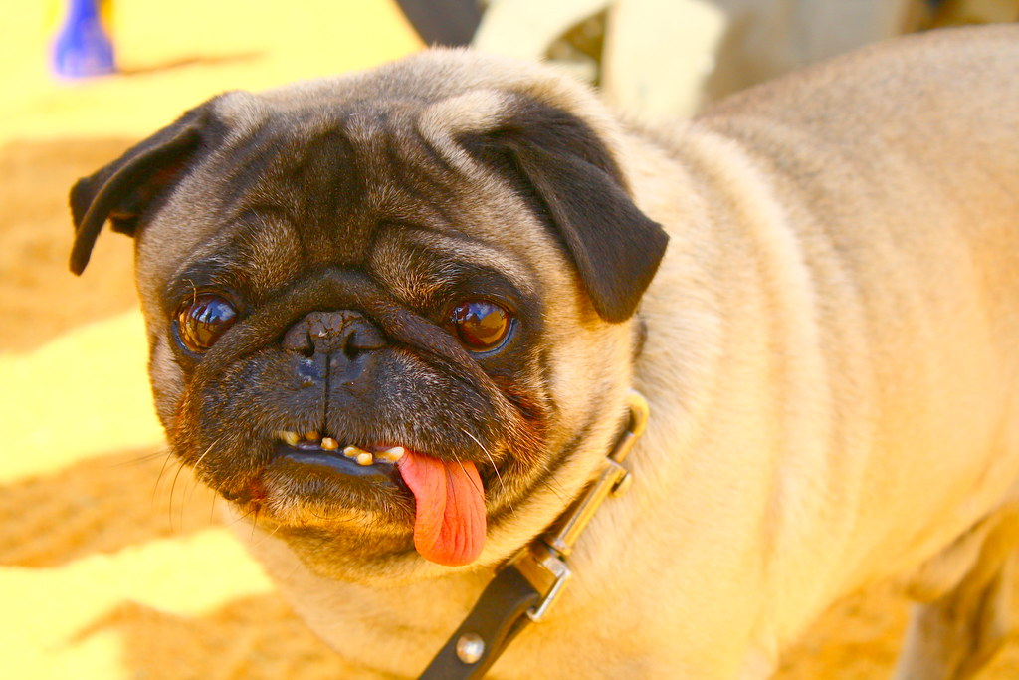
Example
"Beady Eyes" by Adam Awad is licensed under CC BY-NC 2.0
Notes:
So, here’s an example, that I made quickly using the CC search

Slide 42
Things to consider when licensing
You have to own the copyright to your work in order to apply CC license (e.g. faculty, students)
Works created by employees in course of employment – employer usually owns copyright
Creative Commons licenses are irrevocable (“no takesies backsies”)
Specify what content your licensing (e.g. “except where otherwise indicated, this presentation is licensed under CC-BY”)
Do not restrict others from re-using the works (file formats, digital locks)
Considerations for licensing
Notes:
There are some things to consider when applying CC licenses to your own work. First, you have to own the copyright to the work you wish to license, or you have to have the appropriate authorization to be able to apply a Creative Commons license such as through an organizational policy, who by default applies a CC license to the work that they put online.
Copyright ownership varies considerably – for example, employees – in the case of Dalhousie and all other employer-employee arrangements, by default the employer owns the copyright to the work. However, if there is a contract or agreement that says otherwise, it’s possible that some may retain ownership of their copyright.
This is the case with Faculty who are part of the Dalhousie Faculty Association keep the copyright in the work that they create, so they do have the ability to apply a CC license if they so choose. For students, they typically own the copyright to the works that they create (there are some exceptions in the academic calendar that allow certain uses of student works)
It’s important to note as well that copyright ownership is shared jointly when one or more people are authoring a work.
Secondly, it’s important to note that CC licenses are irrevocable (no takeseis backsies – I’m not sure that’s the legal term, but hey. Once you assign a CC license to work, you can’t “unlicensed it” – you can change the type of CC license that it is licensed under - but you can’t revert to an all-rights reserved model – the work that you release under a CC license, still remains CC-licensed.
Thirdly – you can only license what you own copyright for, so if what you’re producing includes third party content to which you do not own copyright – you need to distinguish between what is your copyright, and what is not. I’ve done this with this presentation in fact. I’ve licensed it under a CC license, but I’ve also indicated that not all of this content featured in this slide deck is my copyrighted material - and I don’t have the ability to release that material under a CC license. So, I recommend, when marking something with a license, have something like “Except where otherwise indicated…” to indicate that there are other works that are attributed in the material you’re sharing that is not your copyrighted material and thus, you don’t have the ability to license it under a CC license.
And lastly – do not restrict others from re-using the works – using things like digital locks or locking down works goes against the sprit of the CC licenses, which were intended to allow re-use. And, it’s always advisable to provide things in an editable format in order that users can effectively reuse your work. So, for example, this presentation, it’s hosted on Dalspace as both a Powerpoint – which means you could take it and edit it – and a PDF, which is not so easy to edit (although doable with the right software). It’s just considered good practice to provide CC licensed resources in an editable format.
I also include a link here for more information on considerations for licensing.

Slide 43

Choosing a CC license for your work
Photo by Jon Tyson on Unsplash
https://creativecommons.org/choose
Notes:
If you choose to apply a Creative Commons license to your work, doing so is quite easy using the Creative Commons licensing tool
(give quick demo)

Slide 44

Where to from here?
Find and Use Creative Commons-licensed work
Contribute to the Commons!: Apply Creative Commons licenses to your work (if you are able to)
Learn more about Creative Commons (https://creativecommons.org)
Photo by Daniel Gonzalez on Unsplash
Notes:
So, if you’re interested in Creative Commons there are a few things you can do.

Slide 45
Questions?

Slide 46
Additional Credits and Attribution
Slides 5,6,7 adapted from “Creative Commons Licenses” by eCampusOntario is adapted from “Everything You Wanted to Know about Creative Commons Licenses (But Were Afraid to Ask)” by Lillian Hogendoorn. E-campus Ontario. and is licensed under a Creative Commons Attribution-NonCommercial-ShareAlike 4.0 International License.
Creative Commons Icons from https://creativecommons.org/about/downloads/ (Licensed under )
Icons via Noun Project Pro

