Slide 1
Managing privacy and access with digital forensics tools and techniques
Creighton Barrett
Right to Know: Balancing Access and Privacy
Symposium at Dalhousie University
September 28, 2017
Notes:
Privacy in Nova Scotia
Introduction to digital forensics
Development of Dalhousie’s digital forensics lab
Forensic images
Digital forensics tools and workflows
Case study: Bill Freedman fonds
Research challenges and next steps

Slide 2
What is digital forensics?
Forensic science – recovery and investigation of data found in digital storage devices
Primarily used by specially trained professionals in criminal investigations, corporate investigations, etc.
Archives are adopting digital forensics techniques to support acquisition, accessioning, appraisal, preservation, and access
Acquisition
Identification
Evaluation
Admission
Source: Infosec Institute, Digital Forensic Models (January 25, 2016): http://resources.infosecinstitute.com/digital-forensics-models/
Notes:
This is unfamiliar territory for librarians and archivists:
Windows registry analysis
Deleted files (slack space / unallocated space)
Cached data
Encrypted data
Passwords
Filesystem permissions
Distributed systems and data

Slide 3
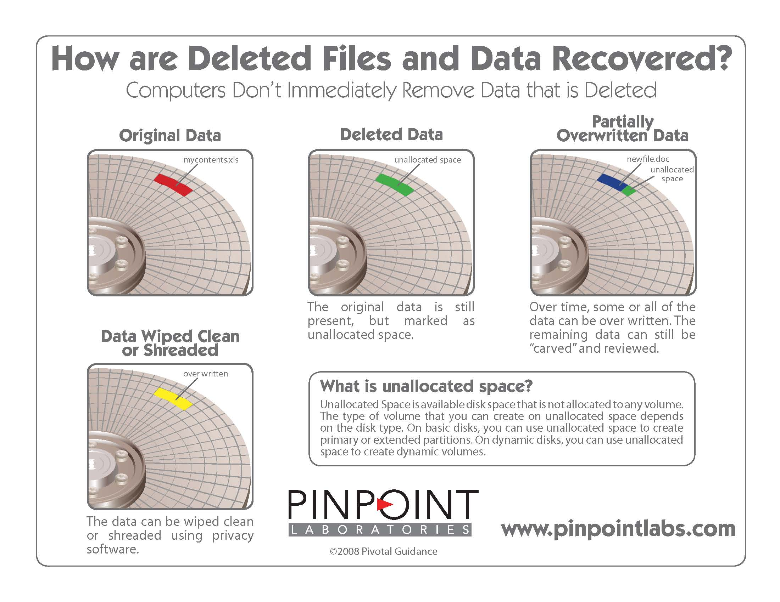
Notes:
Image source: http://www.pinpointlabs.com/wordpress/tag/unallocated-space/
Overwrite zero with one = more like 0.95
Overwrite one with one = more like 1.05
Normal equipment will read both values as a one
Digital forensics equipment makes it possible to determine what data exists in “slack space” and “unallocated space.”

Slide 4
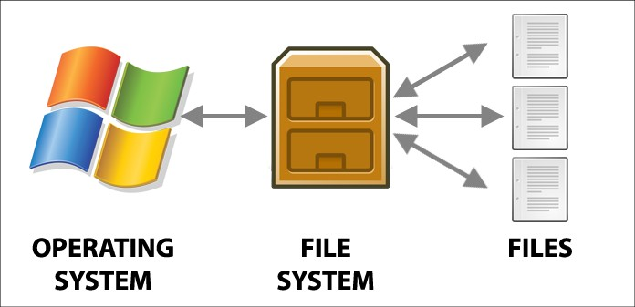
Preserve information about the operating system and file system
Image source: Power Data Recovery: https://www.powerdatarecovery.com/hard-drive-recovery/volume-not-contain-recognized-file-system.html

Slide 5
Digital forensics concepts in context
Concept | Law enforcement | Libraries, archives, and museums
Chain of custody | Incident response, investigation | Acquire, appraise, and preserve data in accordance with accepted archival practice
Private data / personal information | Exploited for prosecution | Identified and redacted to protect privacy and comply with legislation
Storage | Secure storage of digital evidence | Long-term storage of digital objects in accordance with TDR standards
Access to information | Who is entitled to see the evidence? | Who is entitled to see the digital heritage collections?
Constraints | Time to trial | Collections backlogs
Adapted from: Kam Woods, Preservation, Privacy, and Access: Enhancing Digital Curation Workflows with Forensic Analysis (March 21, 2017): http://wiki.bitcurator.net/downloads/kwoods-unc-digpres-v12.pdf

Slide 6
Privacy concerns in digital forensics
Investigations reveal passwords, encryption keys, images, personally identifying information, etc.
Scope of investigation
Legal requirements
Balance between protecting privacy and conducting complete investigations
Lack of awareness or concern about privacy
Lack of standardized ethical principles

Slide 7
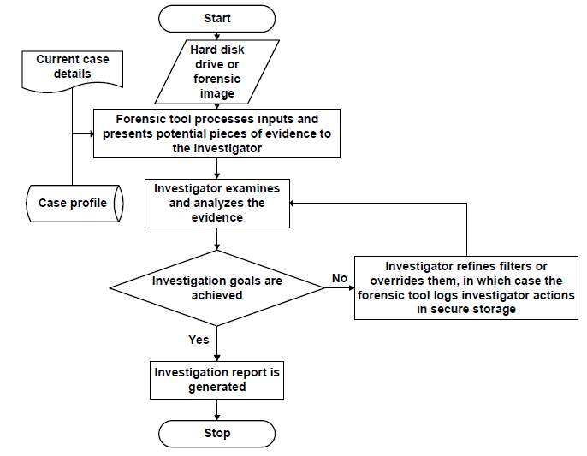
Privacy solutions in digital forensics
Verma, Govindaraj, and Gupta. “Data privacy perceptions about digital forensic investigations in India.” Published in Advances in Digital Forensics XII, edited by Gilbert Peterson and Sujeet Shenoi. Springer: 2016. https://link.springer.com/book/10.1007%2F978-3-319-46279-0

Slide 8
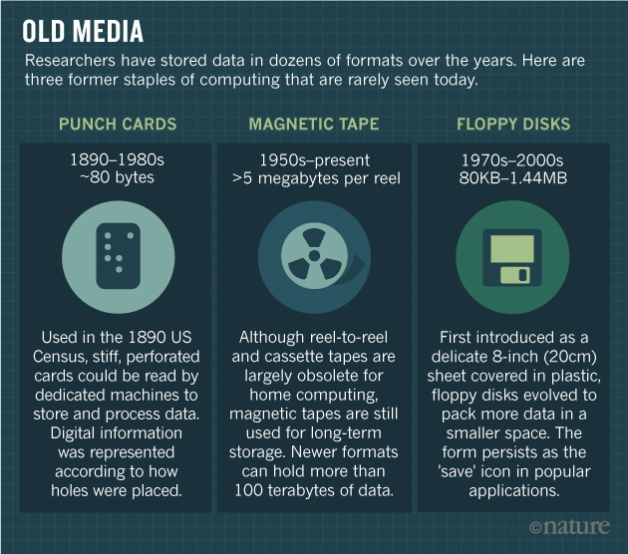
Why have a digital forensics lab in a library or archives setting?
Source: Baker, M. (2017, May 2). Disks back from the dead. Nature, 545 (7652), 117–118. https://doi.org/10.1038/545117a
Notes:
Archivists are now working with a wide variety of:
Digital storage devices
Computer file systems, operating systems, and software
File formats
Digital storage devices are unstable and data is at risk
Supports archival mission to preserve authenticity and integrity of records

Slide 9
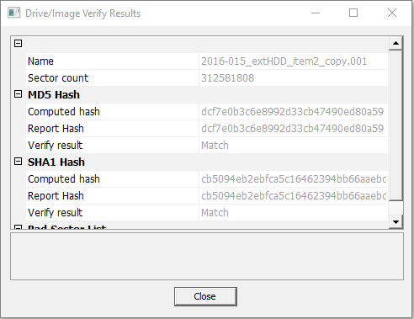
How are archivists doing digital forensics work?
Use write-blockers to create forensic images
Adopt forensic software
Incorporate digital forensics into workflows
New policy decisions (e.g., preserve forensic image or extract files?)
Notes:
What is a forensic image?
Complete (i.e., bit-level) copy of a hard drive or other digital storage media
Includes unallocated space and slack space
Includes operating system and file system
Includes computer registry files, browser history, and other contextual information about how the computer was used
Includes all files on the hard drive

Slide 10
Timeline at Dalhousie
February 2016 – Acquire forensic workstation
May – November 2016 – Digital archives collection assessment project: http://hdl.handle.net/10222/72663
January 2017 – Install BitCurator and Forensic Toolkit (FTK) software
February 2017 – Advanced computer forensics training
May 2017 – Launch digital forensics lab
April 2017 – Dal’s first time at BitCurator Users Forum

Slide 11
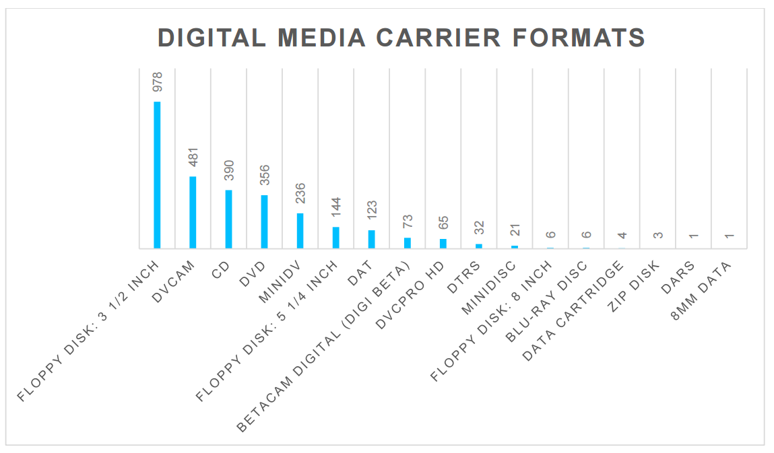

Slide 12
Policy, ethical, and legal questions for libraries and archives
Recovery of deleted files if they appear to be archival?
Decryption of EFS files? Other encryption methods?
Use of Password Recovery Toolkit?
Use of registry information, browser history, etc. to support archival appraisal?
Modifications to standard deed of gift template?
Monetary appraisal of born-digital archival material?

Slide 13
Privacy at Dalhousie
FOIPOP Act
Policy for the protection of personal information from access outside Canada (approved in 2007)
Data classification schema (approved in 2013)
LOTS of personal and confidential information in various locations
Need to consider access requirements of the Archives Permanent Collection when policies are developed and updated
Notes:
“Nova Scotia’s privacy laws lack virtually all of the essential modern privacy protections found in other Canadian jurisdictions.” – Accountability for the Digital Age report, June 2017

Slide 14
Dalhousie data classification schema
Level Number | Description
Highly sensitive | Information which may result in significant and substantial harm to the university or members of the university community, or which may violate legal or contractual requirements, if it were to be released
Sensitive | Information which could have a negative impact on the university or members of the university
Internal use | Information made available to faculty or staff of the university but not necessarily appropriate for the general public. (Directory listings, minutes from non-confidential meetings, internal websites, etc.)
Public use | Information that can be made generally available to the public.

Slide 15
Digital forensics tools

Slide 16
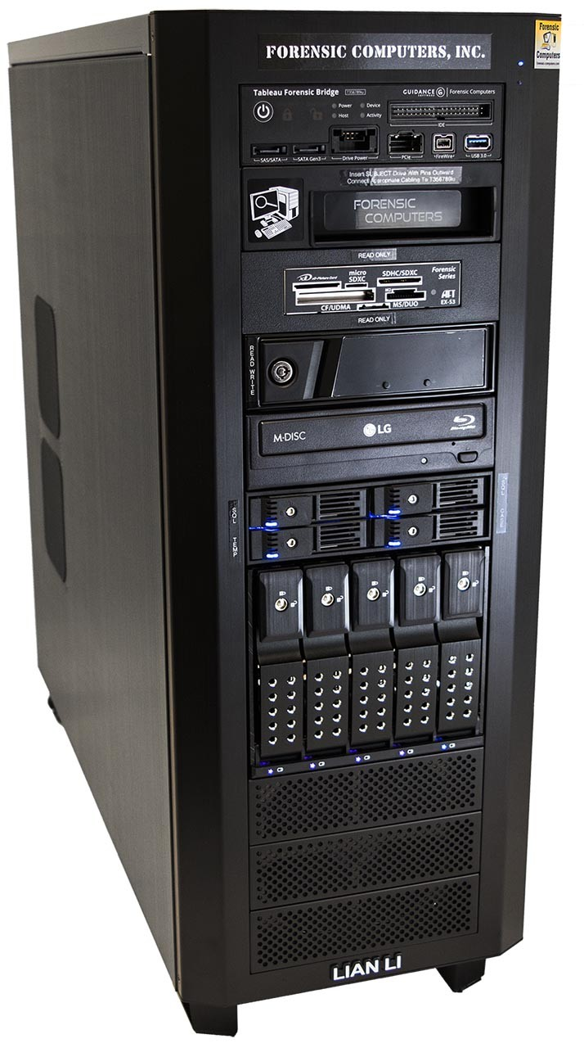

Slide 17
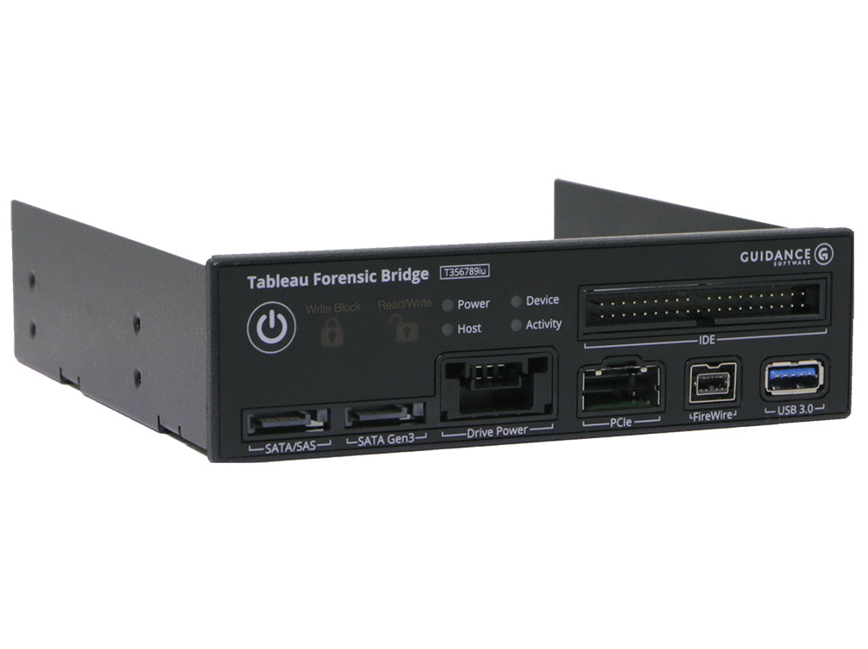

Slide 18
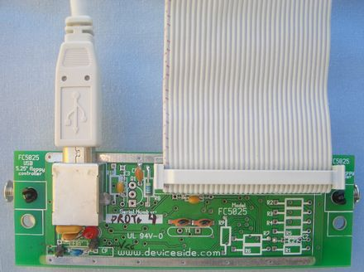
Device Side Data’s FC 5025 USB floppy controller

Slide 19
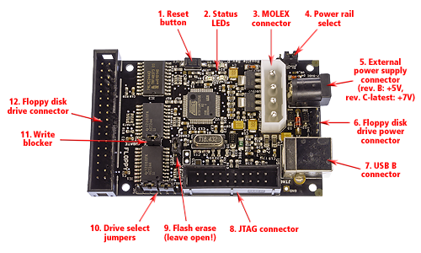
Image source: KryoFlux: https://kryoflux.com/?page=kf_tech

Slide 20

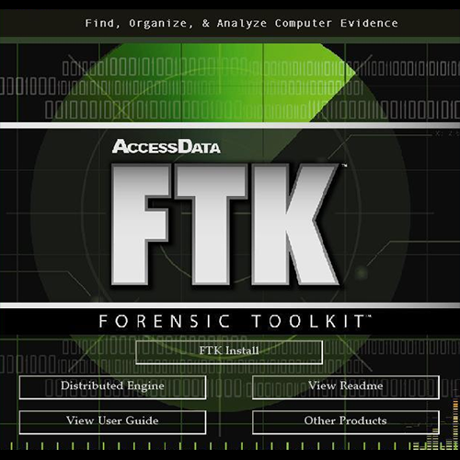
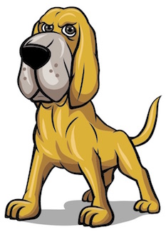


Slide 21
Forensic Toolkit (FTK)
Three components
  Database (Oracle, PostgreSQL, Microsoft SQL)
  Graphical user interface (GUI)
  Known file filter server (contains datasets with hash values for known file types)
Indexing, live search, regular expression
Oracle “Outside In” technology for previewing most file types
Integration with other AccessData products (Registry Viewer and Password Recovery Toolkit)

Slide 22
Digital forensics workflows

Slide 23
Abstract digital forensics model
Identification
Preparation
Approach Strategy
Preservation
Collection
Examination
Analysis
Presentation
Returning Evidence
Source: Infosec Institute, Digital Forensic Models (January 25, 2016): http://resources.infosecinstitute.com/digital-forensics-models/

Slide 24
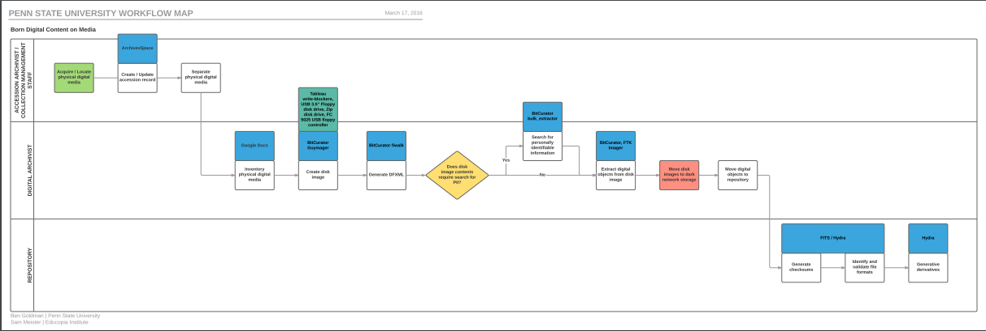
Penn State University workflow

Slide 25
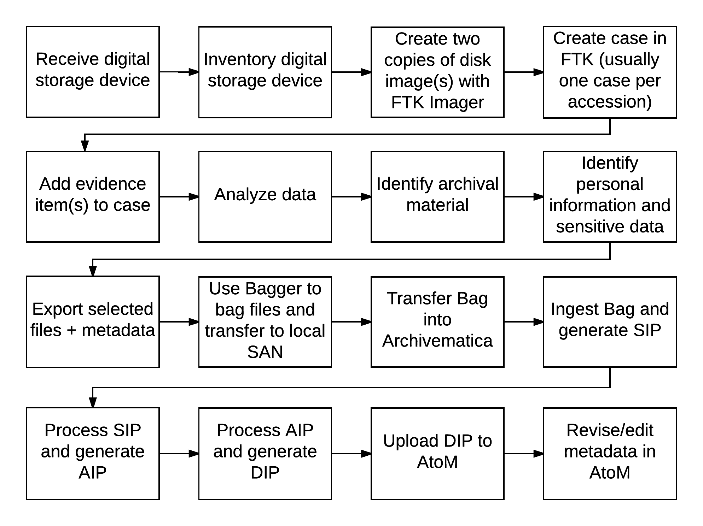
Dalhousie University workflow (draft)
Notes:
Very premature
Does not factor staffing, roles and responsibilities, etc.
Relates to other workflows in development (e.g., acquisitions, accessioning)

Slide 26
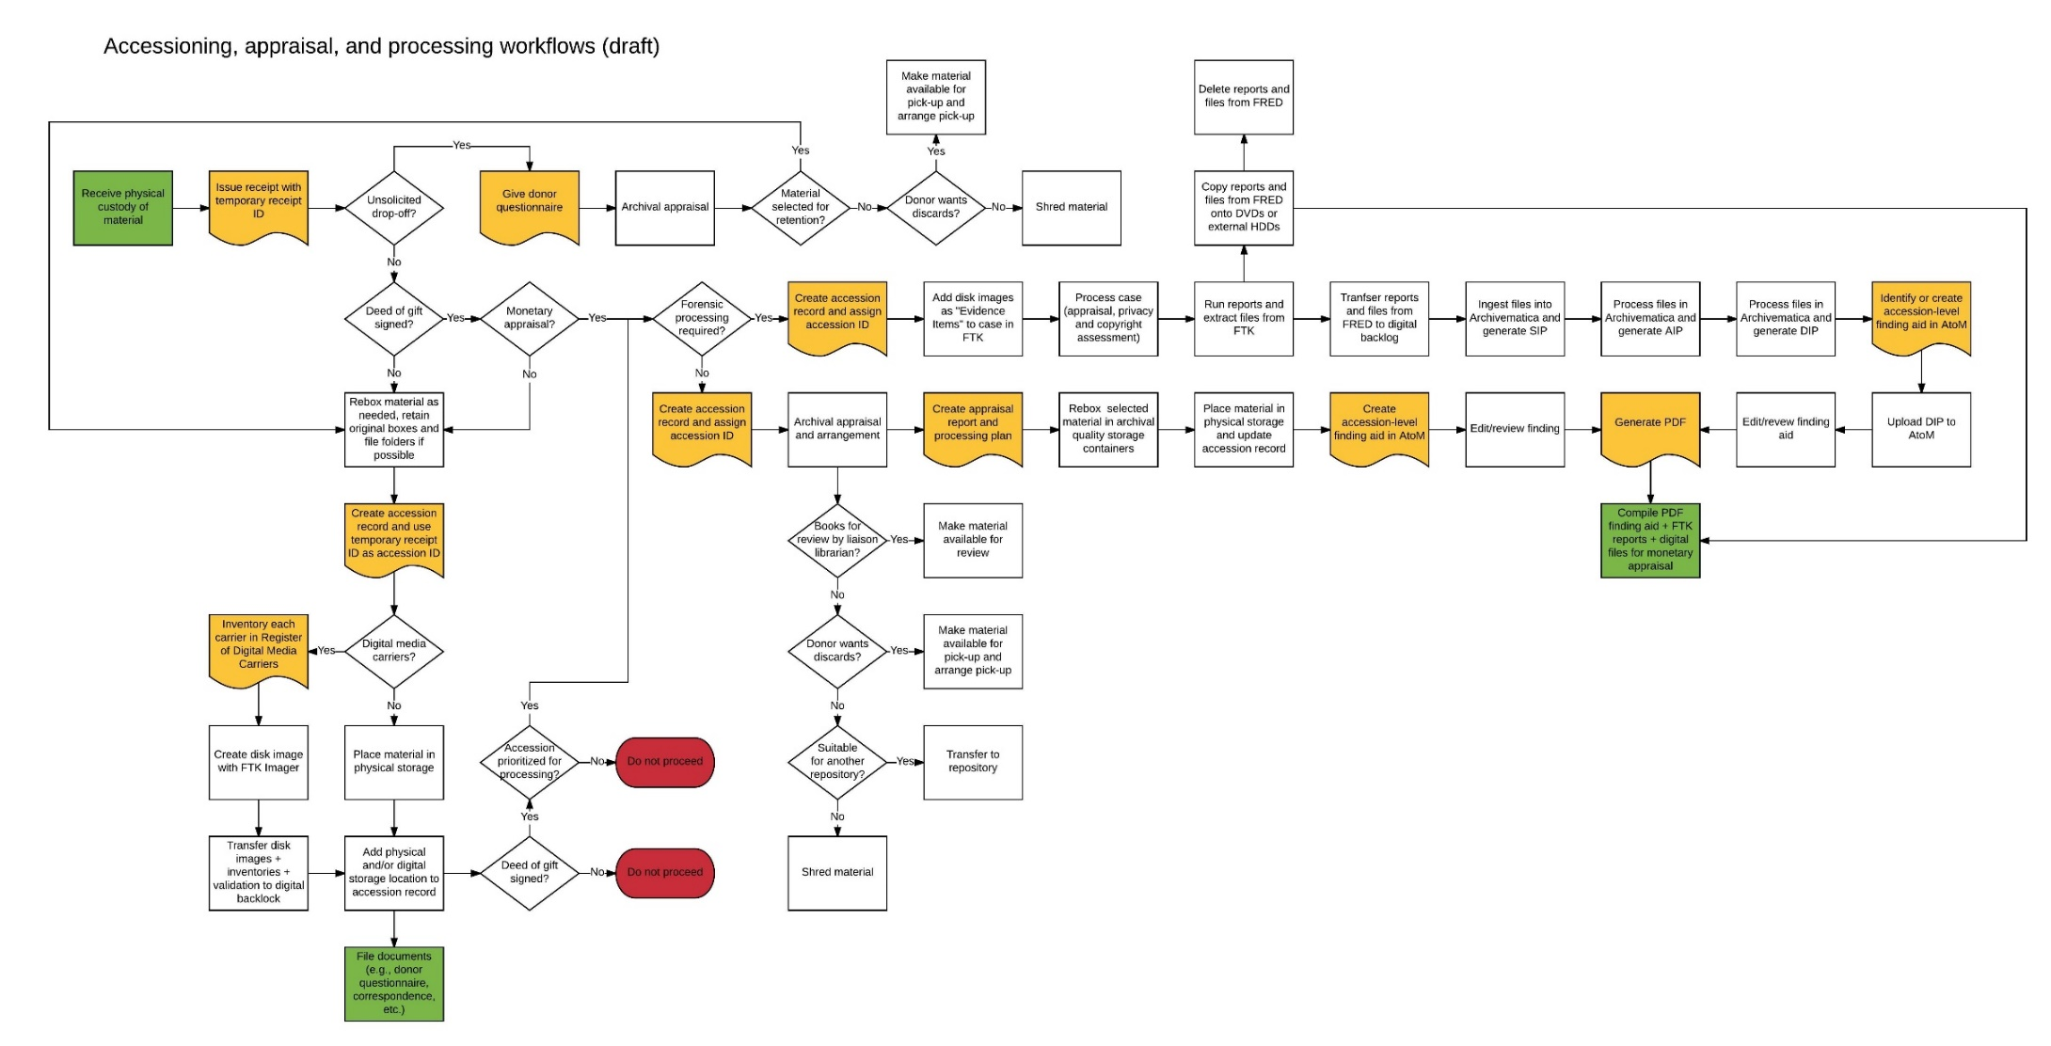
Accessioning, appraisal, and processing workflow (draft)

Slide 27
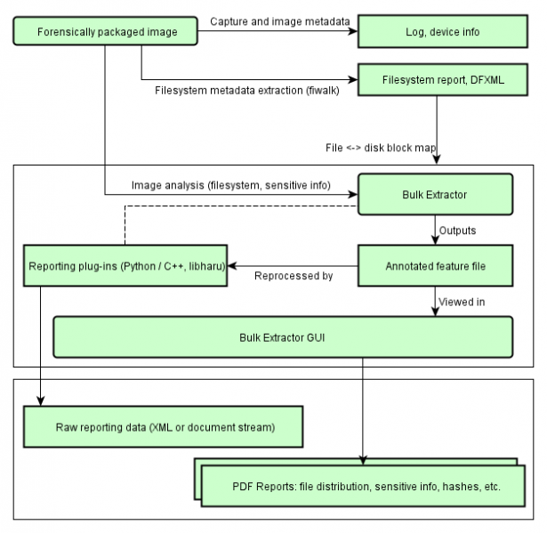
Identification of potentially sensitive information (BitCurator)

Slide 28
Bulk Extractor scanners – examples
Scanner name | Description
Wordlist | A list of all “words” extracted from a disk. Useful for password cracking or searching for specific terms.
Accounts | Credit card numbers, “track two” information, phone numbers, other formatted numbers. Useful for tracking how a device was used for business purposes.
Email | Discovers RFC822 email headers, HTTP cookies, hostnames, IP addresses, email addresses, and URLs. Useful for recreating email correspondence on a device.
Exif | Finds EXIF metadata in image and sound files.
Find | Returns the results of specific regular expressions.
vCard | Recovers vCards (standard electronic business cards).

Slide 29
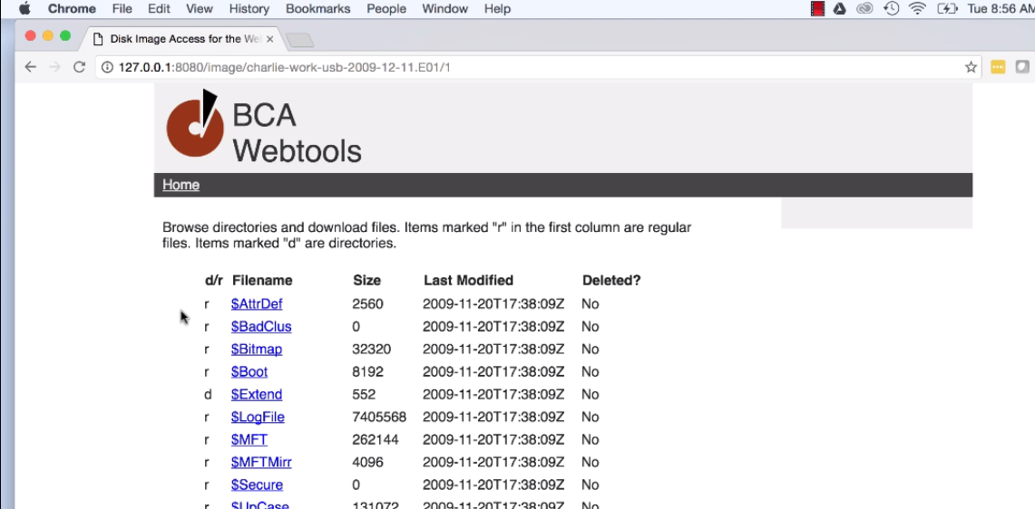
BitCurator Access

Slide 30
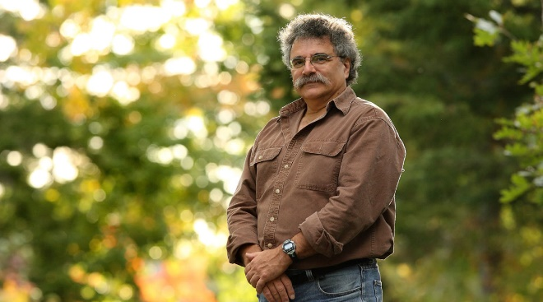
Notes:
Case study: Bill Freedman fonds
Overview of the collection
Digital forensics
Policy, ethics, and legal context
Next steps

Slide 31
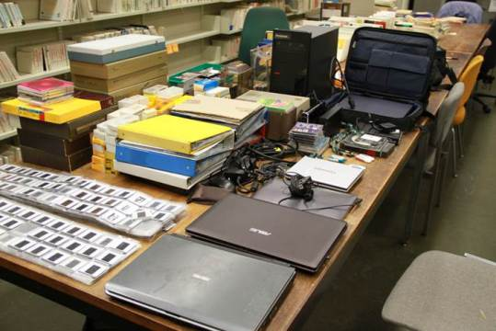

Slide 32
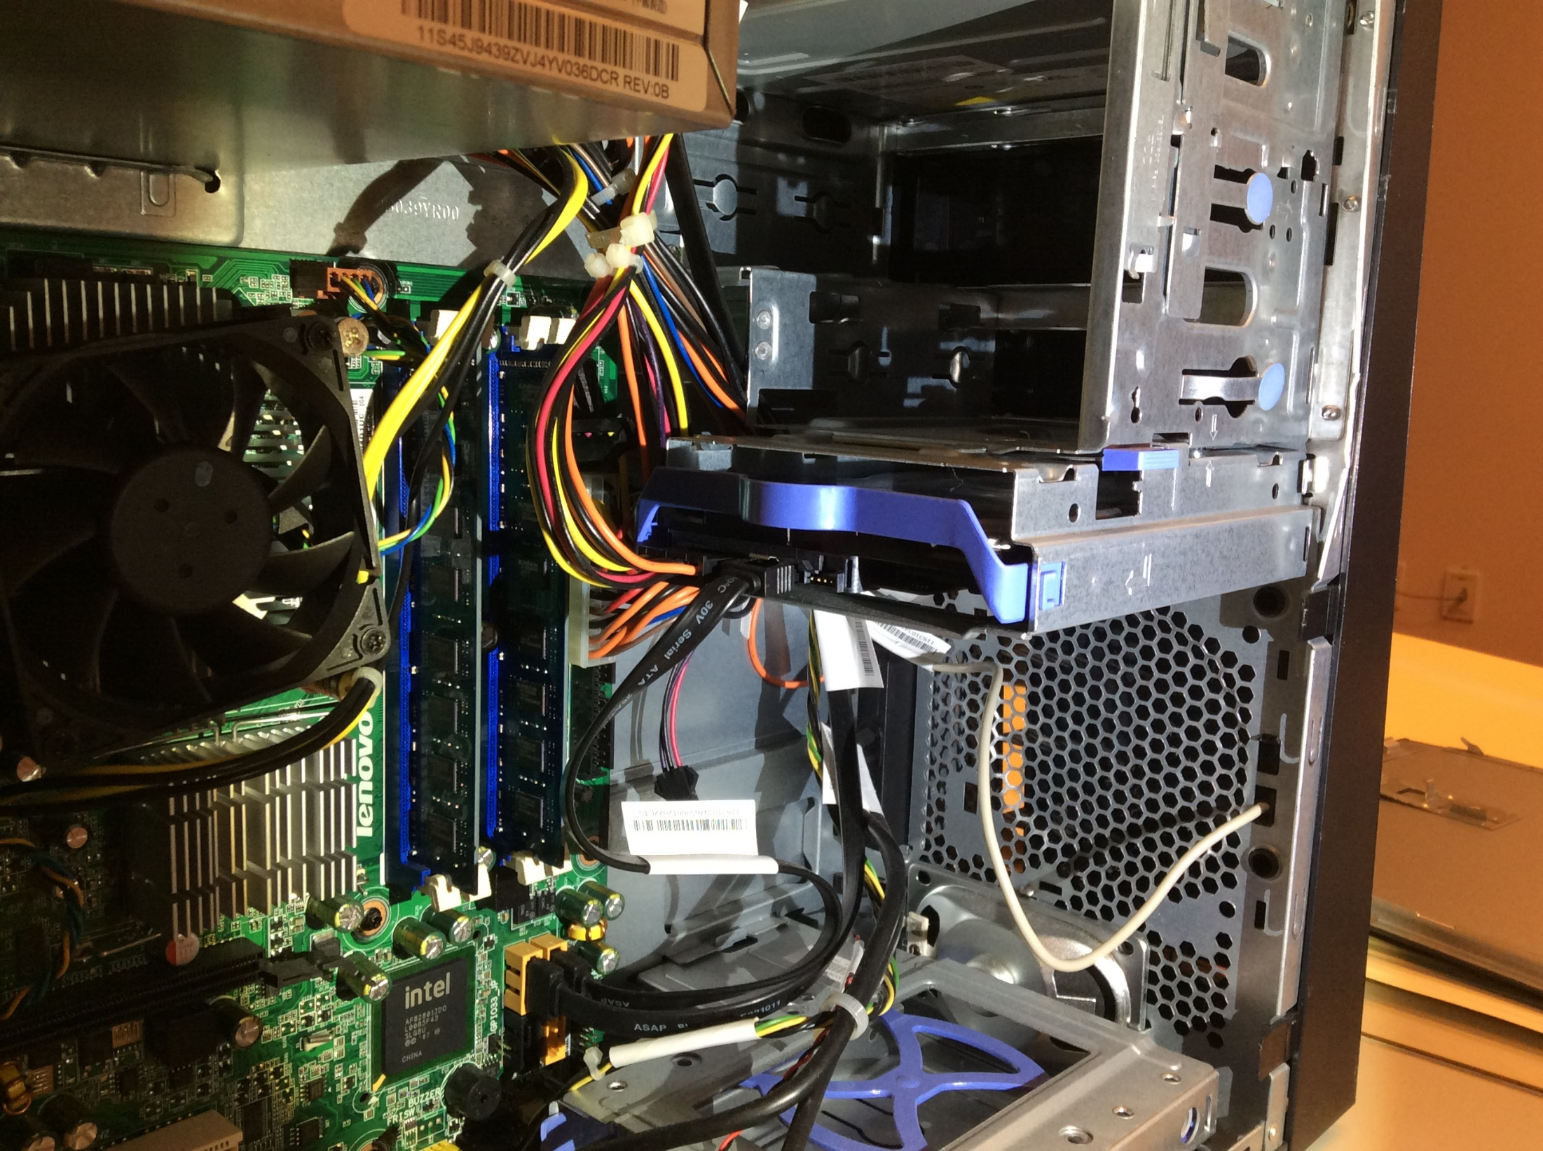

Slide 33
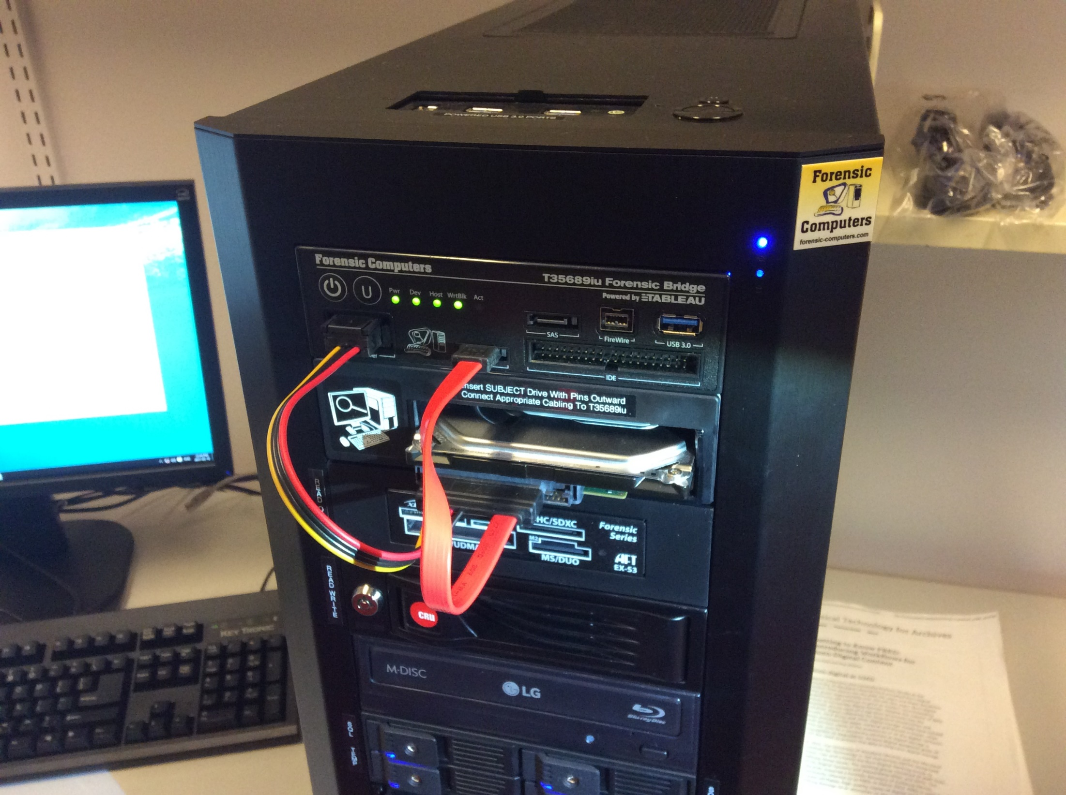

Slide 34
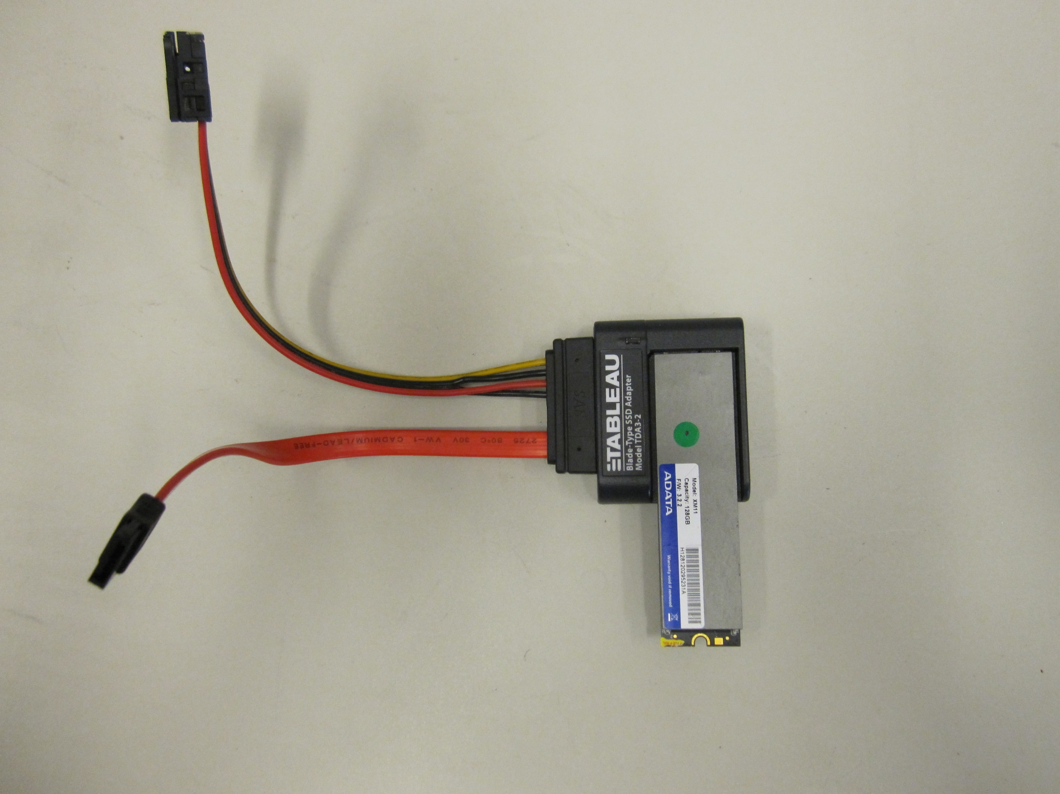

Slide 35
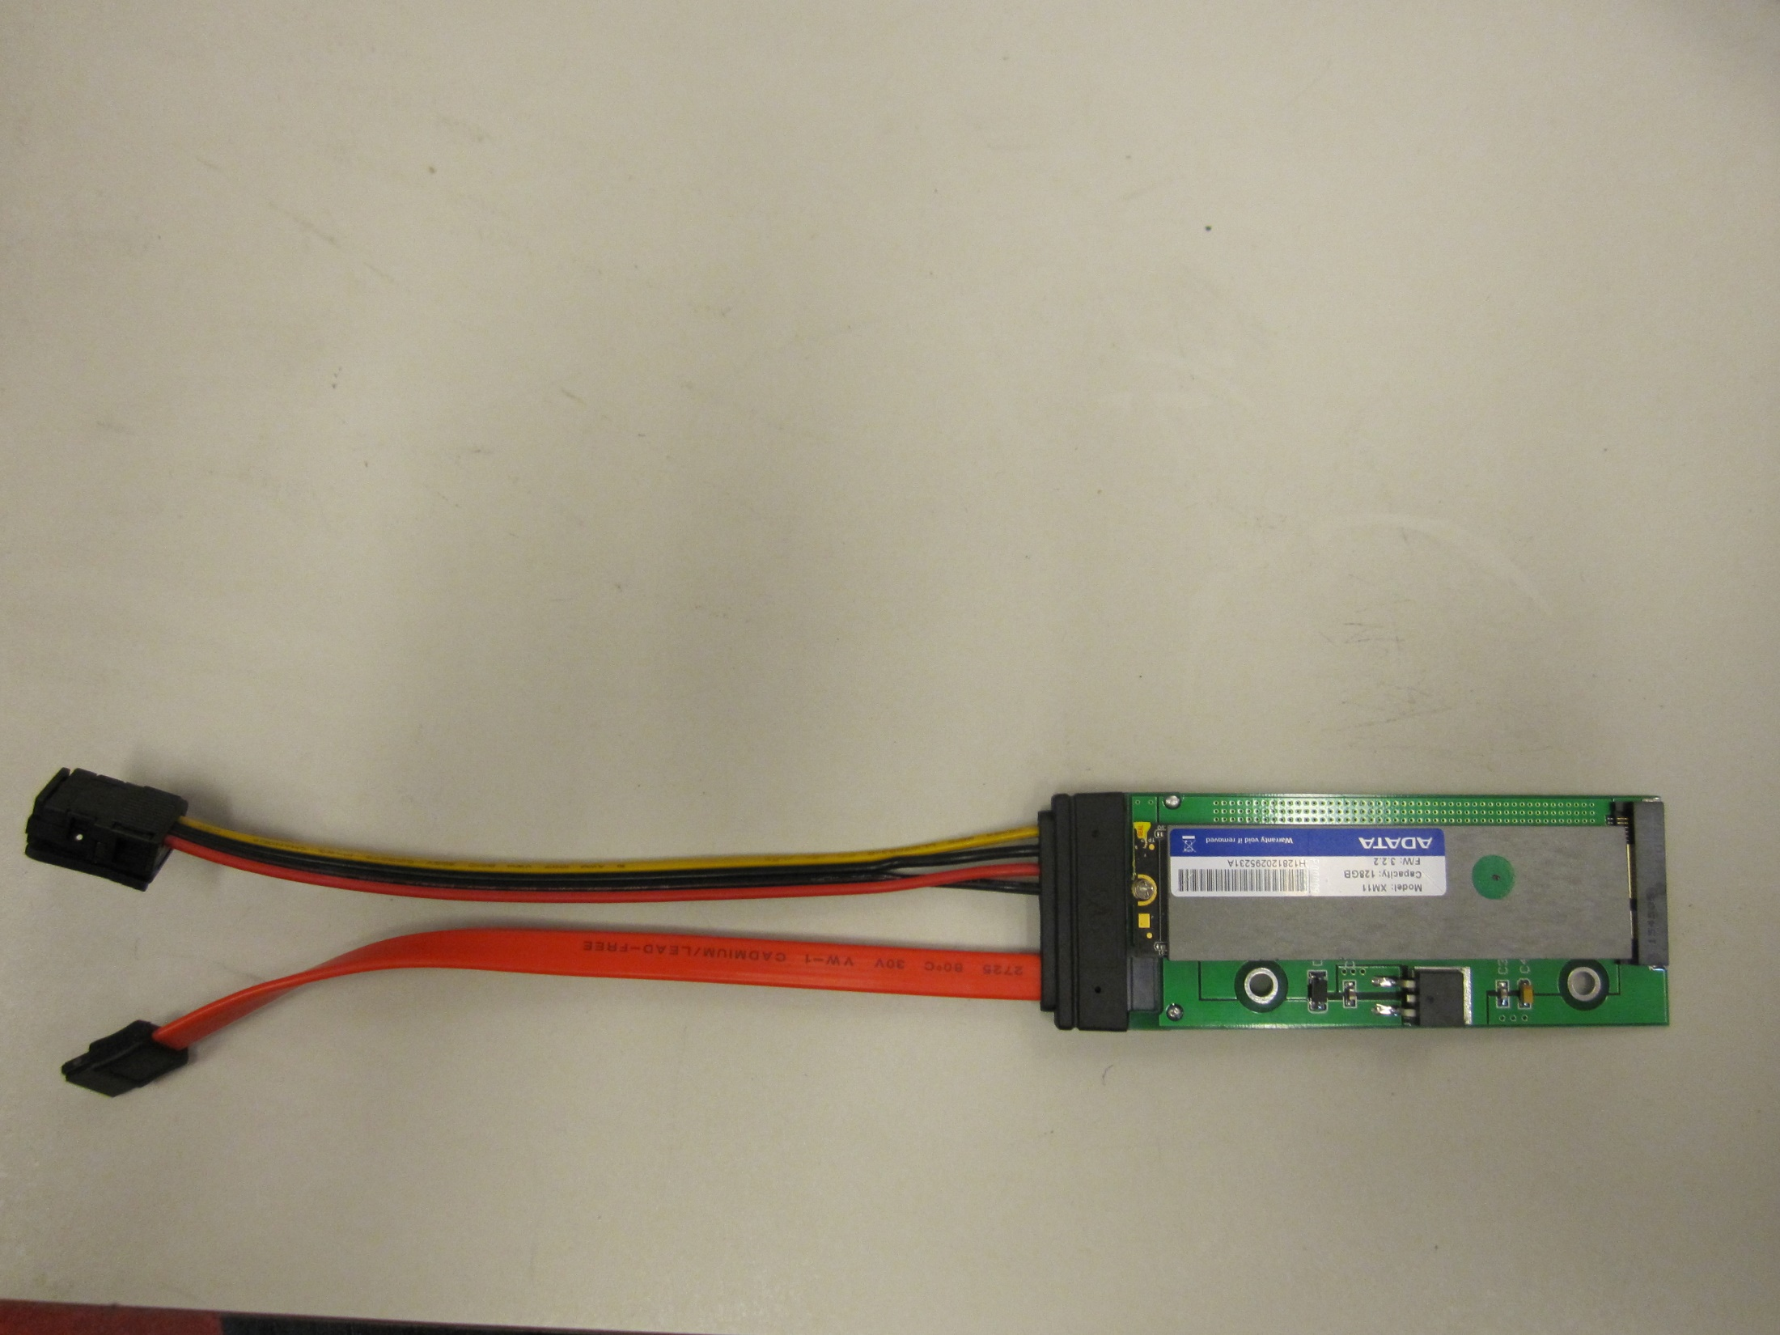

Slide 36
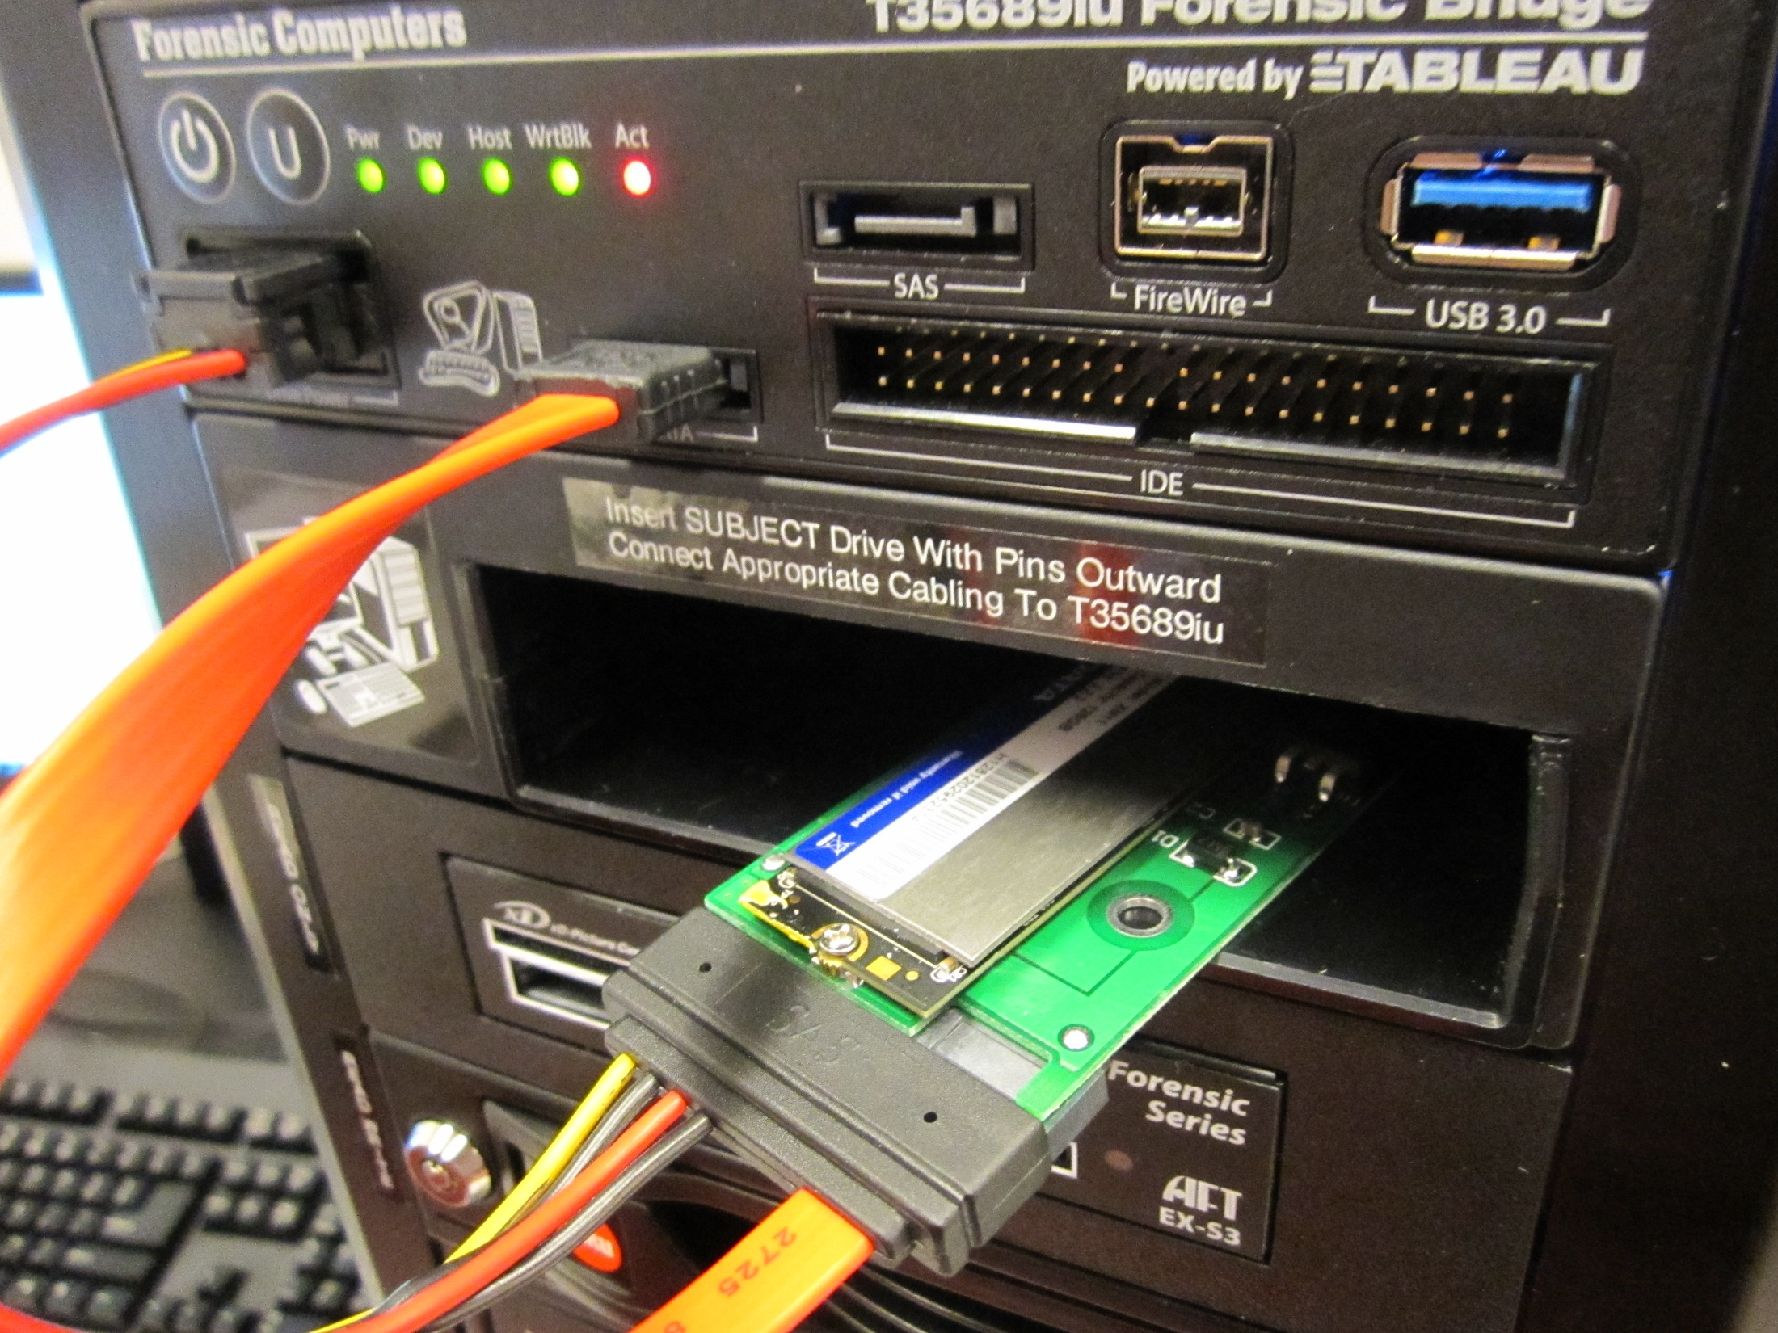

Slide 37
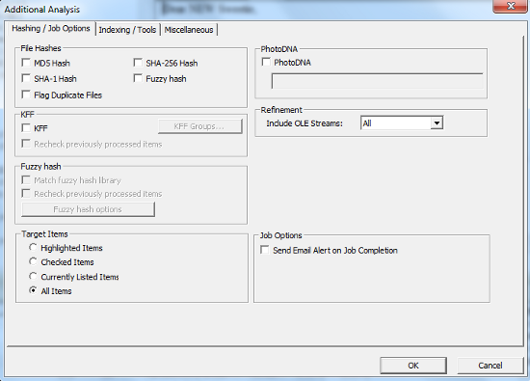
FTK – Flag Duplicates
37
Notes:
Simple process, very time consuming, still a powerful feature
Scans entire file and generates MD5
Assigns primary status to first instance of each MD5
Assigns secondary status to subsequent instances of each MD5

Slide 38

NSRL Reference Data Set (RDS)
Hashsets and metadata used in file identification
Data can be used in third-party digital forensics tools
RDS is updated four times each year
As of v2.55, RDS is partitioned into four divisions:
  Modern – applications created in or after 2000
  Legacy – applications created in or before 1999
  Android – Mobile apps for the Android OS
  iOS – Mobile apps for iOS

Slide 39
FTK – Known File Filter (KFF)
KFF data – hash values of known files that are compared against files in an FTK case
KFF data can come from pre-configured libraries (e.g., NSRL RDS, DHS, ICE, etc.) or custom libraries
FTK ships with version of NSRL RDS bifurcated into “Ignore” and “Alert” libraries
KFF Server – used to process KFF data against evidence in an FTK case
KFF Import Utility – used to import and index KFF data

Slide 40
FTK – Known File Filter (KFF)
Notes:
Used to eliminate known software and OS files in a forensic case OR highlight presence of “alert” files
Used to “profile” someone before getting into case analysis (e.g., can help detect the usage of forensics programs such as drive cleaners)
Custom libraries can be used to find known files (especially in IP theft cases)
Custom libraries could be used to flag duplicates across multiple acquisitions from same donor

Slide 41
Bill Freedman fonds filtered in FTK
Filter | Description | # of files | Size
Unfiltered | All files in case | 26,651,084 | 3,568 GB
Primary status | Duplicate File indicator IS “Primary” | 731,417 | 83.48 GB
Secondary status | Duplicate File indicator IS “Secondary” | 16,569,218 | 271.5 GB
KFF Ignore | Match all files where KFF status IS “Ignore” | 2,548,119 | 44.29 GB
No KFF Ignore | Match all files where KFF status IS NOT “Ignore” + KFF status IS “Not checked” | 24,102,965 | 3524 GB
Primary status + No KFF Ignore | Match all files where duplicate file indicator IS “Primary” + KFF status IS NOT “Ignore” | 626,351 | 71.95 GB
Actual files + Primary status + No KFF Ignore | Match all disk-bound files where duplicate file indicator IS “Primary” + KFF status IS NOT “Ignore” | 103,412 | 61.81 GB

Slide 42
Research challenges and next steps
Finish processing Bill Freedman fonds and preparing paper and electronic records for monetary appraisal
Develop Privacy and Confidential Information Assessment Tool
Finish Digital Forensics Lab manual
Create forensic images of storage media identified during Digital Archives Collection Assessment
Finish one thing…
Notes:
Forensics standards in a networked environment
Develop Privacy and Confidential Information Assessment Tool
Finish Digital Forensics Lab manual
Create forensic images of storage media identified during Digital Archives Collection Assessment
Finish one thing…

