Slide 1
Review of the 2016 Scientific Archives Workshop
Held at the European Molecular Biology Laboratory in
Heidelberg, Germany, November 1-2, 2016
May 11, 2017, Council of Nova Scotia Archives Conference
Creighton Barrett, Dalhousie University Archives
With thanks to the CNSA for financial support provided through the Professional Development and Training Assistance Bursary Program

Slide 2
EMBL Workshop on Scientific Archives
40 archivists from eight countries
Keynote lectures from Jenny Shaw, Wellcome Trust (UK) and Guilio Superti Furga, Scientific Director of the Research Centre for Molecular Medicine of the Austrian Academy of Sciences
Link to programme: https://www.embl.de/aboutus/archive/workshop/index.html
Link to my presentation: http://hdl.handle.net/10222/72276

Slide 3
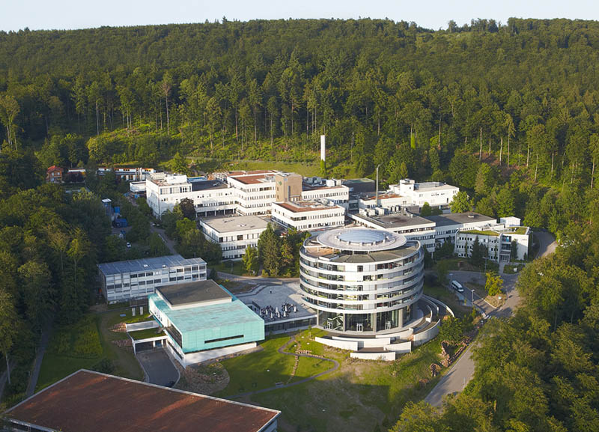
Image source: https://www.embl.de/aboutus/general_information/HD_about/

Slide 4
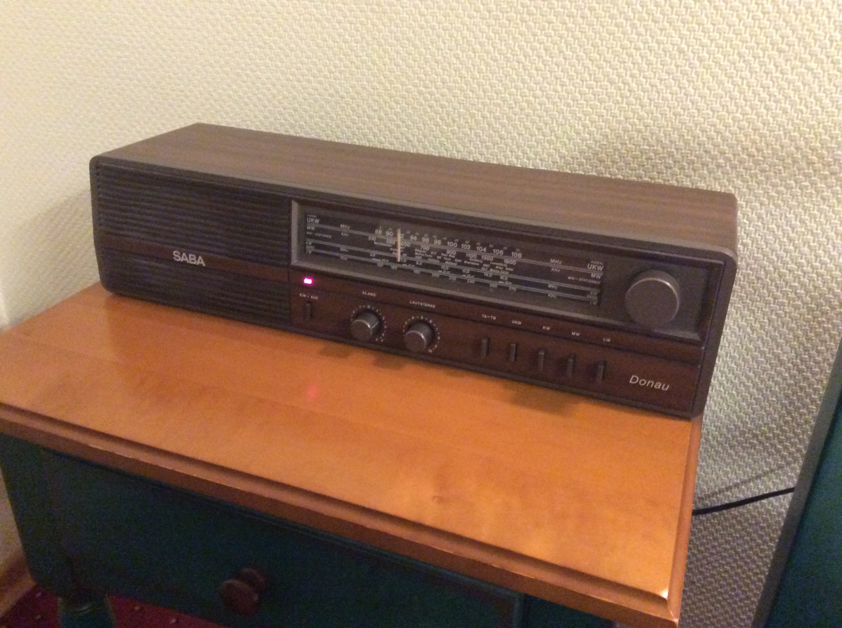

Slide 5
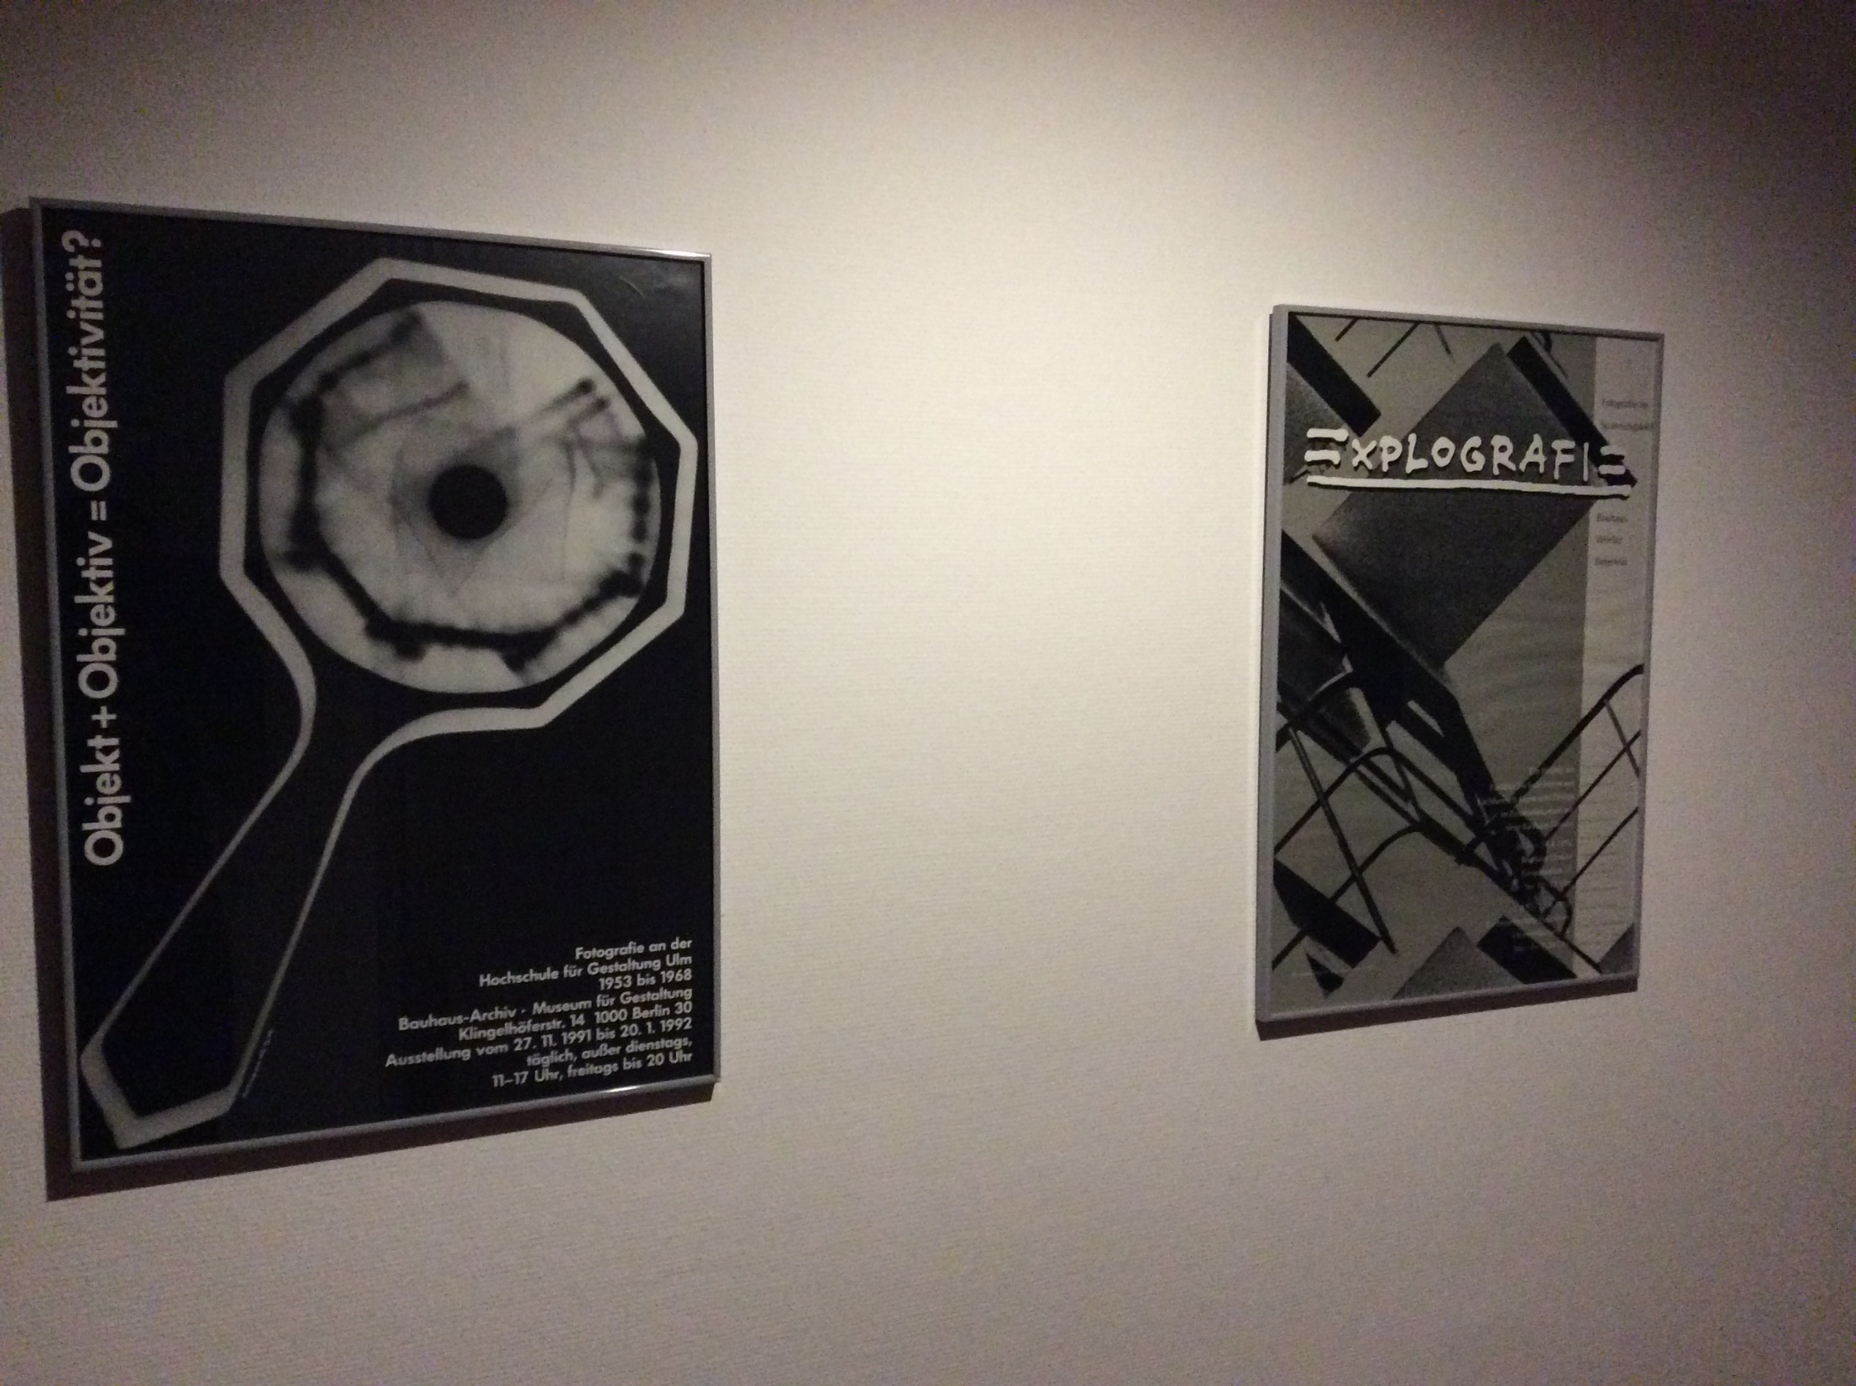

Slide 6
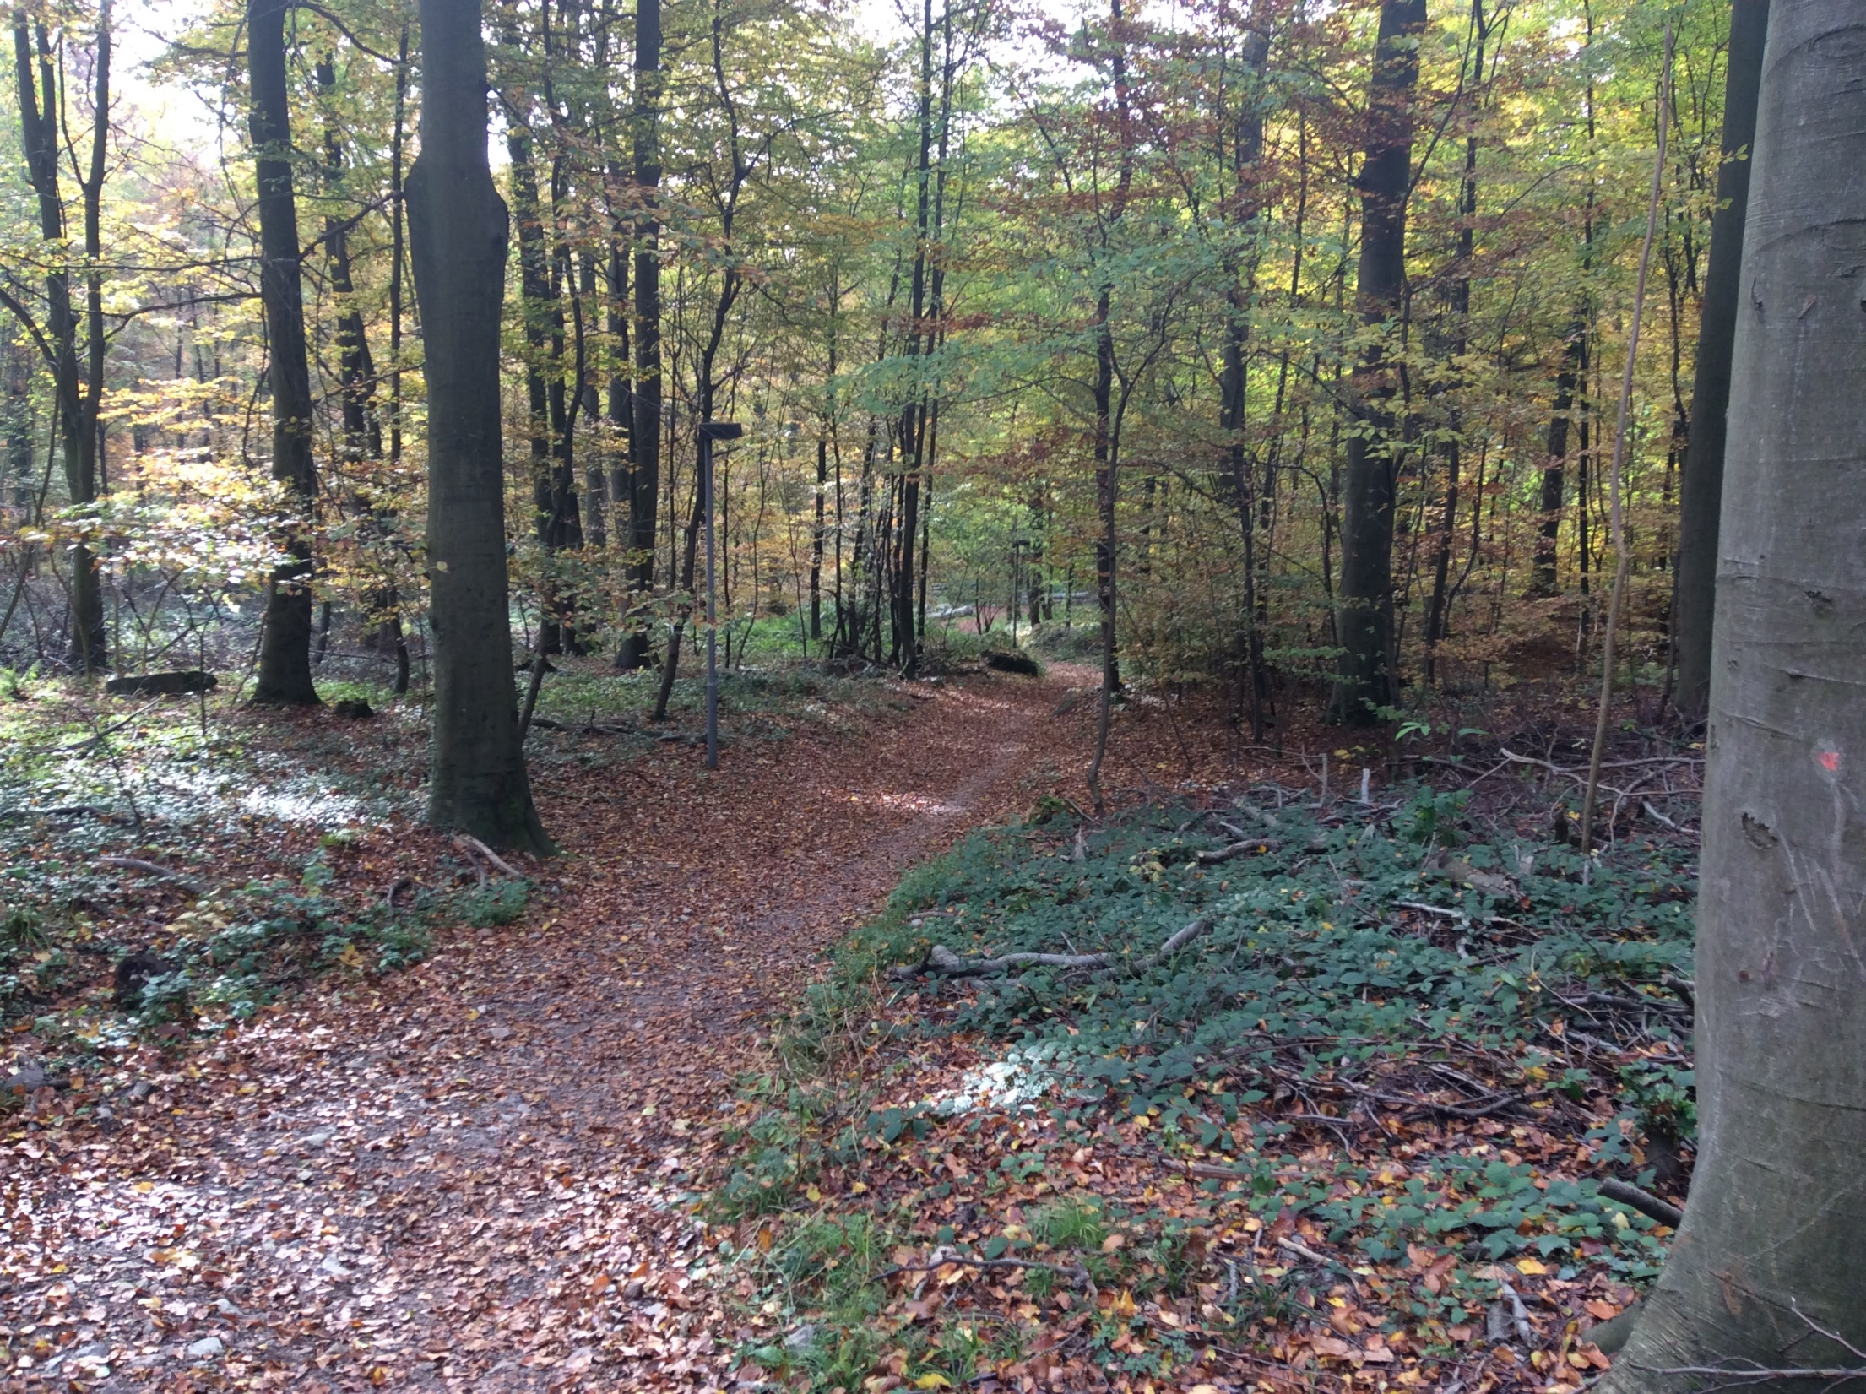

Slide 7
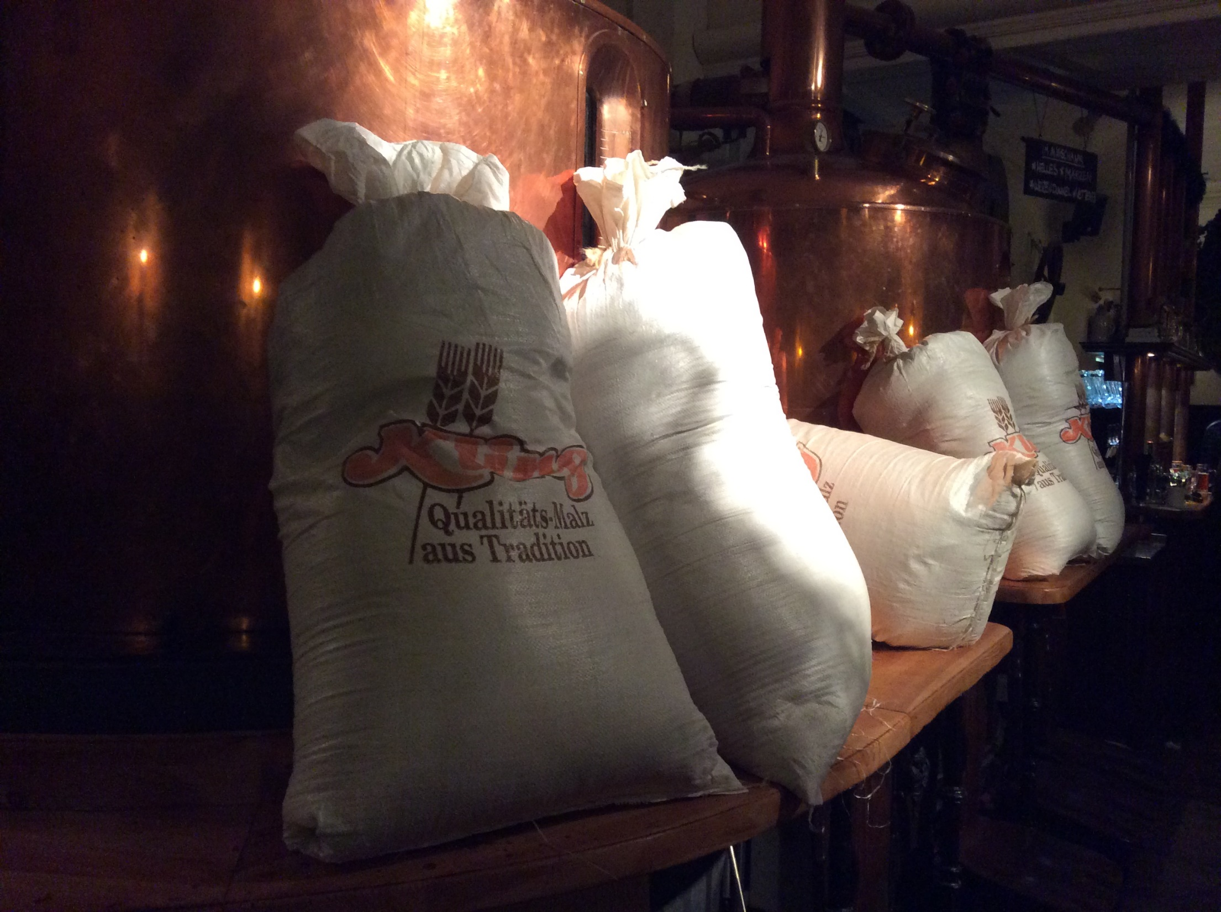

Slide 8
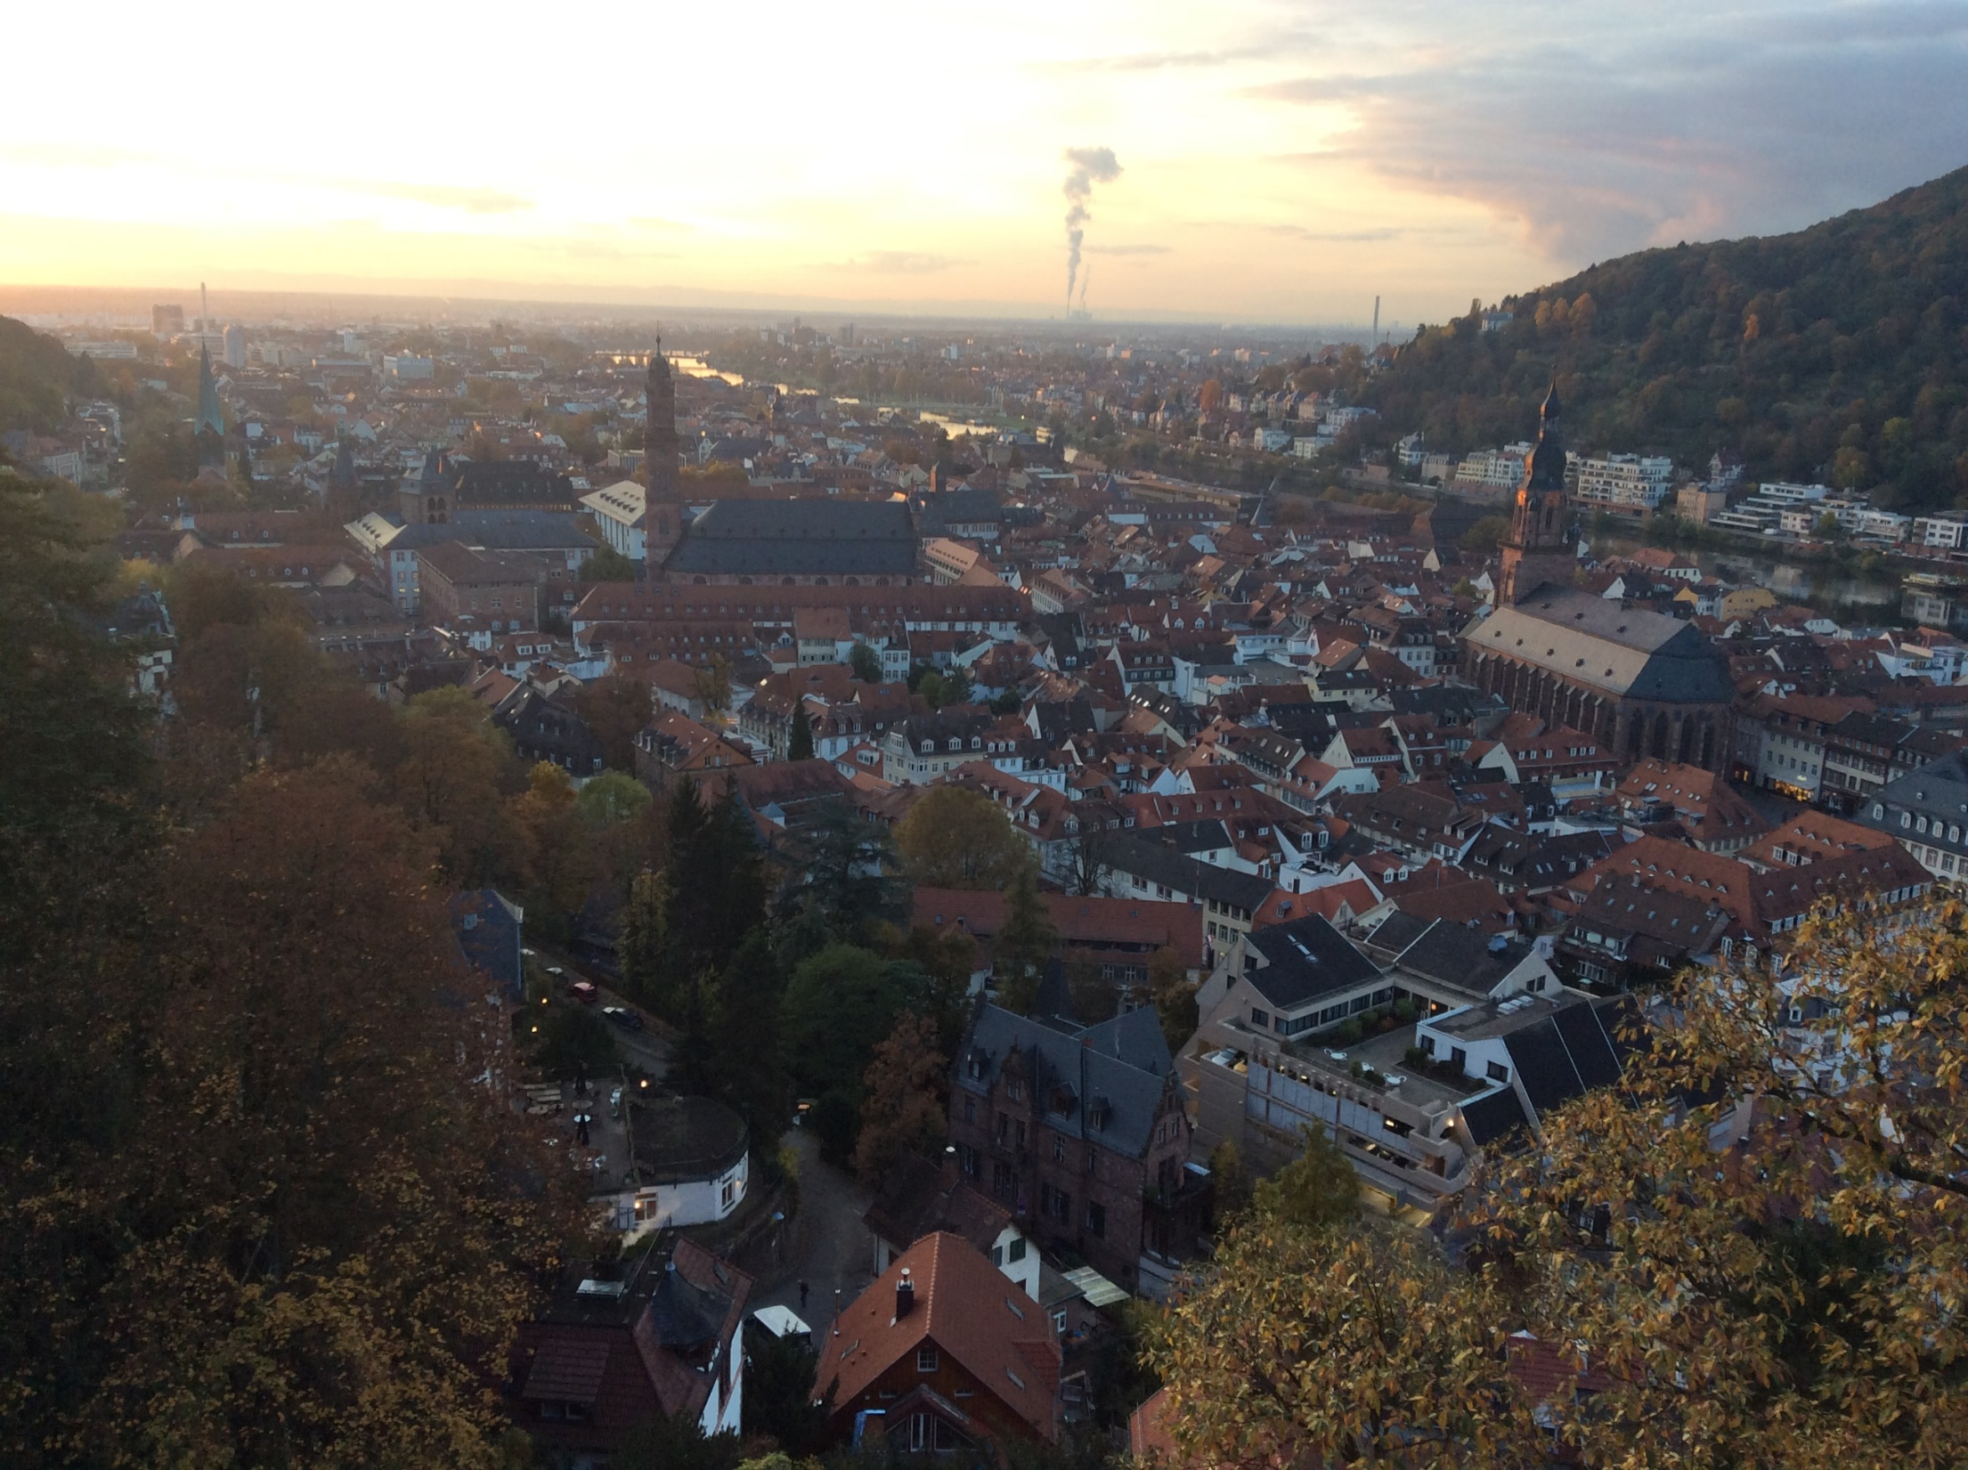

Slide 9
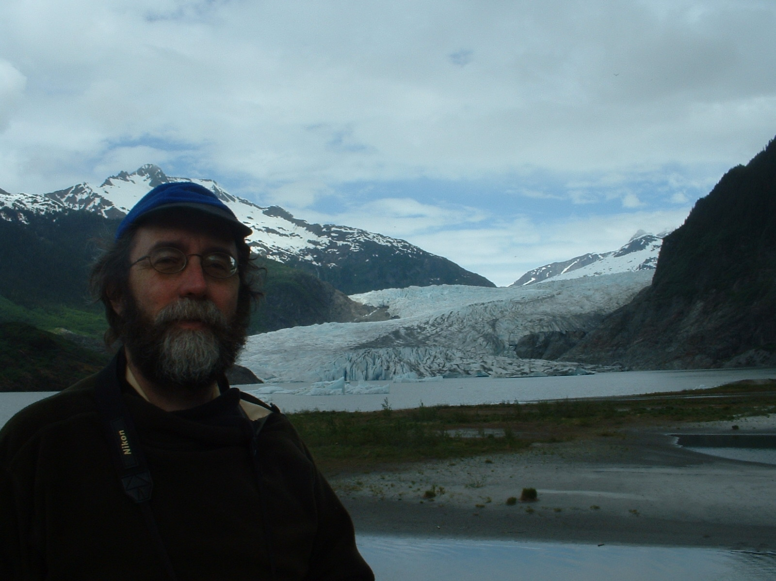
Ransom Myers in Alaska. – 2005. – 1 photograph (jpg) : 355 KB. – Photograph was originally titled “Alaska2_010.jpg” (from the Ransom Myers fonds)

Slide 10
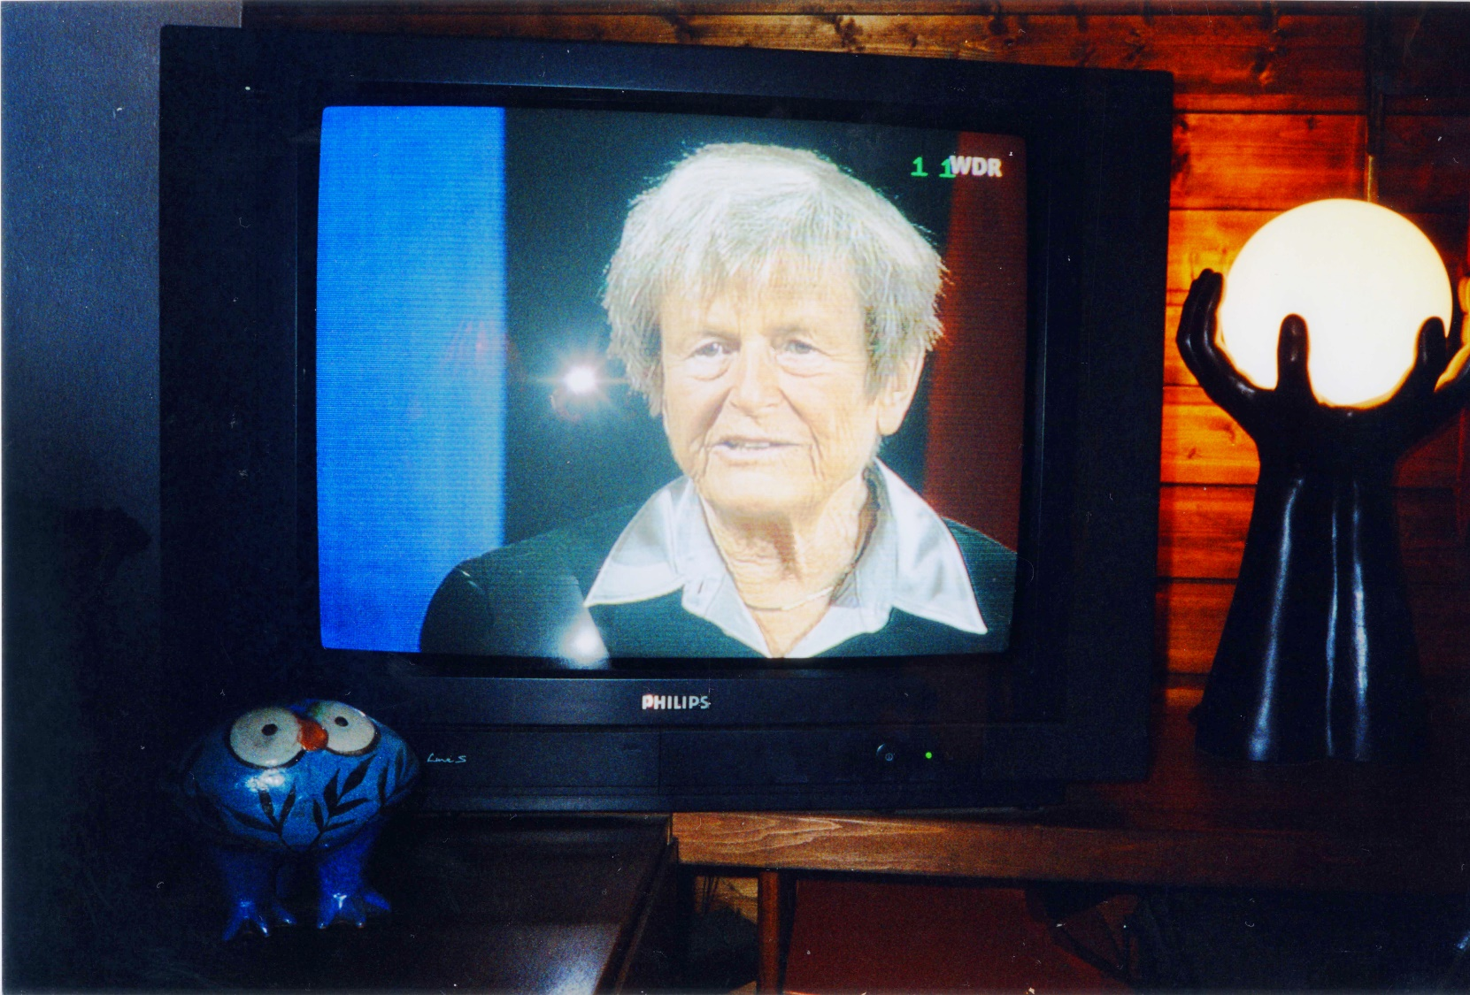
Photograph of Elisabeth Mann Borgese on a television program, MS-2-744, Box 237, Folder 30, Item 1

Slide 11
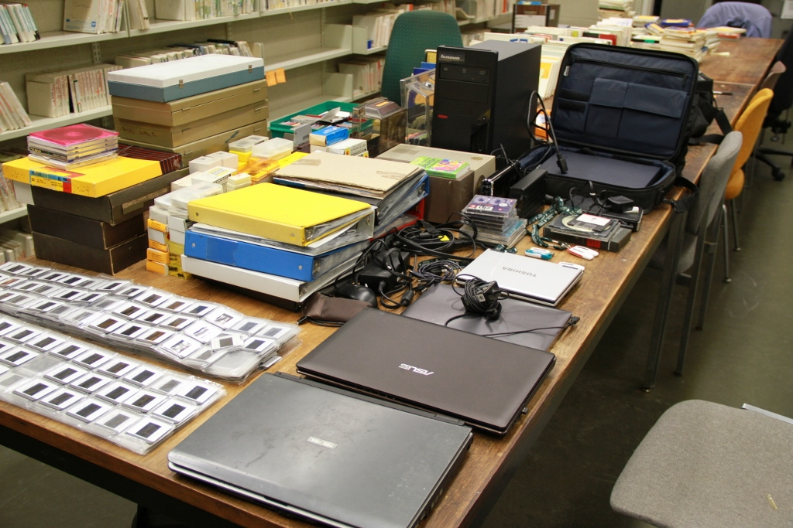
Photograph of Bill Freedman’s slide library and computers (photo by Creighton Barrett)

Slide 12
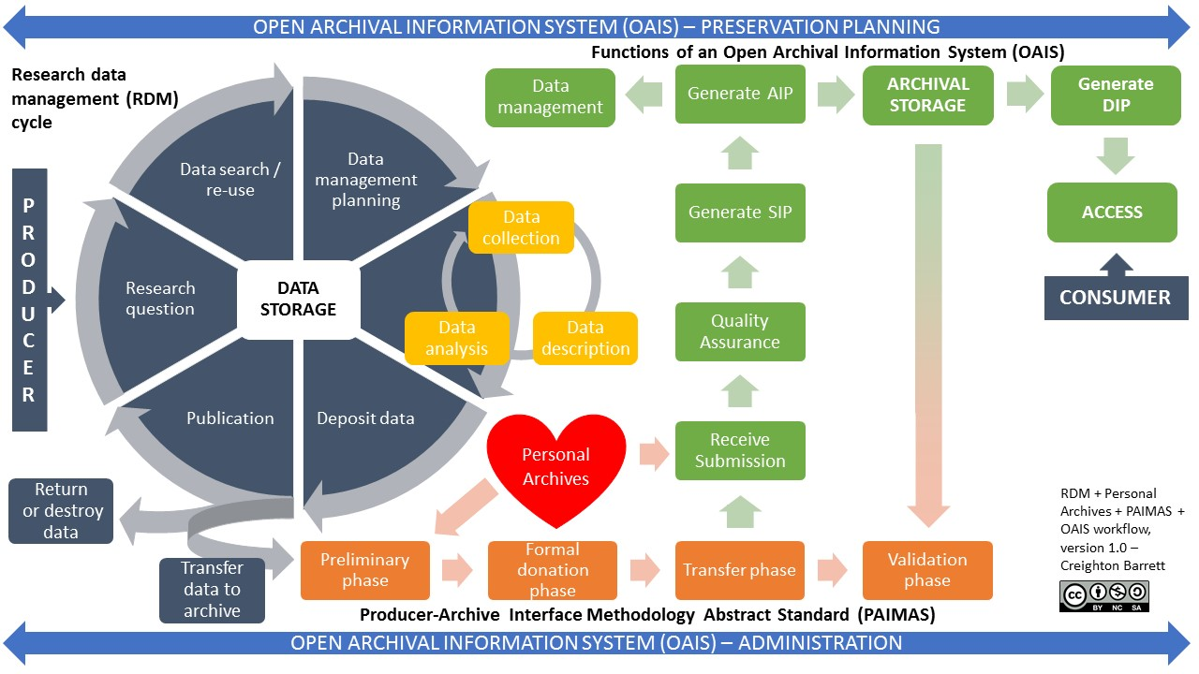

Slide 13
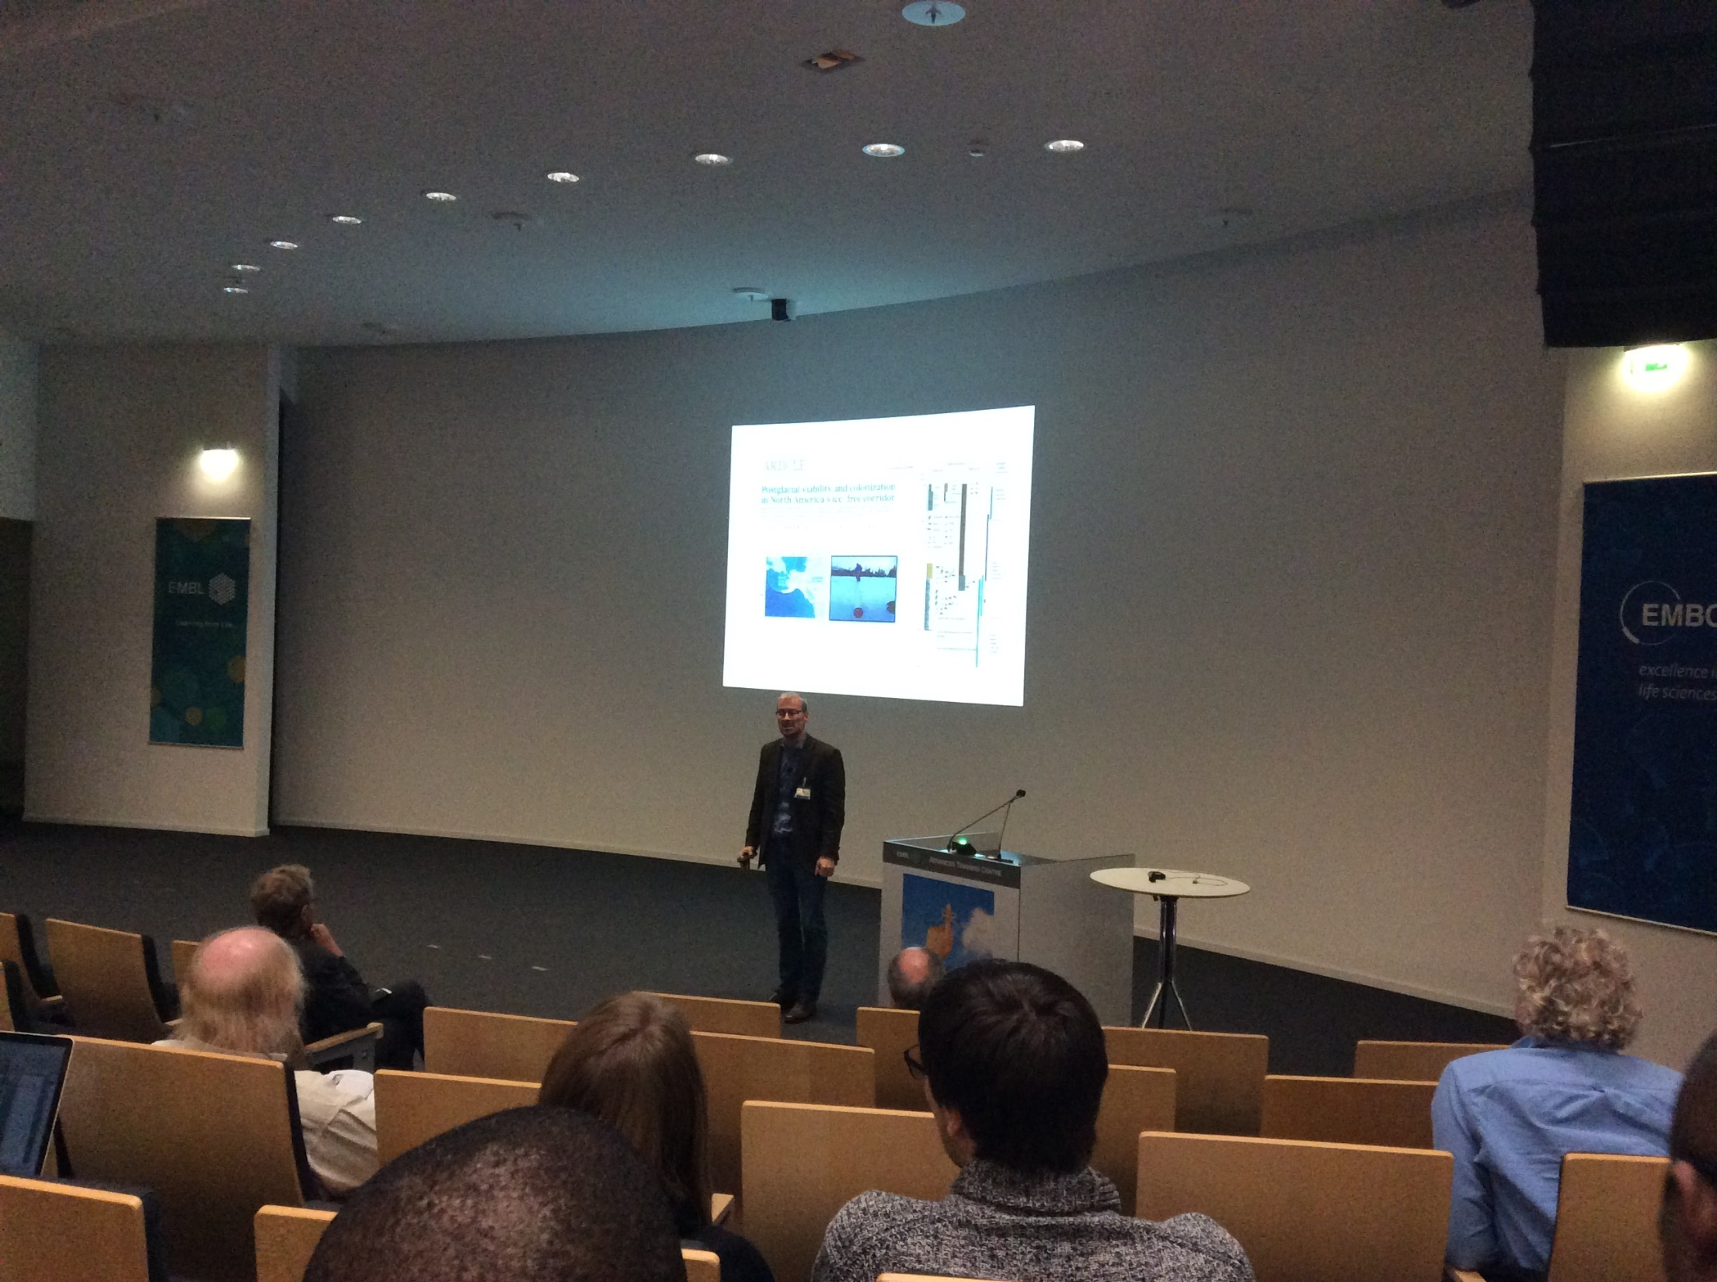
Eske Willerslev is rewriting history with DNA:
https://www.nytimes.com/2016/05/17/science/eske-willerslev-ancient-dna-scientist.html

Slide 14
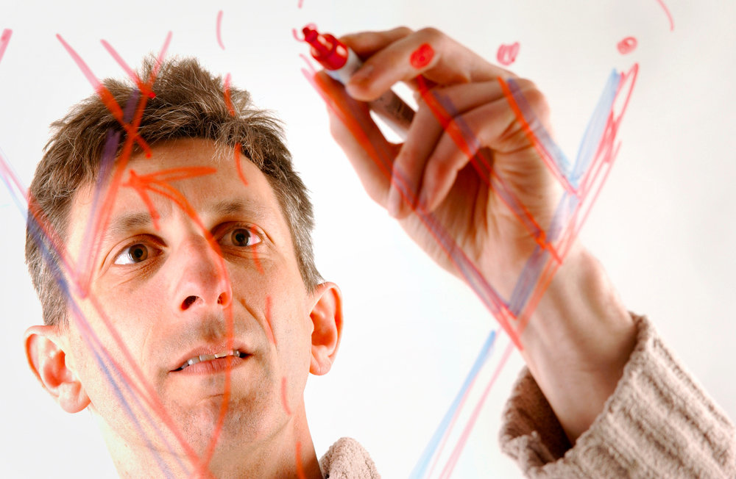
Double Helix Serves Double Duty: http://www.nytimes.com/2013/01/29/science/using-dna-to-store-digital-information.html (photo of Nick Goldman by EMBL)

Slide 15
Personal outcomes
New international network of archivists working with scientific material
Invitation to review a book on provenance for the American Archivist
Notification of “Grants to Archives” program managed by the American Institute of Physics: https://www.aip.org/history-programs/niels-bohr-library/grants-archives
Raise awareness of digital archives, Canadian archival community, etc.
Learned SO MUCH from other participants and “Science and Society” conference

Slide 16
Proposed 2018 Scientific Archives Workshop
Date: August 2018
Location: Washington, D.C.
To be organized directly before or after Society of American Archivists Conference

