Slide 1
INFO 6681 Geospatial Information Management | 18 November 2015
Geographic Information Management and Archives
Creighton Barrett

Slide 2
AGENDA
Dalhousie Archives Catalogue and Online Collections
Finding aid migration project
“Mapping” of finding aids in ArcServer
Challenges, next steps, etc.

Slide 3
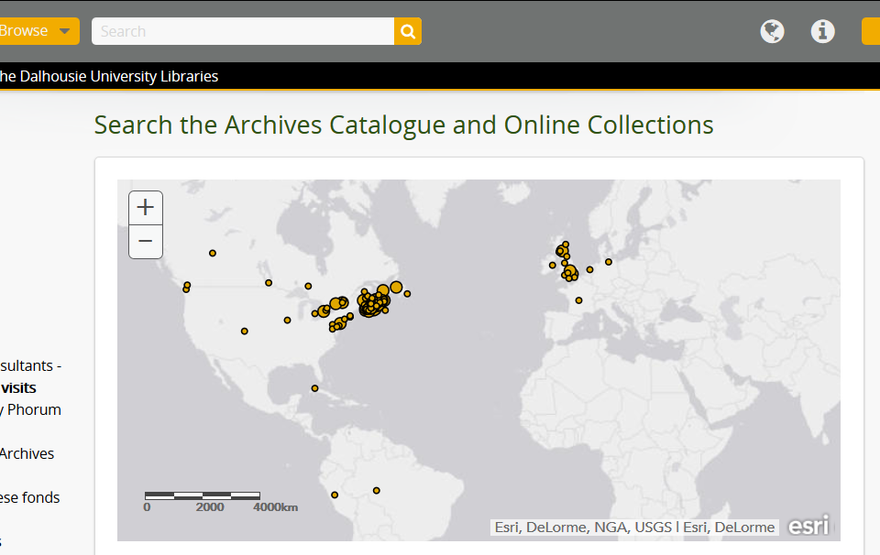
Notes:
Launched in January 2015
For the first time, fully searchable database of *all* finding aids
One large project shaped by many small projects
Work occurred during period of organizational change and physical renovations in the Libraries
Archives began working more with GIS Centre
Developed a map that plots finding aids according to geographic place names

Slide 4
ARCHIVES CATALOGUE STATS (as of November 16, 2015)
167,494 archival descriptions
3,256 authority records
686 subject headings
491 geographic headings
ca. 250,000 descriptions by January 2016
Notes:
167,494 archival descriptions
3,256 authority records
686 subject headings
491 geographic headings
By January 2016, we will have nearly 250,000 descriptions in the catalogue – we are currently preparing a new batch of very large finding aids that will be published soon

Slide 5
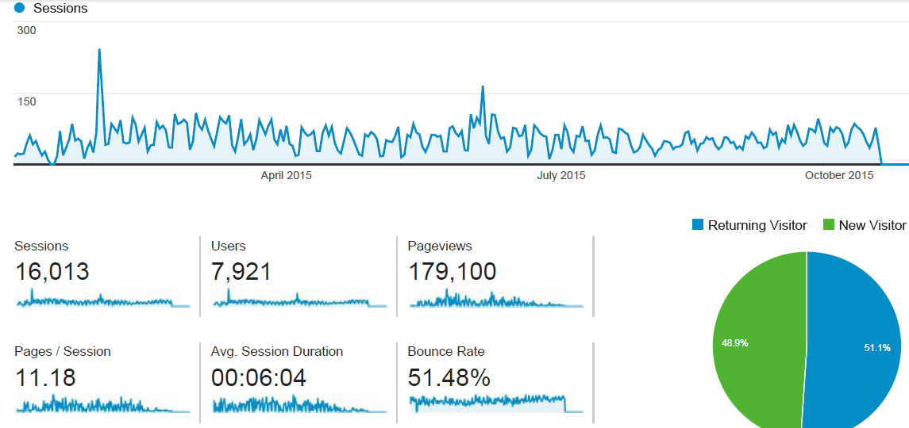
ARCHIVES CATALOGUE STATS

Slide 6
1970-2000s
Paper-based finding aids
2000s-December 2010
MS Access >> HTML finding aids
January 2011-December 2014
Launch Archives Catalogue and Online Collections
January 2015-
Launch Archivists’ Toolkit
Create subject headings and authority records
Publish map in ArcGIS
Import legacy EAD data into Archivists’ Toolkit
Finding aids migration project (import into ATOM)
Archivists’ Toolkit >> HTML finding aids
Notes:
1970: Dalhousie University Archives established
1970s – early 2000s
Typed paper-based finding aids, inventories, etc.
Provided onsite access to finding aids
Early 2000s: Developed procedures for publishing HTML finding aids
2000s – December 2010
Created EAD XML files in MS Access
Used XSLT to create HTML finding aids
Published HTML finding aids on web server
January 2011: Adopt Archivists’ Toolkit
January 2011 – January 2015
Continued publishing HTML pages on web server
Created new subject headings
Developed process to import EAD finding aids into AtoM
January 2015: Launch Archives Catalogue and Online Collections
January 2015 –
Created map of finding aids
Continued migrating data into AtoM
Refined and enhanced subject, geographic, and name authority files

Slide 7
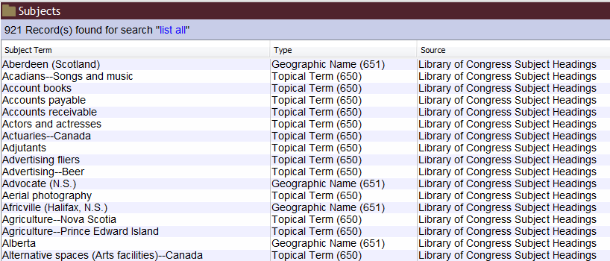
ARCHIVISTS' TOOLKIT SUBJECT HEADINGS
Notes:
Extensive internal data cleaning
Student assistants
Contract data migration specialist
Permanent staff
Cross-pollination with CNSA project
625+ multi-level EAD XML archival descriptions exported from Archivists’ Toolkit
Exported after migration checklist used
Saved as XML files with “collection ID” used as file name (e.g., MS-4-135.xml)
Internal development of custom XSLT to prepare XML files for import into AtoM
Developed technical specifications
Prepared “before” and “after” examples
Tested in Oxygen (use raw Toolkit XML export and check against “after” examples)
Tested in local AtoM instance
Refined XSLT to achieve project goals
Artefactual Systems performed migration
Used external contractor despite ongoing development of in-house expertise
Received helpful results of data analysis and testing

Slide 8
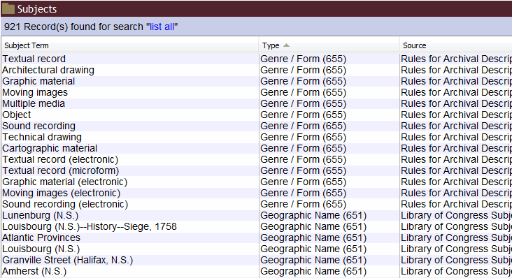
ARCHIVISTS' TOOLKIT SUBJECT HEADINGS
Notes:
Extensive internal data cleaning
Student assistants
Contract data migration specialist
Permanent staff
Cross-pollination with CNSA project
625+ multi-level EAD XML archival descriptions exported from Archivists’ Toolkit
Exported after migration checklist used
Saved as XML files with “collection ID” used as file name (e.g., MS-4-135.xml)
Internal development of custom XSLT to prepare XML files for import into AtoM
Developed technical specifications
Prepared “before” and “after” examples
Tested in Oxygen (use raw Toolkit XML export and check against “after” examples)
Tested in local AtoM instance
Refined XSLT to achieve project goals
Artefactual Systems performed migration
Used external contractor despite ongoing development of in-house expertise
Received helpful results of data analysis and testing

Slide 9
FINDING AIDS MIGRATION PROJECT
Extensive internal data cleaning
625+ multi-level EAD XML archival descriptions exported from Archivists’ Toolkit
Internal development of custom XSLT to prepare XML files for import into AtoM
Artefactual Systems did final data migration
Notes:
Extensive internal data cleaning
Student assistants
Contract data migration specialist
Permanent staff
Cross-pollination with CNSA project
625+ multi-level EAD XML archival descriptions exported from Archivists’ Toolkit
Exported after migration checklist used
Saved as XML files with “collection ID” used as file name (e.g., MS-4-135.xml)
Internal development of custom XSLT to prepare XML files for import into AtoM
Developed technical specifications
Prepared “before” and “after” examples
Tested in Oxygen (use raw Toolkit XML export and check against “after” examples)
Tested in local AtoM instance
Refined XSLT to achieve project goals
Artefactual Systems performed migration
Used external contractor despite ongoing development of in-house expertise
Received helpful results of data analysis and testing

Slide 10
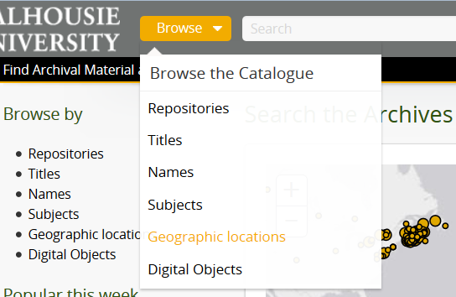
ATOM TAXONOMIES
Taxonomies were “rebuilt” based on EAD <controlaccess> headings

Slide 11
ATOM TAXONOMIES
EAD <CONTROLACCESS> ELEMENT | ATOM TAXONOMY
<corpname> or <persname> or <famname> | Authority record
<subject> | Subject heading
<geogname> | Geographic heading
<genreform> | general material designation [GMD]

Slide 12
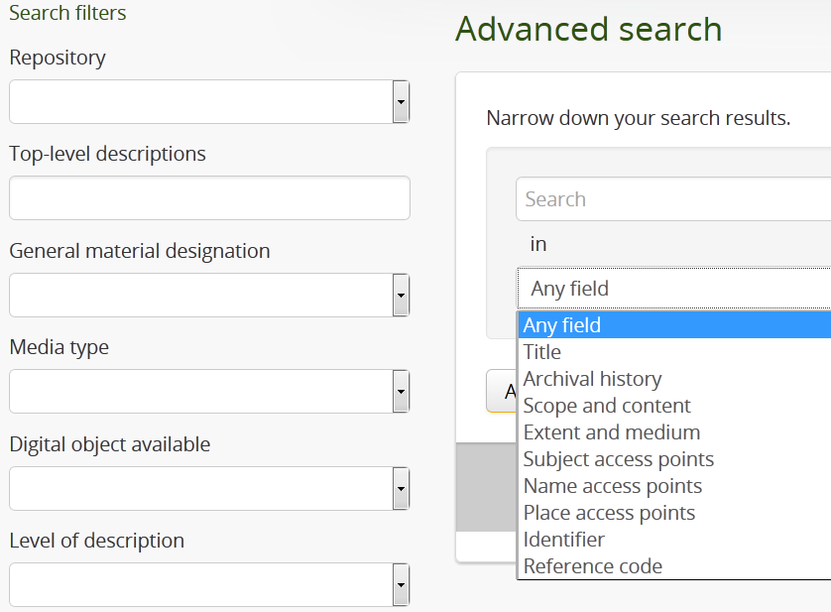
ATOM TAXONOMIES
Taxonomies were “rebuilt” based on EAD <controlaccess> headings

Slide 13
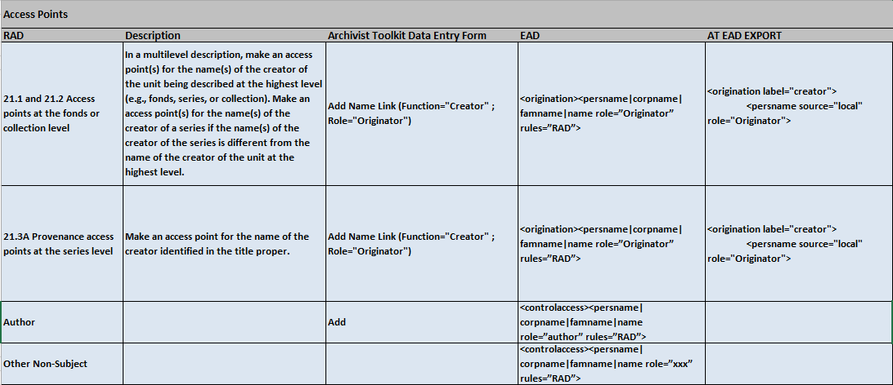
WE WORKED REALLY HARD TO
MAKE THIS WORK…

Slide 14
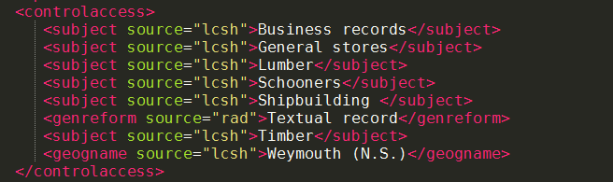
AND THERE WERE PROBLEMS…
AtoM lost “source” attribute in authority records, subject headings, genre/form statements, and geographic place names
Consider internal usage vs. external usage
Move on…

Slide 15
BUILD FINDING AIDS MAP

Slide 16
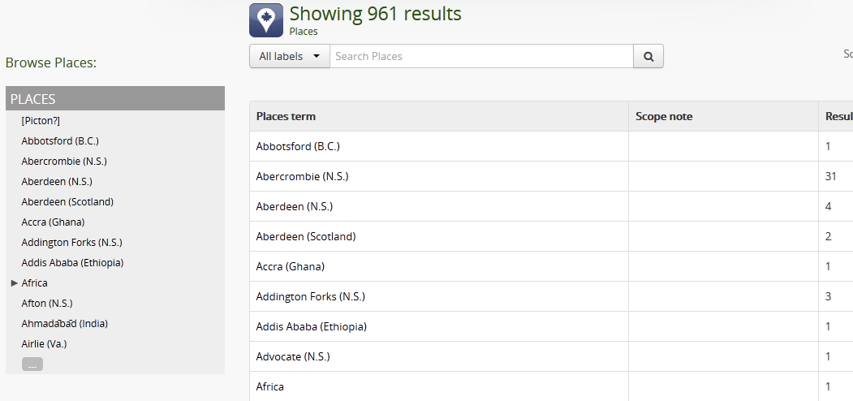
CHECK GEOGRAPHIC PLACE NAMES

Slide 17
CREATE MAP DATA
Geographic location name
Number of results
URL to geographic heading
Coordinates

Slide 18
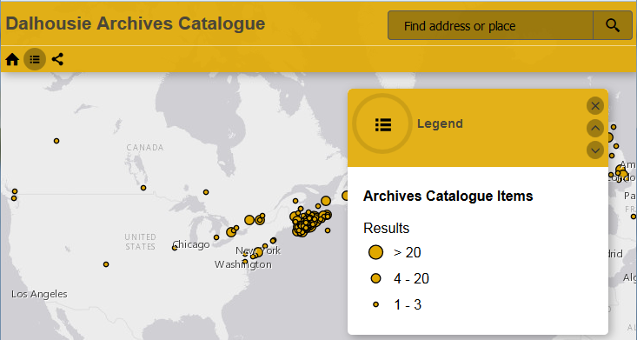
TEST PRESENTATION OPTIONS
Notes:
First approach used colour coding to distinguish between municipal headings and provincial/territorial/national headings
Second approach used three different plot sizes to indicate the number of results for a given geographic heading

Slide 19
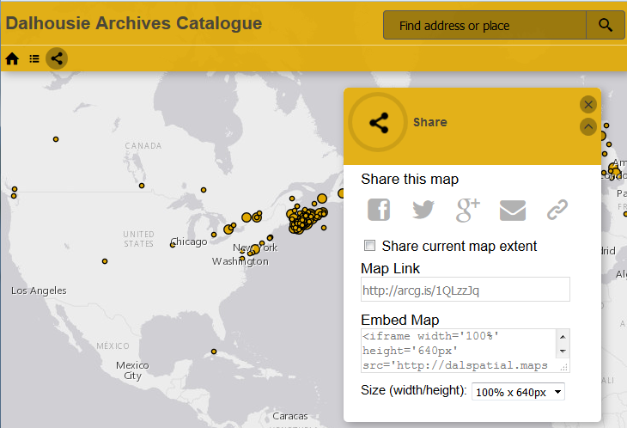
EMBED MAP WITH <IFRAME>

Slide 20
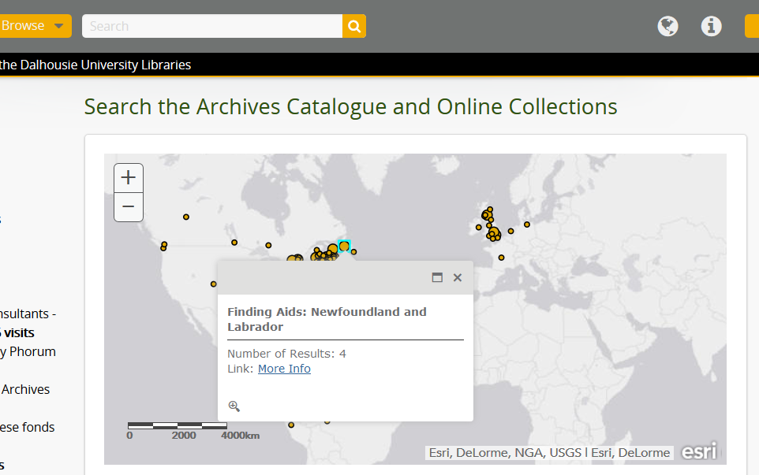

Slide 21
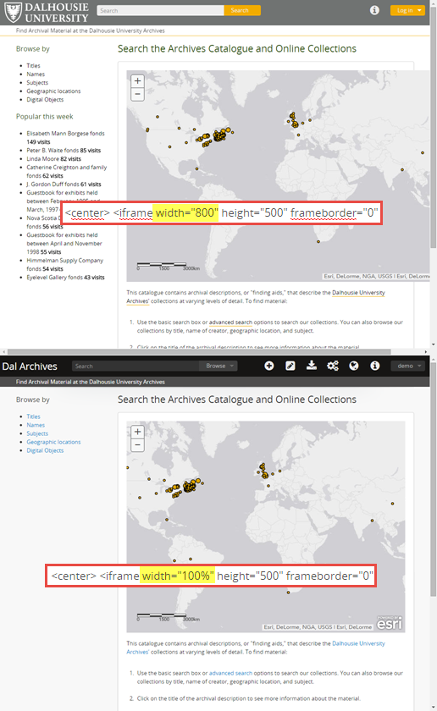
ISSUE #1: <IFRAME> IS NOT “RESPONSIVE”

Slide 22

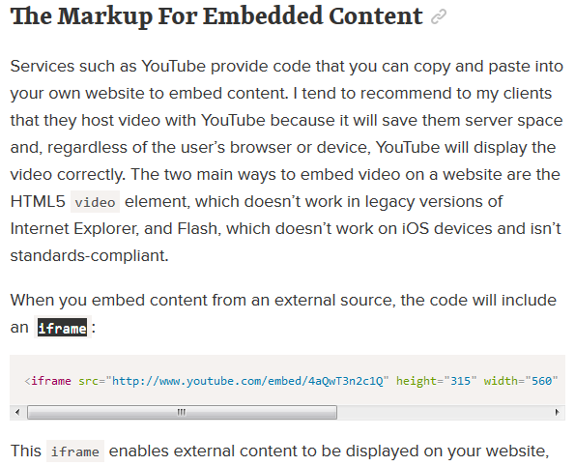
ISSUE #1: <IFRAME> IS NOT “RESPONSIVE”

Slide 23
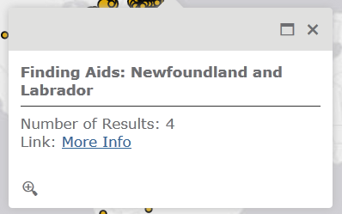
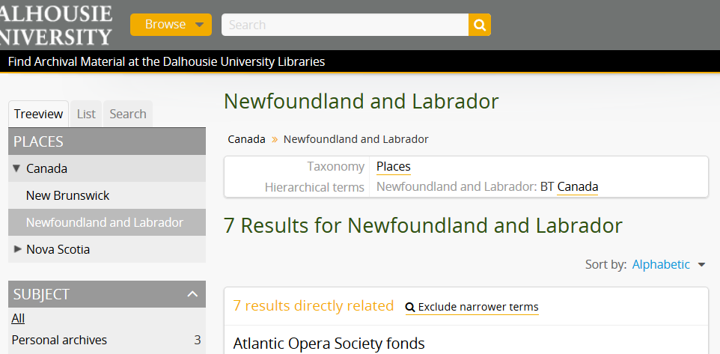
ISSUE #2: UPDATES!

Slide 24
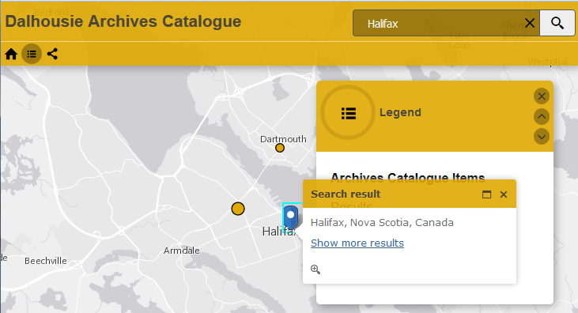
ISSUE #3: MAP SEARCH RESULTS VS. PLOTS
Notes:
If you go to the ArcServer map, you can’t search the controlled list of geographic headings.

Slide 25
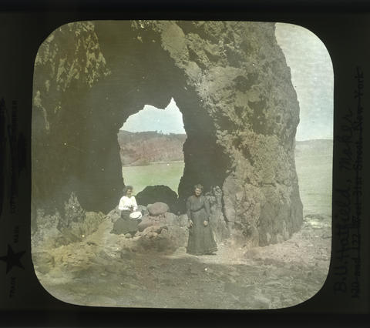
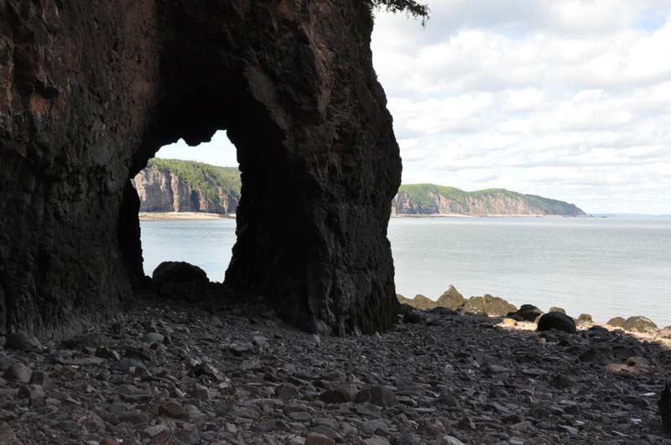
ISSUE #4: IDENTIFYING GEOGRAPHIC LOCATIONS
MS-2-781, PB Box 16, Folder 70 - Photograph of two women in front of rock arch along the Bay of Fundy
David K. Joyce Minerals: “This is a rock arch that we came upon, unexpectedly, when we rounded a corner in the bluffs.”
Notes:
If you go to the ArcServer map, you can’t search the controlled list of geographic headings.

Slide 26
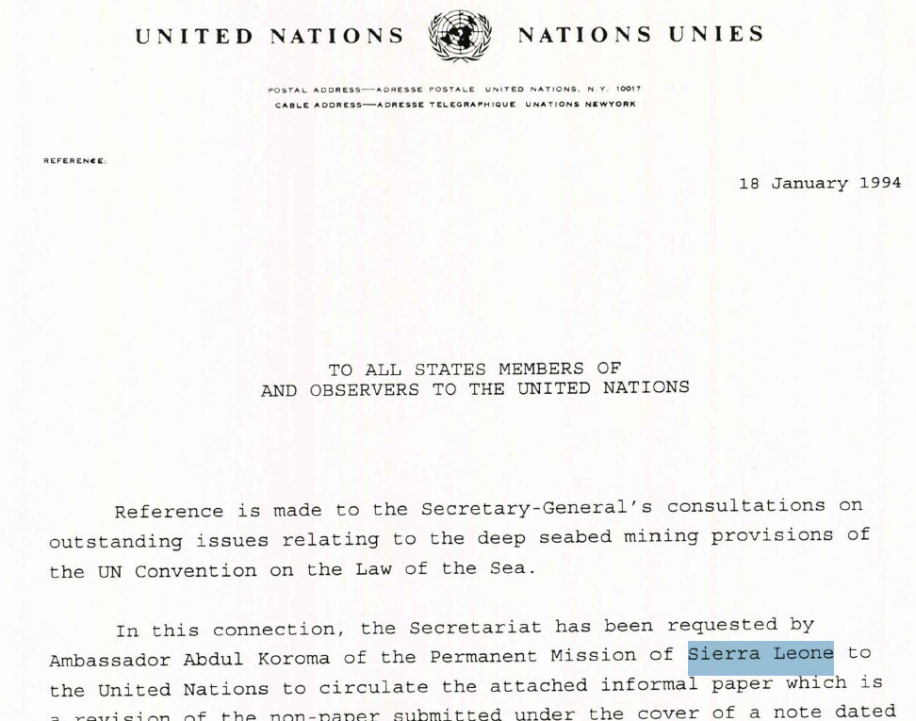
ISSUE #5:
SELECTING GEOGRAPHIC HEADINGS
MS-2-744, Box 323, Folder 18 - Boat paper and nonpaper : [informal discussion documents]

Slide 27
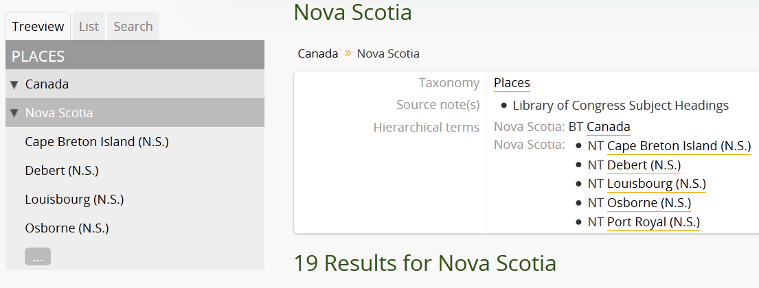
NEXT STEP: STRUCTURE GEOGRAPHIC HEADINGS

Slide 28
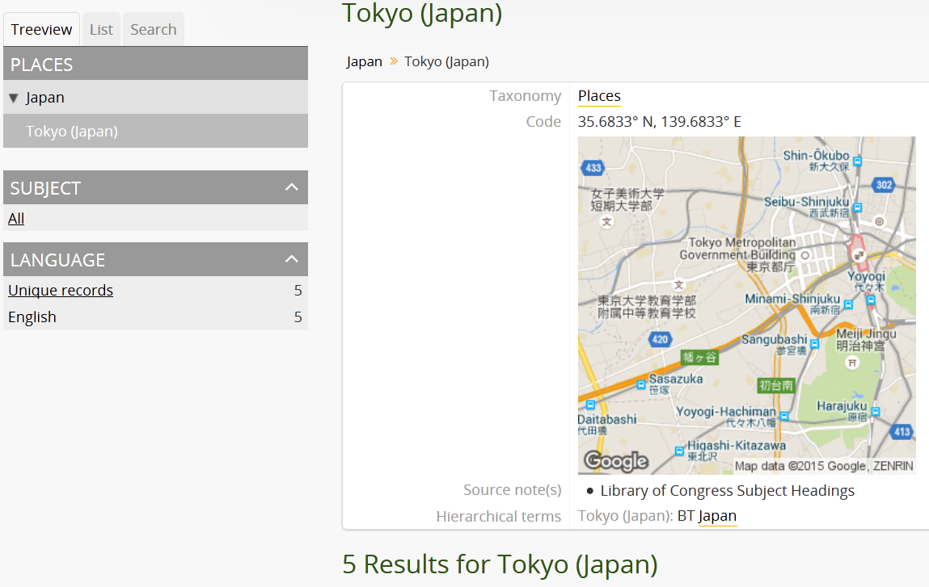
NEXT STEP: ADD COORDINATES

Slide 29
NEXT STEP: UPDATE MAP

Slide 30
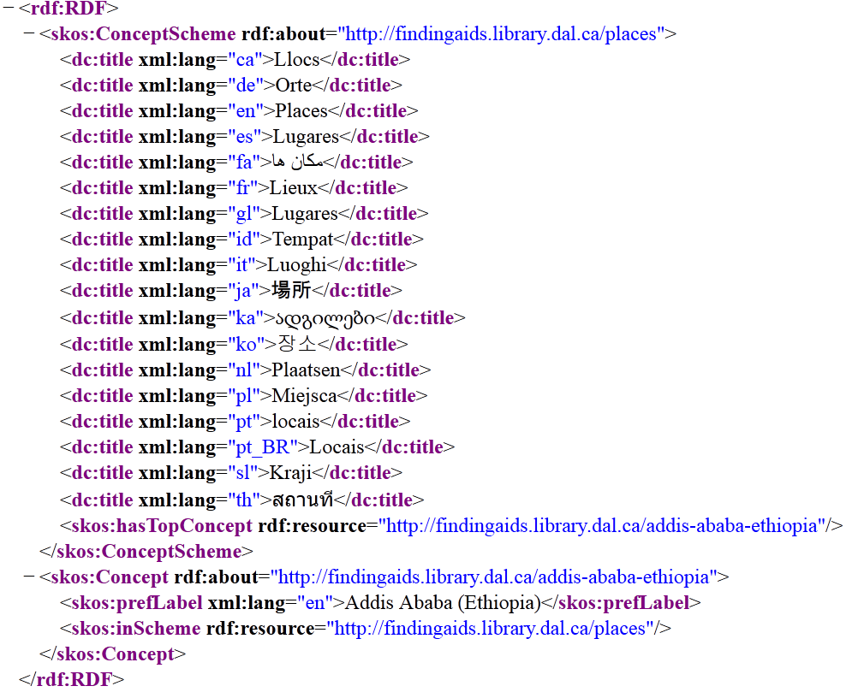
NEXT STEP: AUTOMATION?

Slide 31
IMAGE CREDITS
Slide 14: Screenshot of Dal Archives XML provided by Dal Gillean of Artefactual Systems
Slide 25: Photograph of two women in front of rock arch along the Bay of Fundy, MS-2-781, PB Box 16, Folder 70, Byron Ulric Hatfield Photograph Collection: http://findingaids-stage.library.dal.ca/photograph-of-two-women-in-front-of-rock-arch-along-bay-of-fundy
Slide 25: Photograph of rock arch, David K. Joyce Minerals website: http://www.davidkjoyceminerals.com/pagefiles/activities_detail.asp?ProdID=arch

