Slide 1
Library Council
October 15, 2015
DIGITAL ARCHIVES UPDATE
Creighton Barrett
Digital Archivist
http://hdl.handle.net/10222/64480

Slide 2
OVERVIEW
“Pilot” Archives Document Delivery Service
Archives Catalogue and Online Collections
Copyright Tools

Slide 3
PILOT PROJECT
Digital copies of analog materials found in archives catalogue can be requested through a new archives document delivery form
Requests are (usually) free for Dalhousie community

Slide 4
PILOT PROJECT
Limitations on large and “complex” files, media types, etc.
Service is not available to consortia members (at least for duration of pilot project)

Slide 5
RATIONALE FOR PILOT PROJECT
Merge “parallel” archives reproduction service with established document delivery service
Help embed archives in other core library services

Slide 6
RATIONALE FOR PILOT PROJECT
Utilize robust library IT services
Utilize “file-level descriptions” in archives catalogue
Increase awareness of archives

Slide 7
RATIONALE FOR PILOT PROJECT
Build on Elisabeth Mann Borgese Digitization Project
Help to increase open access to Archives Permanent Collection

Slide 8
UNIVERSITY ARCHIVES
Assist users with archives document delivery form
Develop tutorials and promote service
Lead digitization efforts

Slide 9
DOCUMENT DELIVERY
Helped establish archives document delivery form
Liaise with Relais
Contribute to digitization efforts

Slide 10
WORKFLOW

Slide 11
1
Researcher submits archives document delivery request
Receive Request
File-level Description
Prep Materials
Create TIFFs
Compile PDF
OCR PDF
Deliver PDF
Retrieve materials from Archives storage area
Print PDA and attach to cover of folder(s)
Determine if request can be fulfilled

Slide 12
2
Dal Libraries Digitization Standards and Best Practices
Prep Materials
Assess size/format of materials
Remove fasteners
Insert strips of paper to flag documents
File-level Description
Prep Materials
Create TIFFs
Compile PDF
OCR PDF
Deliver PDF

Slide 13
3
Dal Libraries Digitization Standards and Best Practices
Create TIFFs
600 dpi 24-bit colour TIFFs
TIFF directory structure based on reference code
TIFF filename based on reference code “prefix” + sequence
File-level Description
Prep Materials
Create TIFFs
Compile PDF
OCR PDF
Deliver PDF

Slide 14
3
Example of a reference code
MS-3-35, Box 46, Folder 15
MS-3-35
  46
    46.15
TIFF directory structure based on reference code
TIFF filename based on reference code “prefix” + sequence
MS-3-35_46_15_001.tiff
MS-3-35_46_15_002.tiff

Slide 15
4
Dal Libraries Digitization Standards and Best Practices
Compile PDF
Custom TIFF2PDF script developed by Libraries’ IT
Add filepaths to “toprocess.ini” file
Nightly CRON job runs script
File-level Description
Prep Materials
Create TIFFs
Compile PDF
OCR PDF
Deliver PDF

Slide 16
5
Dal Libraries Digitization Standards and Best Practices
OCR PDF
Assess linguistic features (language/script)
OCR in ABBYY FineReader
QA processes
File-level Description
Prep Materials
Create TIFFs
Compile PDF
OCR PDF
Deliver PDF

Slide 17
6
Fulfill researcher request
Deliver PDF
Fulfill PDA
Use Copyright Assessment Tool
Update archival description
Upload to archives catalogue if permissible
File-level Description
Prep Materials
Create TIFFs
Compile PDF
OCR PDF
Deliver PDF

Slide 18
PILOT PROJECT CHALLENGES
Integrating new service
Technical infrastructure
Potential workload
Rights management
Notes:
INTEGRATING NEW SERVICCE INTO LIAISON LIBRARIAN ACTIVITIES
Info session for liaison librarians?
Add information to Libraries website and “central” LibGuide
Request referrals be sent to Archives
TECHNICAL INFRASTRUCTURE
Consultation between Digital Archivist and Libraries IT
Training for Archives and Doc Del staff
Evolving storage environment
Evolving OCR procedures
POTENTIAL WORKLOAD
Hard to anticipate
What if it’s too popular?
What if it’s not popular enough?
When does the file become too complicated?
Importance of project tracking spreadsheet
RIGHTS MANAGEMENT
Lots of possibilities, little clarity
Development of copyright consent form and takedown request form
“Adoption” of SFU Archives rights management tools
Consultation with Copyright Services Coordinator and Legal Counsel

Slide 19
COLLECTING DATA ON PILOT PROJECT
LibAnalytics + Tracking spreadsheet
Relais reports
Google Analytics
Notes:
TRACKING SPREADSHEET
Excel file based on Elisabeth Mann Borgese Digitization Project
Tracks certain parts of workflow

Slide 20
ANALYZING AND USING STATISTICS
Results will inform assessment of pilot project
Results will inform digitization project planning

Slide 21
ARCHIVES CATALOGUE

Slide 22
ARCHIVES CATALOGUE AND ONLINE COLLECTIONS
Launched in January 2015
Over 165,000 catalogue records
Over 2,000 digital objects

Slide 23
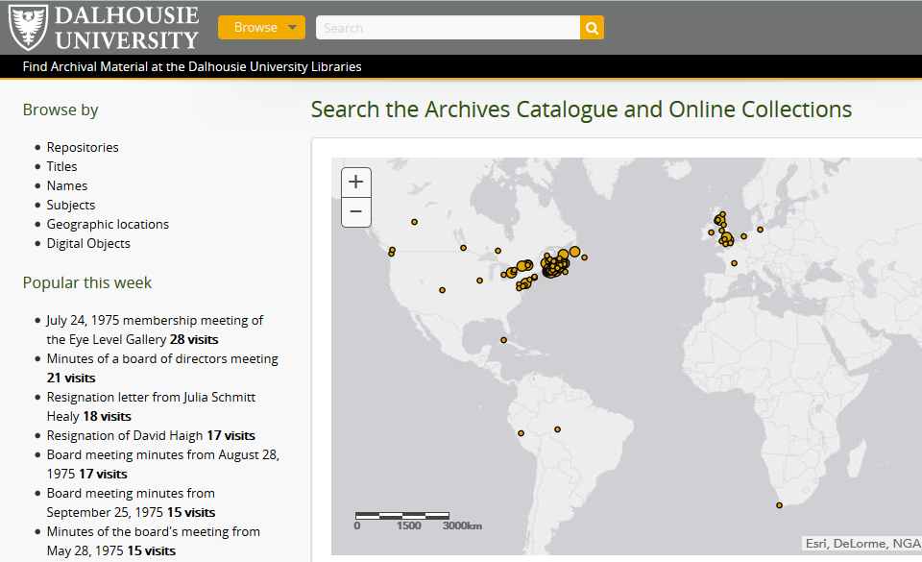

Slide 24
ARCHIVES CATALOGUE AND ONLINE COLLECTIONS “NEXT STEPS”
Metadata migration
Systems architecture
Digital objects (tens of thousands in “backlog”)

Slide 25
READ ONLY DATABASES
DATABASES
ARCHIVES CATALOGUE
DEVELOPMENT SITE
DEV-DATABASE
ARCHIVES CATALOGUE
DATA “STAGING” SITE
STAGE-DATABASE
PUBLIC-DATABASE
ARCHIVES CATALOGUE
PUBLIC SITE
LIVE-DATABASE

Slide 26
COPYRIGHT TOOLS

Slide 27
NEW COPYRIGHT TOOLS
Copyright consent form
Copyright assessment tool
Takedown request protocol
Takedown request form

Slide 28
COPYRIGHT ASSESSMENT TOOL
Owner’s economic rights
Author’s moral rights
Owner’s history of copyright defense
Author / owner’s relationship to Dalhousie University

