Slide 1
Twenty-Five Years of Popular Music in Nova Scotia: The Archives of Solar Audio and Recording Limited
Fountain School of Performing Arts, Dalhousie University
Performing Arts Research Forum
Creighton Barrett
October 1, 2015
Notes:
Agenda:
Introduce three research questions
Introduce Solar Audio and Recording Limited
Summarize archival work to date
Discuss research questions

Slide 2
Research questions in the University Archives
How much “local music” should the University Archives preserve?
How should archivists describe multi-track sound recordings?
How should the Libraries service the archives of Solar Audio and Recording Limited?
Archival Theory
Archival Practice

Slide 3
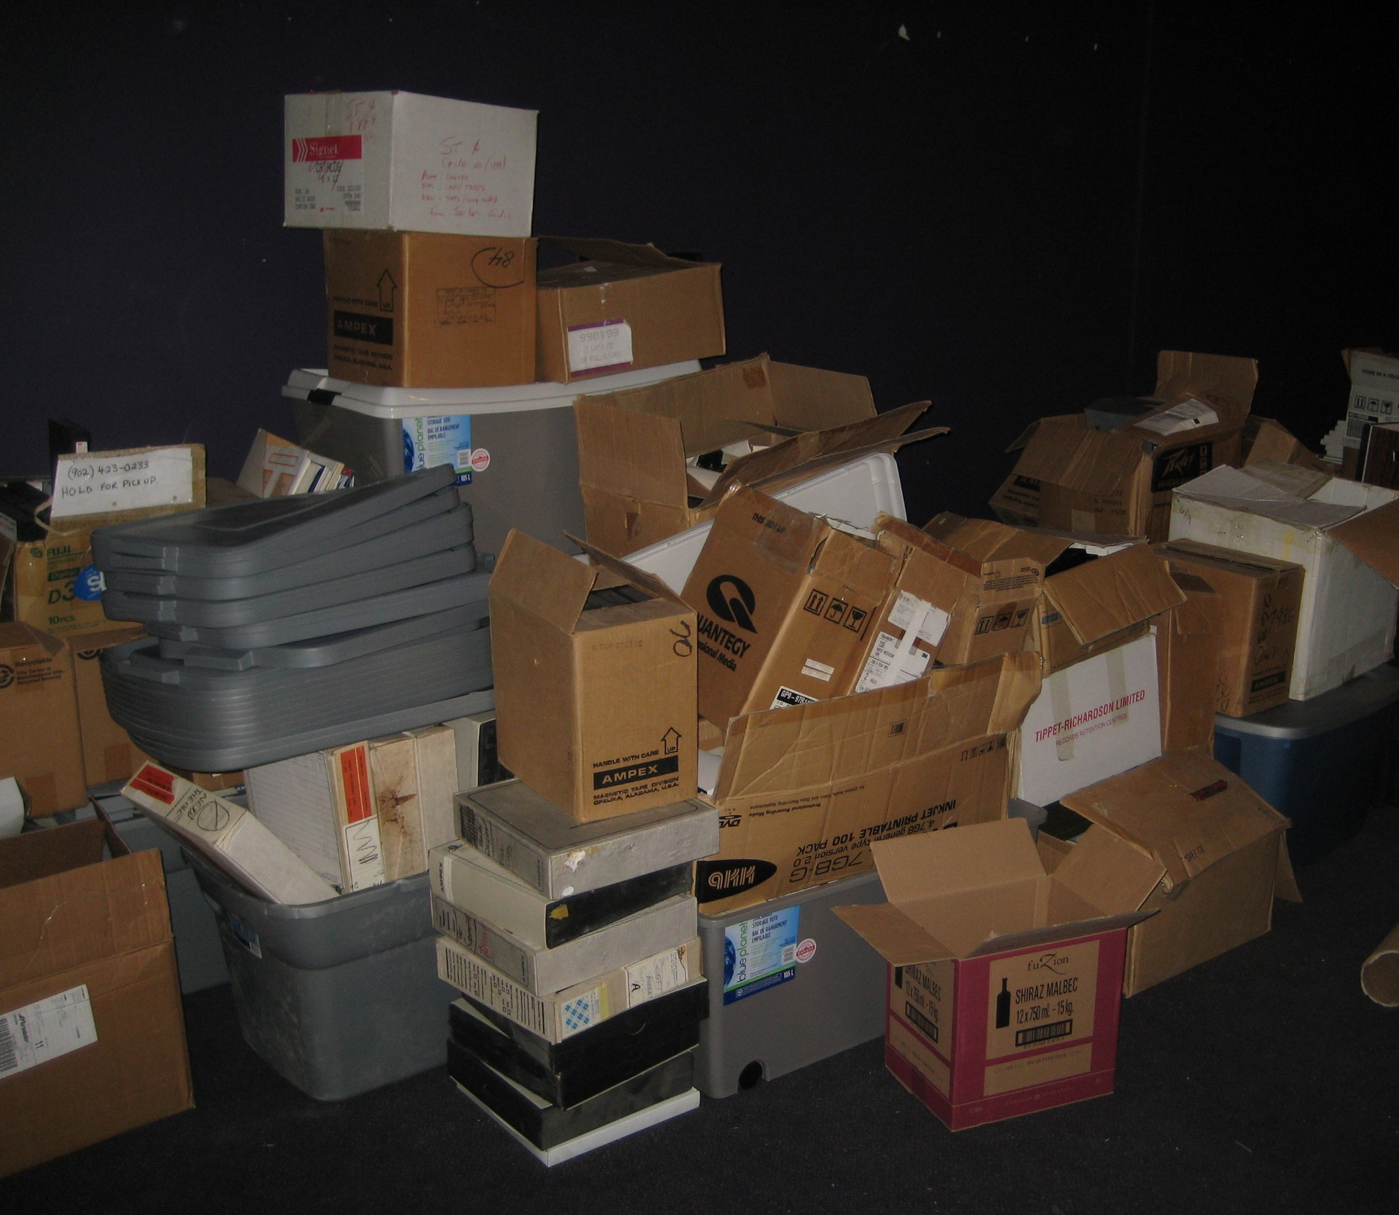
Solar Audio
and Recording Limited
Studio founded by Russell Brannon
Acted as “label” for many bands
Master tapes and stereo mixes left in attic on Cunard Street…

Slide 4
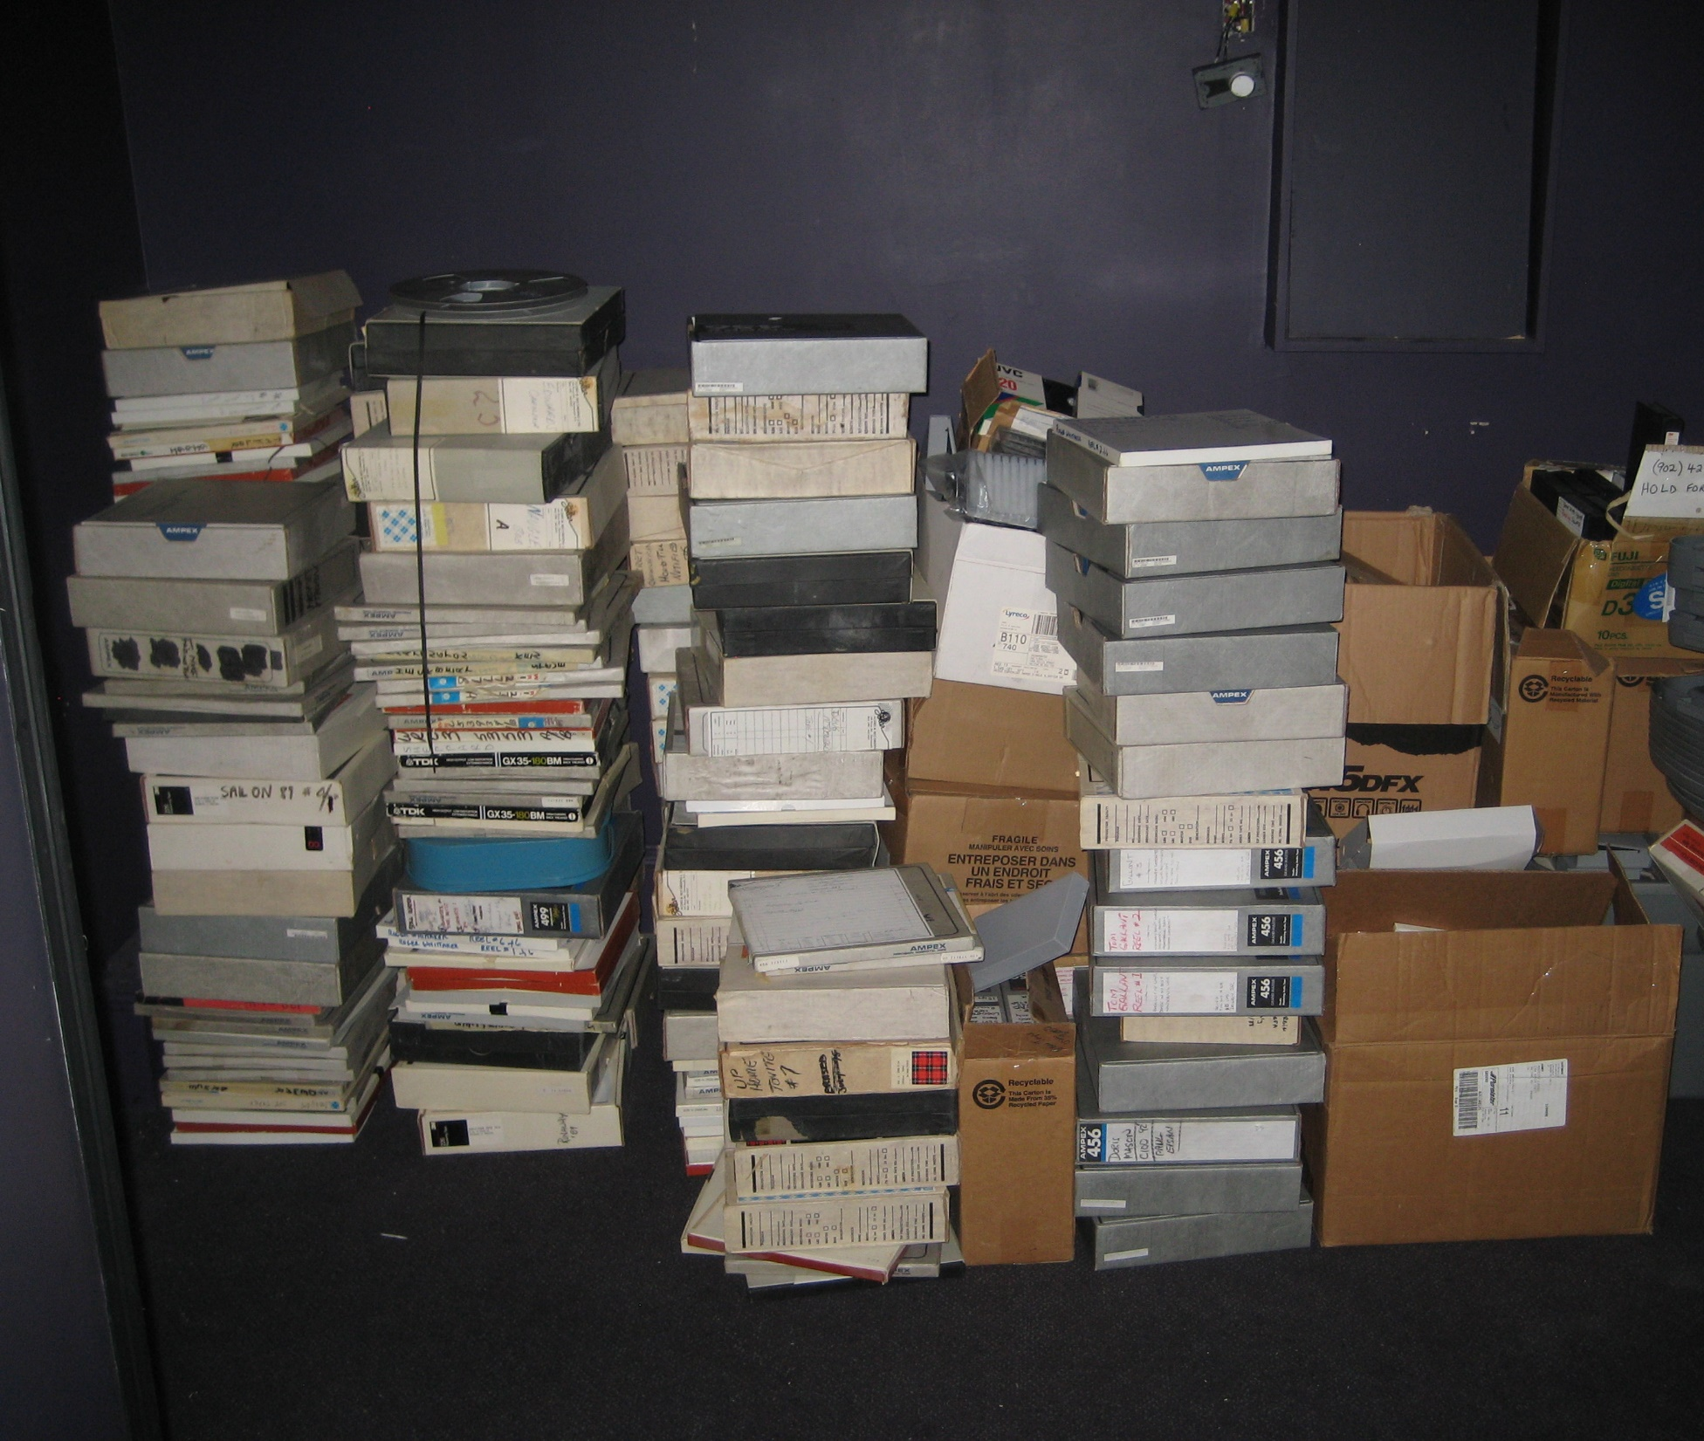
Solar Audio
and Recording Limited
Recorded many well-known artists
Recorded many unknown artists
“Paid the bills” by recording radio advertisements

Slide 5
Archival work to date
Chronological organization of tapes
Research on digitization and archival description of sound recordings…
Archival description of over 860 tapes
Creation of new “authority records” for many recording artists
Successful “test” digitization of multi-track tapes and stereo mixes

Slide 6
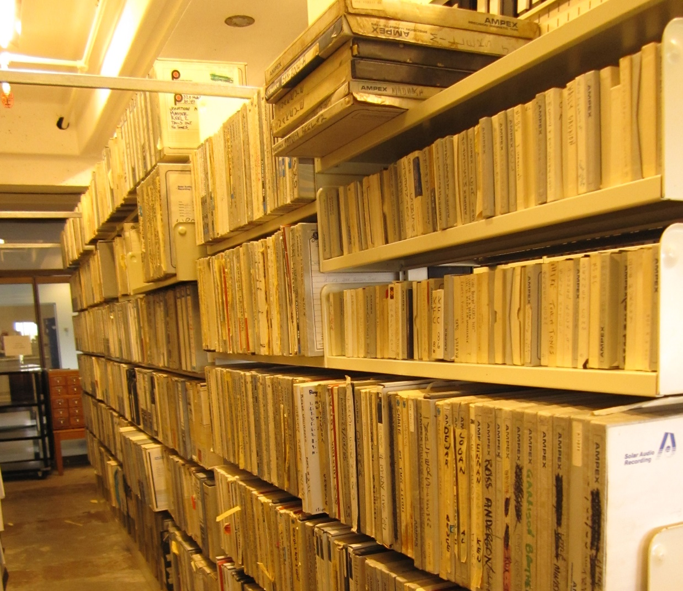
Chronological organization of Solar Audio Recording tapes in Dalhousie University Archives storage
Notes:
Chronological organization, but each format is organized separately.

Slide 7
Research on digitization and description of sound recordings
Audiovisual archives reading courses
Ongoing work with Helen Creighton sound recordings
Kevin Hartford, Audiovisual Archives Assistant
Dave MacLachlan, Young Canada Works Audiovisual Archives Intern
Recent audiovisual digitization projects with The MediaPreserve (audiovisual digitization vendor)

Slide 8
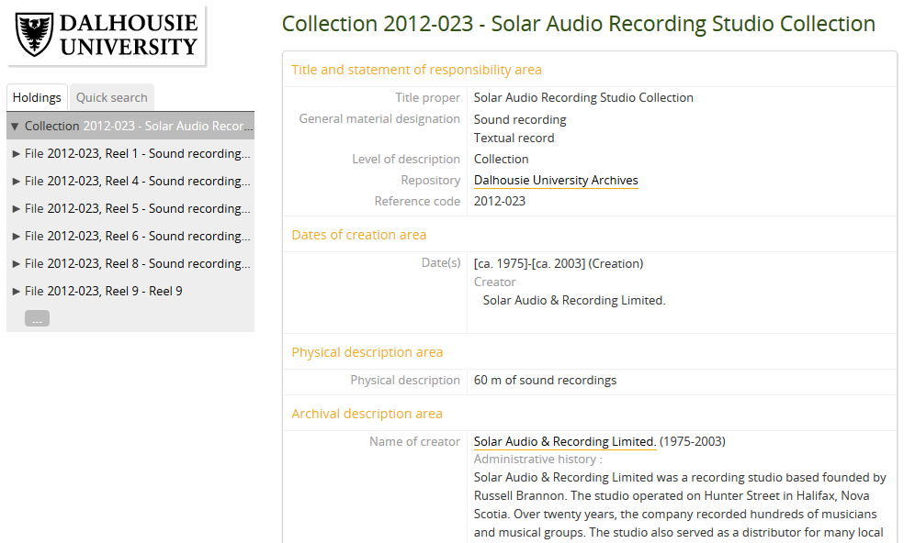
“Collection Level” description

Slide 9
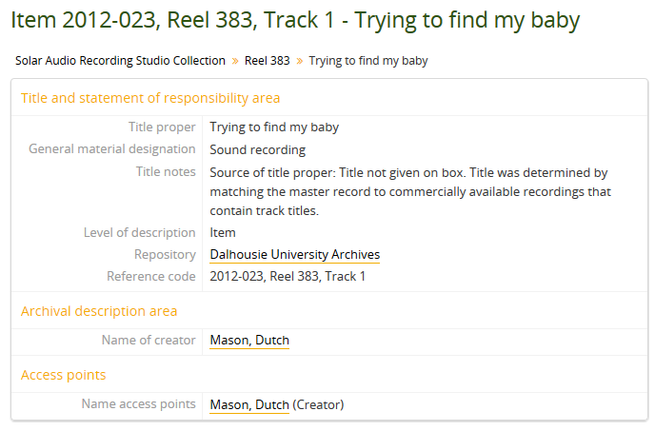
“Item-Level” Description of Dutch Mason recording

Slide 10
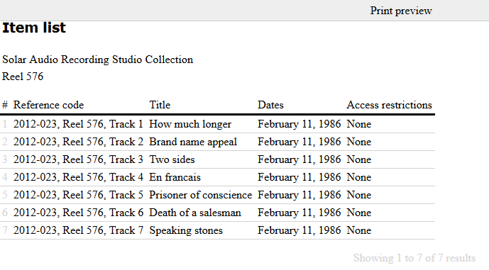
“Item-Level” Descriptions of Killer Klamz recordings

Slide 11
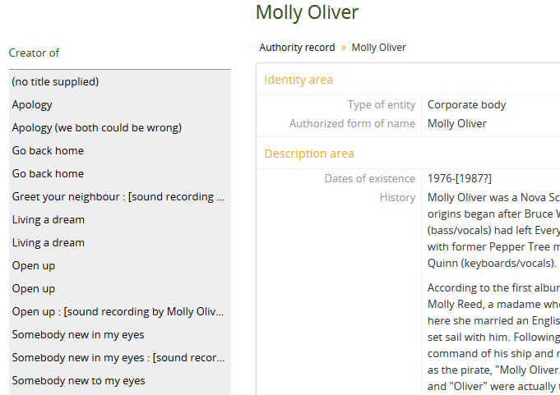
“Authority Record” for Molly Oliver

Slide 12
Vendor “deliverables” for digitized ¼ inch audio tape
XML Metadata (MODS and METS standards)
XML Metadata for WAV digital preservation file
MD5 checksum file for each digital sound recording
Mp3 streaming file
WAV access file
WAV digital preservation file (BWF)
JPEG photographs of box front and reel front
MRK file

Slide 13
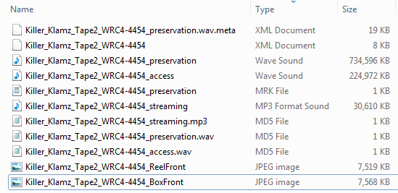
Digital files from “Killer Klamz” ¼ inch tape 2

Slide 14
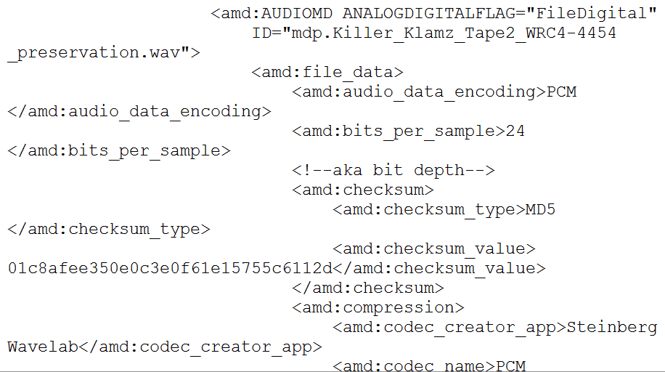
MODS/METS metadata

Slide 15
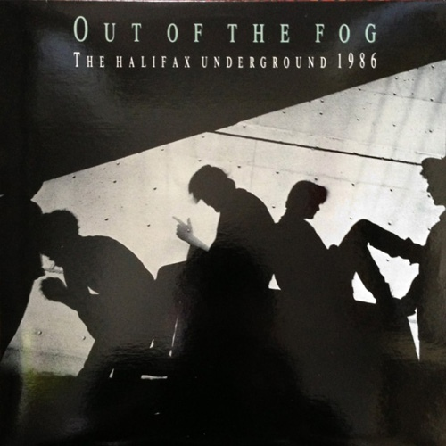
Research question #1 – How much “local music” should the University Archives preserve ?
Mandate and acquisitions policy
Archival appraisal theory and practice
Matrix of criteria
Monetary appraisal considerations
Out of the Fog compilation: http://www.discogs.com/Various-Out-Of-The-Fog-The-Halifax-Underground-1986/release/4600634

Slide 16
Artist Recognition and Critical Reception
Musicality and Acoustic Quality
Representation and Diversity
Institutional Capacity for Multimedia Archives

Slide 17
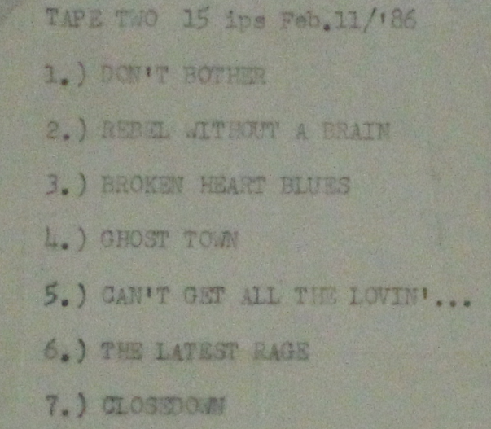
Research focus #2 – How should archivists describe multi-track sound recordings?
Canadian Rules for Archival Description
ISAAR (CPF) – International Standard for Archival Authority Records, Corporate Bodies, Persons, and Families
Hierarchical “levels of description” proceed from the general to the specific

Slide 18
Hierarchy of Recording Sessions
Collection
File
File
Item
Item
Item
Item
File
Series
Item
Item
Hierarchical “Levels of Description”
Recording Session
Song 1
Tape 1
Audio Track 1
Audio Track 2
Song 2
Tape 1
Audio Track 1
Audio Track 3
N/A
Notes:
Hierarchies
Physical arrangement of collection is a hierarchy
Intellectual arrangement of collection is a hierarchy
Relationship between intellectual “levels of description” and hierarchical nature of recordings (a session has multiple tapes, each with multiple songs, each with multiple tracks)

Slide 19
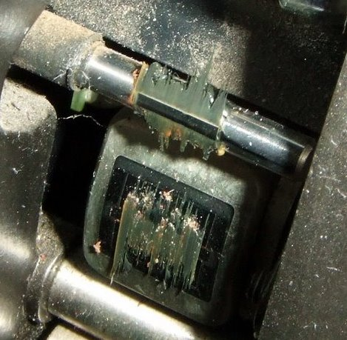
Research focus #3 – How should the Dalhousie Libraries service this collection?
Accessibility - streaming audio via Learning Management System? YouTube? iTunes?
Usability - Develop unique teaching tools?
Preservation - Work with recording artists to complete digital preservation?
Opportunity – Marketing and communications
Sticky shed on tape head. Source: https://en.wikipedia.org/wiki/File:Shedonhead.JPG

Slide 20
Dutch Mason – Trying to Find my Baby
YouTube: https://www.youtube.com/watch?v=k84HtWhxF0g
Libraries’ LibVine Blog: https://blogs.dal.ca/libraries/2013/12/university-archives-digitizes-dutch-mason-master-recording/
Reel 383, Solar Audio and Recording Limited Collection

Slide 21
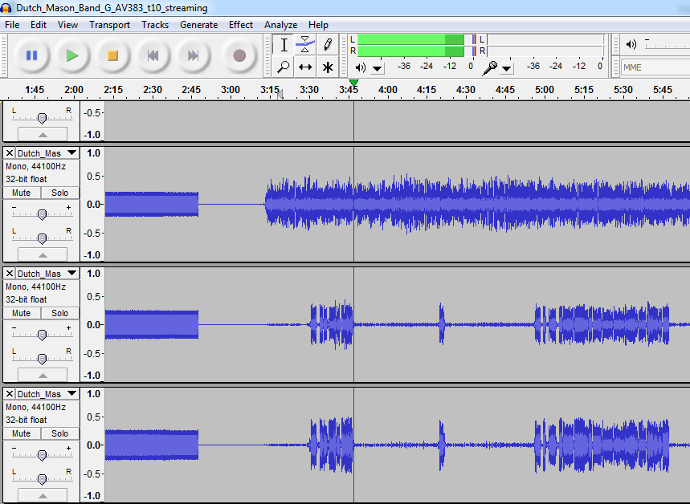

Slide 22
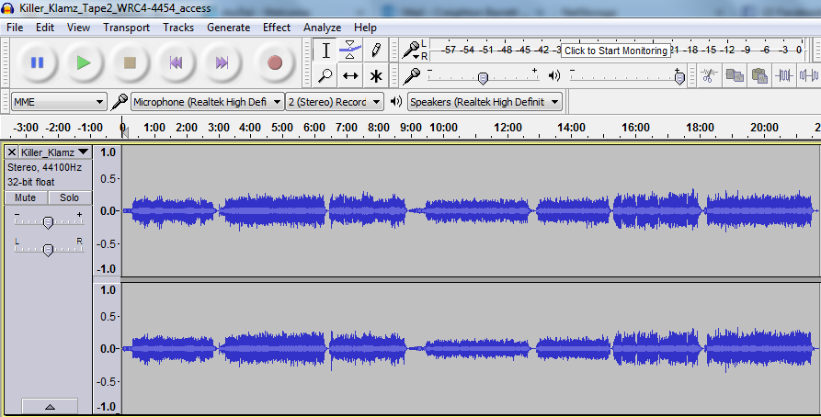

Slide 23
Image sources
Slide 1: Photograph of reel front, Killer Klamz, tape 2, WRC4-4454. Photograph by The MediaPreserve, February 17, 2012.
Slide 15: Cover of Out of the Fog compilation: http://www.discogs.com/Various-Out-Of-The-Fog-The-Halifax-Underground-1986/release/4600634
Slide 17: Photograph of reel front, Killer Klamz, tape 2, WRC4-4454. Photograph by The MediaPreserve, February 17, 2012.
Slide 19: Shed on head. https://en.wikipedia.org/wiki/File:Shedonhead.JPG
Slide 20: Photograph of box front, Dutch Mason Band. Photograph by The MediaPreserve, February 17, 2012
All other images taken by Creighton Barrett.

